Slide 1
Oak Specialist
Independent Living Unit 4- Community Living
Applying Learning

Slide 2
Unit 4- Community Living
Lesson 1- Knowing which shop to buy from
Lesson 2- Putting shopping away
Identifying a range of high street shops and knowing what they sell.
Knowing where to store food in the kitchen and other items.
Lesson 4- Health support in the community
Option 3
Lesson 3- Best Value
Option 4
Comparing same items from different shop including price, quality and quantity.
Who can support us with health and where to find help in the community.
Lesson 5- People who help us
Lesson 5- Travel in the community/planning a journey
Option 3
Option 4
Identifying emergency services and their roles.
Following steps to plan a journey and choose the correct mode of transport.
Notes:
Choose a lesson from the list

Slide 3
Lesson 3- Shopping for best value

Slide 4
Teacher notes- Lesson 3
Learning objective: To understand what value means and how to identify value according to product quality and size.
Learning that value for money means not over-spending. Looking at and identifying the same products being charged at different prices at three different supermarkets.
Looking at different sized items for similar prices and identifying best value. E.g. Looking at the cost of 4 pints of milk vs 2 pints of milk.
Introducing the idea of paying slightly more for better quality items. E.g. Organic food items and why people might choose to buy organic food.
-Additional resources: pen and paper
Notes:
This is the equivalent to a loose lesson plan/overview for teachers before starting the lesson.

Slide 5
Community Living
Shopping for best value
Applying Learning

Slide 6
Lesson Activity Stages
This lesson will be taught in 2 stages:
Identify the best value item, looking at the same product from 3 different supermarkets.
Learn why different size and quality items are priced differently.

Slide 7
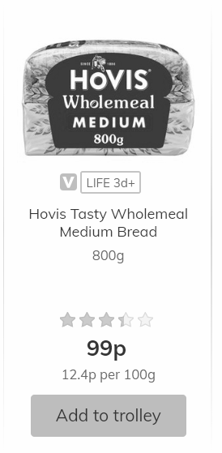
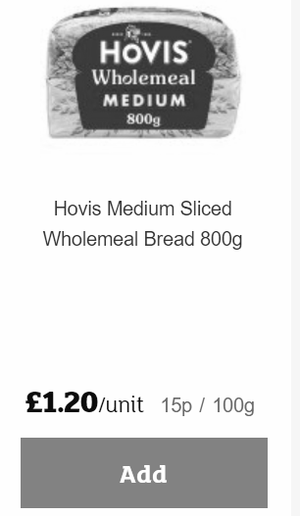
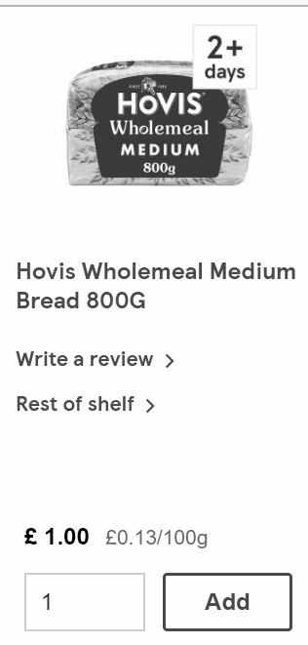
Screenshot taken from Morrisons
Screenshot taken from Sainsburys
Screenshot taken from Tesco
Notes:
Discuss;
When we talk about value for money, we mean that we don’t want to over-pay for products. We should try to gain a good idea of the cost of everyday food items such as bread, so we don’t end up paying too much money at the supermarkets or local shops.
*This bread is exactly the same size, weight and brand.
Let’s look closely at the price of the bread from the 3 different supermarkets.
How much does it cost at Morrisons?
How much does it cost at Sainsbury’s?
How much does it cost at Tesco?

Slide 8
Question-
Which Supermarket has the best value for money for their loaf of bread?
Notes:
Answer - Morrisons

Slide 9
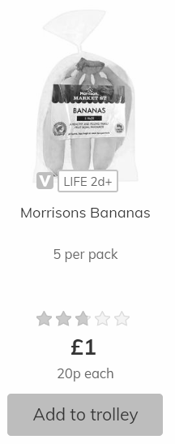
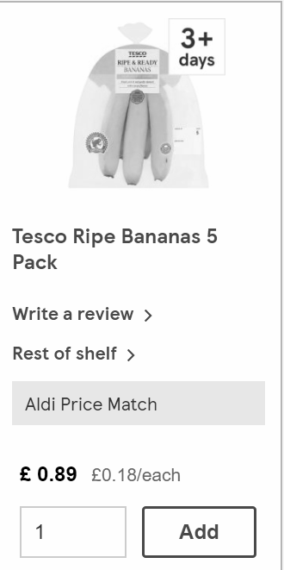
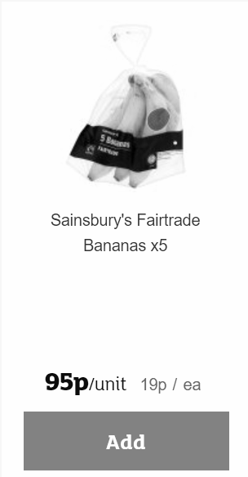
Screenshot taken from Morrisons
Screenshot taken from Sainsburys
Screenshot taken from Tesco
Notes:
Discuss;
*Each packet has the same amount of bananas and they are all medium sized bananas, but come from different supermarkets.
How much are the bananas from Morrisons?
How much are the bananas from Sainsbury’s?
How much are the bananas from Tesco?

Slide 10
Question-
Which Supermarket has the best value for money for their bananas?
Notes:
Answer - Tesco

Slide 11
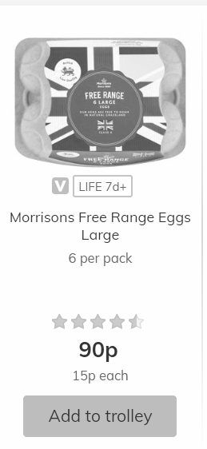
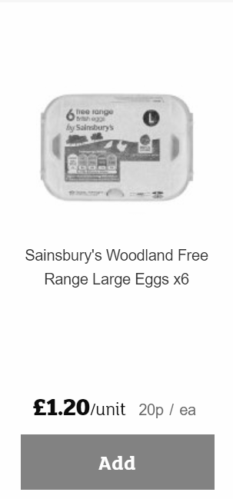
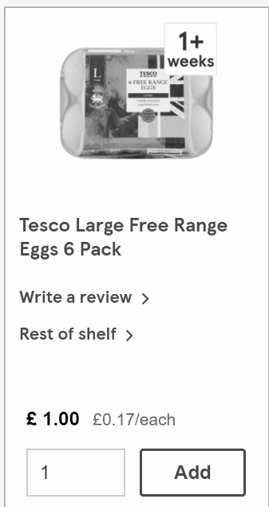
Screenshot taken from Morrisons
Screenshot taken from Sainsburys
Screenshot taken from Tesco
Notes:
Discuss:
*Look carefully at the eggs. All the eggs are from ‘Free Range Chickens’ (Chickens that have had some room to roam), they are all large eggs and there are 6 in each pack.
How much are the eggs from Morrisons?
How much are the eggs from Sainsbury’s?
How much are the eggs from Tesco?

Slide 12
Question-
Which Supermarket has the best value for money for their eggs?
Notes:
Answer - Sainsbury’s

Slide 13
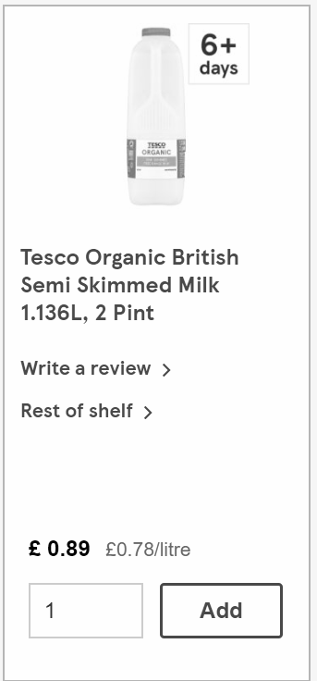
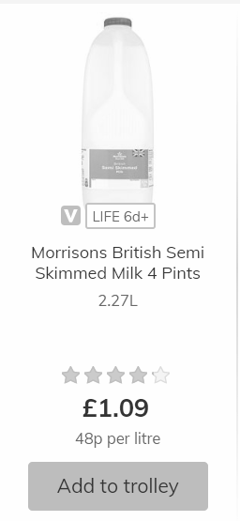
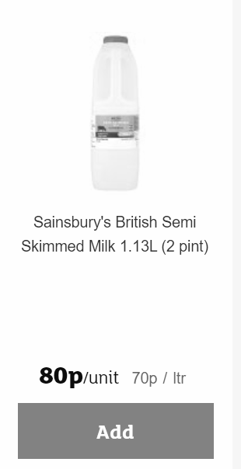
Screenshot taken from Morrisons
Screenshot taken from Sainsburys
Screenshot taken from Tesco
Notes:
Discuss:
*Look carefully at the Milk. All the milk is Semi Skimmed (green-top, with half the fat removed).
Are they the same size? *no, one is 4 pints.
Are they all the same quality? *no, one is organic. This means that the milk comes from a cow that has had a better quality of life. This means it costs a little more money for better quality.
See next slide for close up of products.

Slide 14
Screenshot taken from Morrisons
Screenshot taken from Sainsburys
Screenshot taken from Tesco
Notes:
Discuss:
We need to look very carefully at the items we are shopping for to make sure that we are getting good value for our money.

Slide 15
Question-
Using the information that we have learned during this lesson, which supermarket do you think is selling the milk for the best value and why?
Notes:
Answer - Morrisons is very good value because for only 29p more you can get double the amount of milk than the the one Sainsbury's is selling.
If you wanted to buy organic milk because you like the quality or the better animal welfare standards, Tesco’s organic milk is also good value because it is only 9p more than the same sized milk sold at Sainsbury’s.

Slide 16
Independent Living
Applying Learning
Shopping - Value for Money
Make it easier
Make it harder
More ideas
Get a Parent/Carer to help you choose two food items of your own on an online supermarket and look at the different products available.
Write a weekly shopping list and shop for the best value items, checking the size, quantity and quality.
Look at the difference between organic and non-organic food items.
Find a recipe and shop online (with parent/carer supervision) for the items you need to create it.

Slide 17
Signposting
Independent Living:
Building Understanding- Knowing which shop to buy from (Unit 4)
Building Understanding- What’s on the high street (Unit 4)
Building Understanding- Supermarket shopping (Unit 4)
Applying Learning- Putting shopping away (Unit 4)
Numeracy:
Building Understanding/ Applying Learning- Number (Unit 1)
Occupational Therapy:
Activities of Daily Living (Unit 6)
Notes:
Insert info for subject/lesson name/stage (if appropriate)

