Slide 1
Combined Science - Chemistry - Key Stage 4
Developing an Electrolysis Hypothesis
Mr Campbell

Slide 2
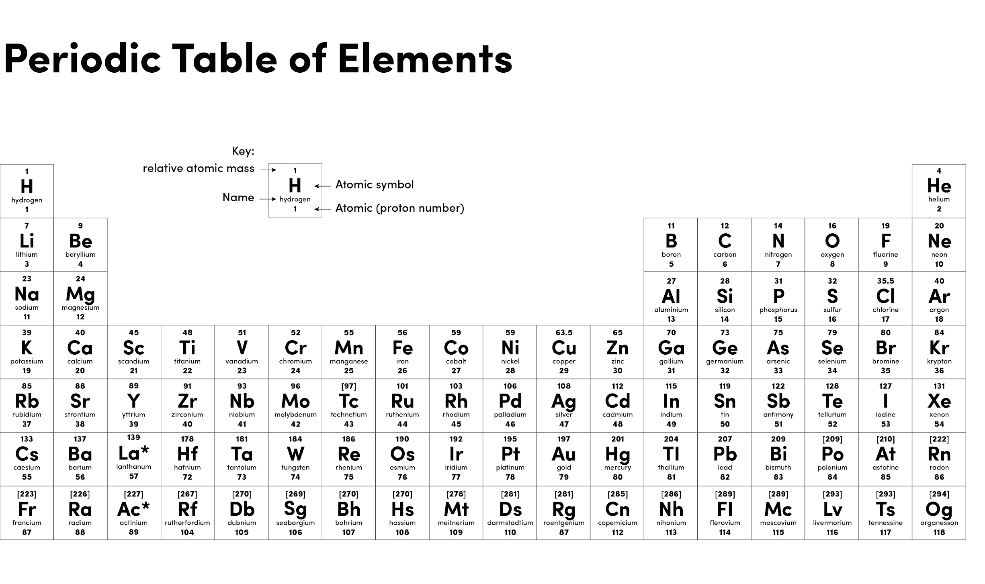
Source: Oak

Slide 3
Electrolysis of solutions
At the anode
If the non-metal ions is a halide ion (group 7) chloride Cl⁻, Br⁻, I⁻.
Then the halogen will form chlorine Cl₂, Br₂ or I₂.
If the non-metal ion is not a halide ion then oxygen, O_{2,} forms.
At the cathode
If the metal is more reactive than hydrogen then hydrogen forms.
If the metal is less reactive than hydrogen (copper, silver, gold, platinum) then the metal forms.
Potassium
Sodium
Calcium
Magnesium
Aluminium
Zinc
Iron
Tin
Lead
Hydrogen
Copper
Silver
Gold
Platinum
Increasing Reactivity

Slide 4
Electrolysis of solutions
Solution | Product at anode | Product at cathode
Copper chloride
Copper sulfate
Sodium chloride
Sodium sulfate

Slide 5
Electrolysis of solutions answers
Solution | Product at anode | Product at cathode
Copper chloride
Copper sulfate
Sodium chloride
Sodium sulfate
chlorine
copper
oxygen
copper
chlorine
hydrogen
oxygen
hydrogen

Slide 6
Independent task
Identify the products made at the anode and cathode during the electrolysis of the following solutions.
Silver chloride
Potassium bromide
Sodium sulfate
Copper nitrate

Slide 7
Independent task
Complete the sentences describing the tests for the gases below.
Hydrogen, a __________ splint gives a …….
Oxygen, a ___________ splint will …………
Chlorine, damp blue __________ paper will turn ________ then ____________

Slide 8
Independent task answers
Identify the products made at the anode and cathode during the electrolysis of the following solutions.
Silver chloride anode = chlorine cathode = silver
Potassium bromide anode = bromine cathode = hydrogen
Sodium sulfate anode = oxygen cathode = hydrogen
Copper nitrate anode = oxygen cathode = copper

Slide 9
Independent task answers
Complete the sentences describing the tests for the gases below.
Hydrogen, a lit splint gives a squeaky pop.
Oxygen, a glowing splint will relight.
Chlorine, damp blue Litmus paper will turn red then bleaches or white.

Slide 10
Independent task
Hypothesis - The greater the concentration of of copper sulfate electrolysed, the greater the mass of copper produced at the cathode.
Plan an investigation to test this hypothesis that would produce valid results.
Identify
The independent variable
The dependent variable
Control variables
Identify your range and intervals for the independent variable.
Give a brief descriptions of the method (remember repeats).

Slide 11
Independent task answers
Independent variable
Dependent variable
Control variables
Concentration of copper sulfate solution
Mass of copper produced
Volume of solution
The voltage of the power supply
The temperature of the solution
The time electrolysis is run for

Slide 12
Identify your range and intervals for the independent variable.
0.5 to 2 mol/dm³ going up in 0.5’s
Give a brief description of how to carry out the experiment.
Set up electrolysis equipment (you could use a diagram for this)
Measure 50cm³ of 0.5 mol/dm³ copper sulfate solution
Record the mass of the cathode
Turn on the power supply at 2V for 5 minutes
Record the mass of the cathode, the calculate the increase in mass
Repeat 3 times
Repeat for concentrations of 1, 1.5 and 2 mol/dm³

