Slide 1
Manipulating powers
Maths
Mr Clasper

Slide 2
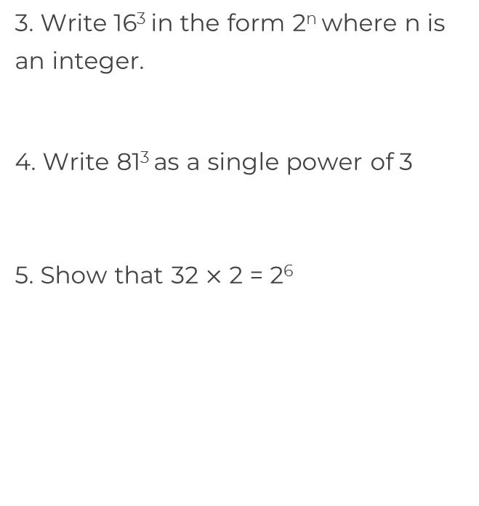
Manipulating powers
1. Write each number as a single
power of 2
8
32
2. For each equation find the value of p.
3^{p} = 27
p⁴ = 625
c) 128
d) 512
e) 2
c) 4^{p} = 256
d) p³ = 0.125

Slide 3
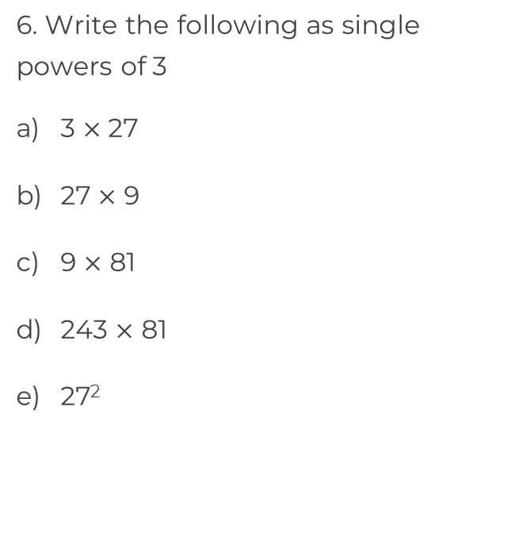
Manipulating powers
7. Write (8²)³ as a single power of 2
8. Here are some number cards.
Which two cards are equal?
Which two cards have a product equal to 2⁹?
16
4³
32
8
(2³)²

Slide 4
Answers

Slide 5
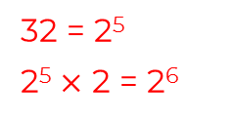
Manipulating powers
1. Write each number as a single
power of 2
8
32
2. For each equation find the value of p.
3^{p} = 27
p⁴ = 625
(2⁴)³ = 2¹²
2³
c) 128
d) 512
e) 2
2⁷
2¹ = 2
2⁵
2⁹
(3⁴)³ = 3¹²
p = 3
c) 4^{p} = 256
d) p³ = 0.125
p = 4
p = 5
p = 0.5

Slide 6
Manipulating powers
7. Write (8²)³ as a single power of 2
8. Here are some number cards.
Which two cards are equal?
Which two cards have a product equal to 2⁹?
2¹⁸
3⁴
3⁵
16
4³
32
2²
(2³)²
3⁶
4³ and (2³)²
3⁹
3⁶
16 and 32

