Slide 1
Mixed circle theorem problems
Maths
Mr Chan

Slide 2
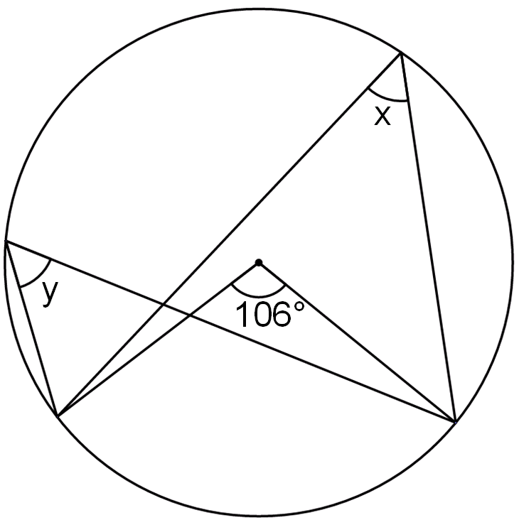
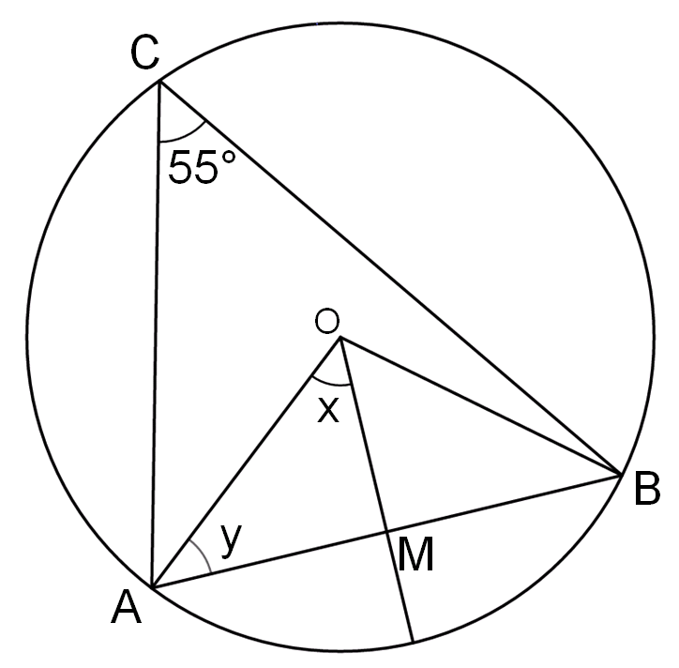
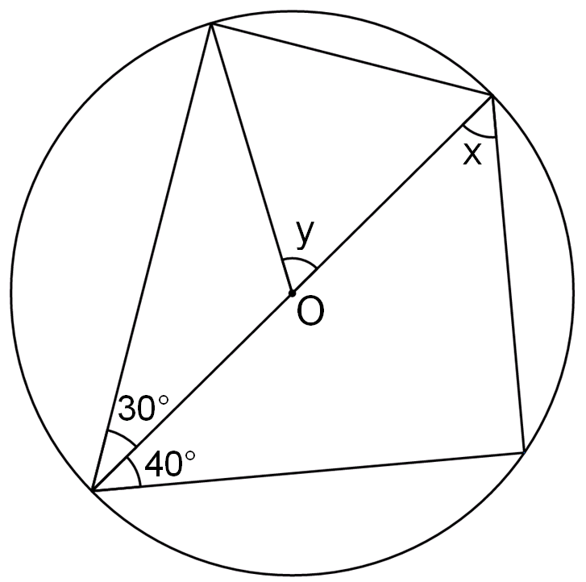
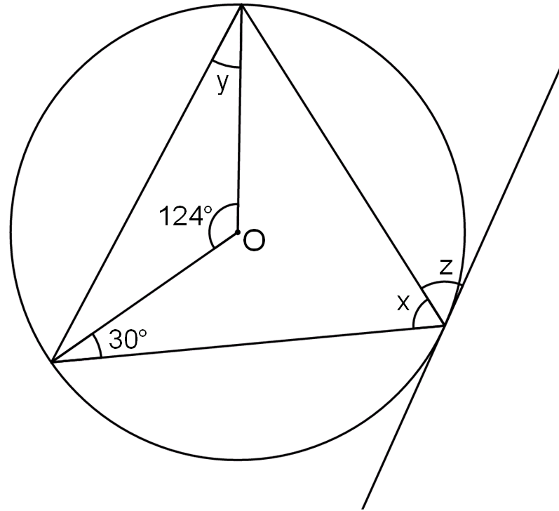
Mixed circle theorem problems
1. Work out the size of each angle marked with a letter.
a) b)
2. Work out the size of each angle marked with a letter.
a) b)

Slide 3
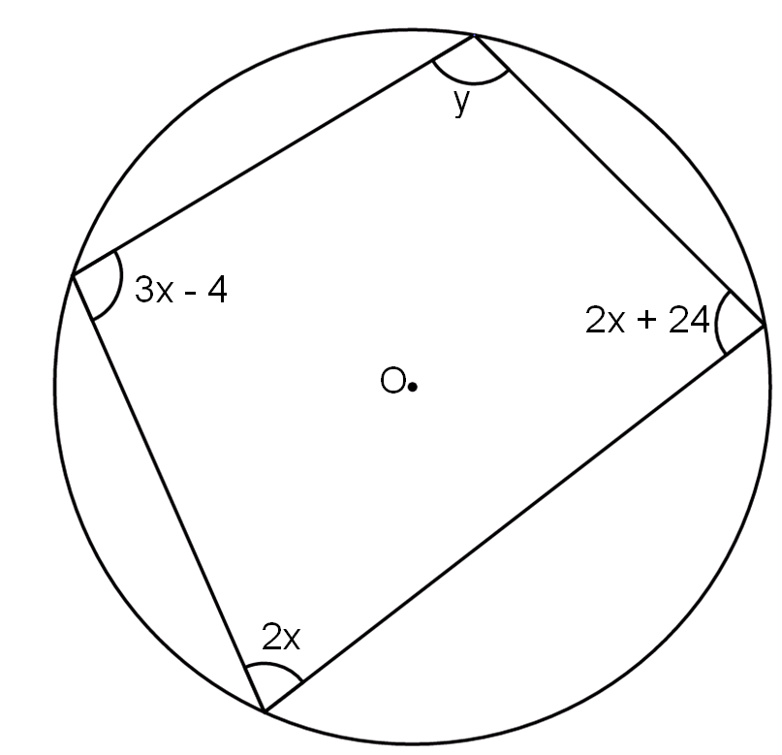
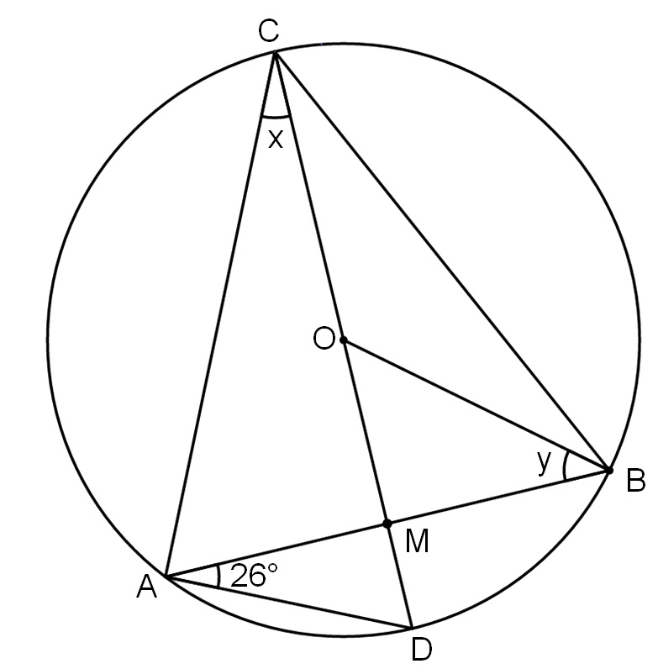
Mixed circle theorem problems
3. The circle has centre O with a chord AB. CD is a diameter to the circle. Work out the size of angle x and y.
4. Work out the size of angle y.

Slide 4
Answers

Slide 5
Mixed circle theorem problems
1. Work out the size of each angle marked with a letter.
a) b)
2. Work out the size of each angle marked with a letter.
a) b)
x = 50º
y = 60º
x = 62º
y = 28º
z = 58º
x = 53º
y = 53º
x = 55º
y = 35º

Slide 6
Mixed circle theorem problems
3. The circle has centre O with a chord AB. CD is a diameter to the circle. Work out the size of angle x and y.
4. Work out the size of angle y.
x = 26º
y = 38º
y = 116º

