Slide 1
Solving addition equations
Maths
Mrs Crane

Slide 2
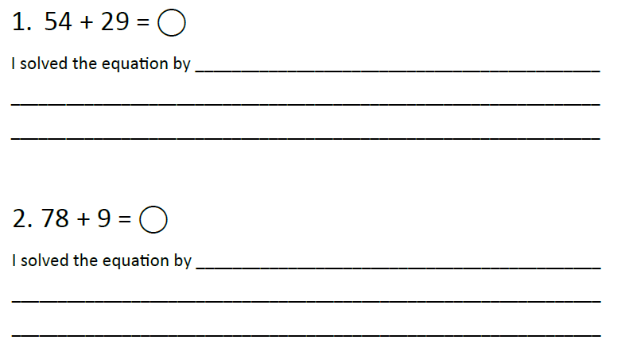
Independent Task
Remember, you could use Dienes, drawings of Dienes or number lines to help you!

Slide 3
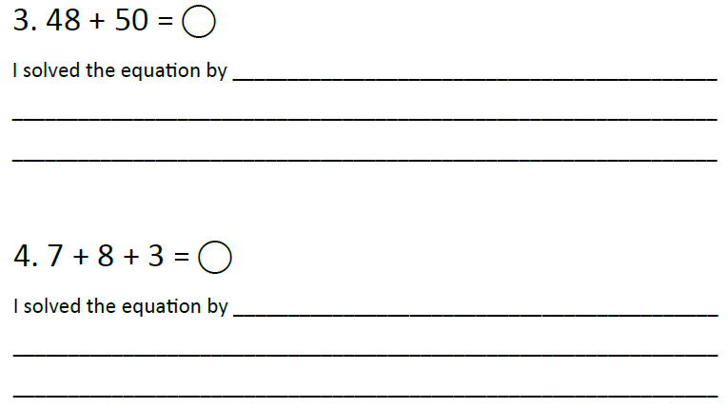
Independent Task
Challenge: What numbers could the boxes be replaced by?

