Slide 1
Shape and Symmetry:
To compare and classify quadrilaterals.
Maths
Mr Critchlow

Slide 2
To Start
Complete the number trees. The number at the top is the sum of the two numbers below it.
30
68
11
19
60
2
9
10
18
17
46
1
8
2
12
14
10
7
22
23
4
6
14
11
11
This one has been ALMOST completed for you

Slide 3
Moving on
Name the shape and explain how you know:
This is a _____________________
I know because: __________________________________________________________________________________________________________________________________________
This is a _____________________
I know because: __________________________________________________________________________________________________________________________________________
This is a _____________________
I know because: __________________________________________________________________________________________________________________________________________

Slide 4
Moving on
Name the shape and explain how you know:
This is a _____________________
I know because: __________________________________________________________________________________________________________________________________________
This is a _____________________
I know because: __________________________________________________________________________________________________________________________________________
This is a _____________________
I know because: __________________________________________________________________________________________________________________________________________

Slide 5
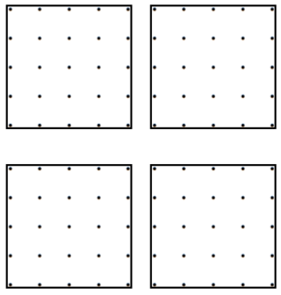
Main task
Using the dotty grids, how many different quadrilaterals can you make by joining 4 dots together with straight lines?

Slide 6
Main task
Using the dotty grids, how many different quadrilaterals can you make by joining 4 dots together with straight lines?

