Slide 1
Effect of Changing Temperature on
Rate of Reaction
Worksheet
Combined Science - Chemistry - Key Stage 4
The Rate and Extent of Chemical Change
Dr Deng

Slide 2
Graph paper

Slide 4
Exam style questions

Slide 5
Exam style Question 1 (information)
The table shows the results from investigating the effect of changing temperature of sodium thiosulphate with hydrochloric acid.
Temperature (℃) | Mean time taken for cross to disappear (s)
20 | 85
30 | 56
40 | 29
50 | 13
60 | 4

Slide 6
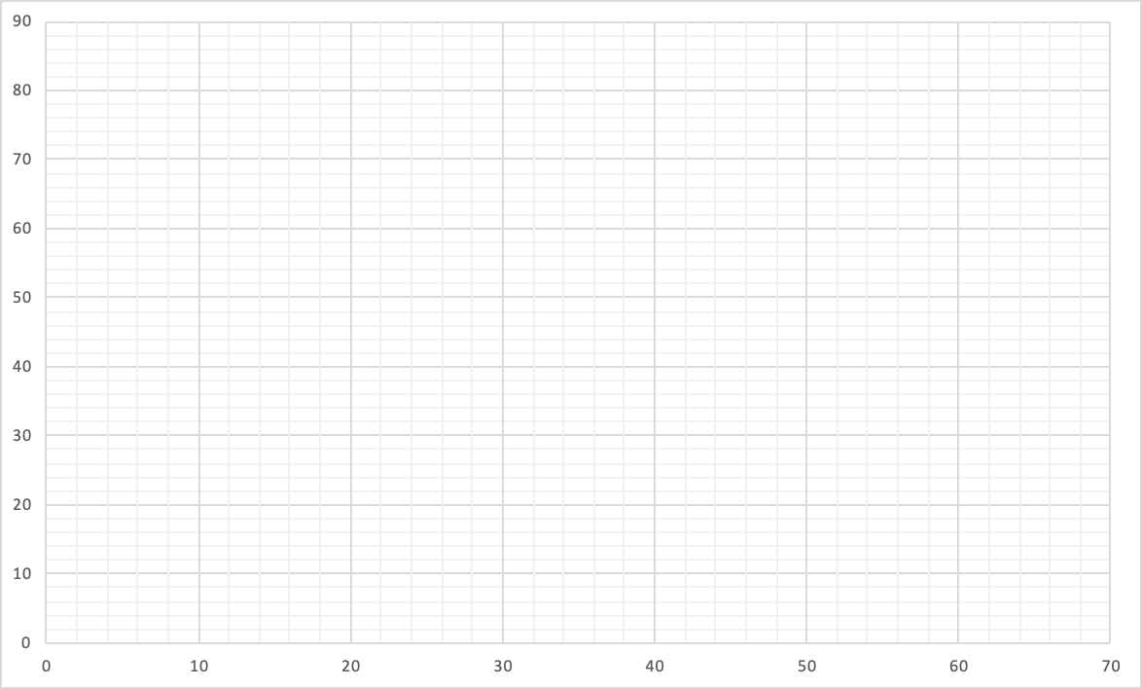
Exam style Question 1
Task: Plot a graph using data from table of results
Mean time taken for cross to disappear (s)
Temperature (℃)

Slide 7
Exam style Question 2
From the graph plotted in the previous question, describe the trend of the graph. Use figures from the graph.

Slide 8
Exam style Question 3
For the investigation of the effect of changing temperature of sodium thiosulphate with hydrochloric acid, give two control variables.

Slide 9
Exam style Question 4
Using collision theory, explain how increasing the temperature of sodium thiosulphate for the reaction with hydrochloric acid increases the rate of reaction.

Slide 10
Exam style Question 1 answer
x
x
Mean time taken for cross to disappear (s)
x
x
x
Temperature (℃)

Slide 11
Exam style Question 2 answer
From the graph plotted in the previous question, describe the trend of the graph. Use figures from the graph.
As temperature increases, mean time taken for cross to disappear decreases
Faster rate of reaction
Comparison of two values from graph (e.g at 20℃, mean time taken for cross to disappear is 85 second. At 60℃, mean time taken for cross to disappear is only 4 seconds)

Slide 12
Exam style Question 3 answer
For the investigation of the effect of changing temperature of sodium thiosulphate with hydrochloric acid, give two control variables.
Any two of the following:
Volume of sodium thiosulphate
Volume of hydrochloric acid
Concentration of sodium thiosulphate
Concentration of hydrochloric acid

Slide 13
Exam style Question 4 answer
Using collision theory, explain how increasing the temperature of sodium thiosulphate for the reaction with hydrochloric acid increases the rate of reaction.
Increasing temperature, reacting particles gain more energy
Reacting particles move more quickly
Particles collide more frequently with more energy

