Slide 1
How can we measure the size of forces?
Worksheet
Science - Forces
Miss Hummel
Notes:
Hi everyone! My name is Miss Hummel and in this lesson we will be answering the question: What are forces?
In this lesson, we will learn what forces are. We will also learn about contact forces and non-contact forces. Finally, we will test our knowledge with some application questions.

Slide 2
Answer this question:
What is the difference between mass and weight? What are they each measured in?

Slide 3
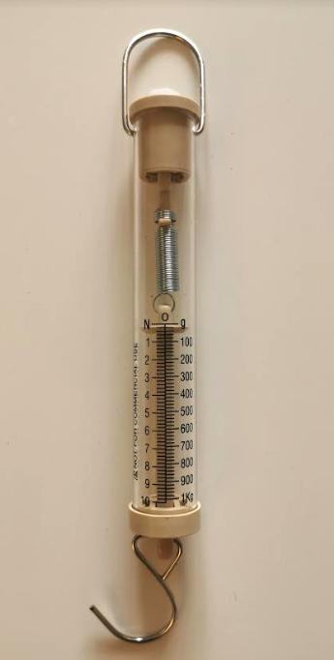
Label the photo
The _____ at the top can be used to….
If you don’t have the photo in front of you, sketch your own Newton meter that you can label.
The numbers at the side that say N show...
The _____ at the bottom can be used to...
Source: Miss Hummel
Notes:
Air resistance
Gravitational force
Friction
Magnetic force
Upthrust
pushes objects upwards on objects that are in water.
- pulls everything downwards towards the earth.
- acts when something tries to move quickly through air.
- acts between two surfaces that are sliding, or trying to slide, across each other
- which makes magnetic objects attract or repel each other

Slide 4
Answers
The hook at the top can be used to hold the Newton Meter.
If you don’t have the photo in front of you, sketch your own Newton meter that you can label.
The numbers at the side that say N show
the weight or size of the force.
The hook at the bottom can be used to connect the object or force you are measuring with the Newton meter.
Notes:
Air resistance
Gravitational force
Friction
Magnetic force
Upthrust
pushes objects upwards on objects that are in water.
- pulls everything downwards towards the earth.
- acts when something tries to move quickly through air.
- acts between two surfaces that are sliding, or trying to slide, across each other
- which makes magnetic objects attract or repel each other

Slide 5
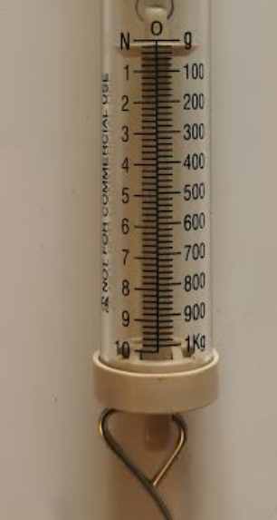
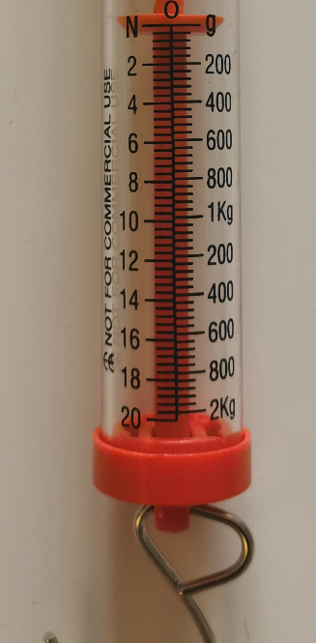
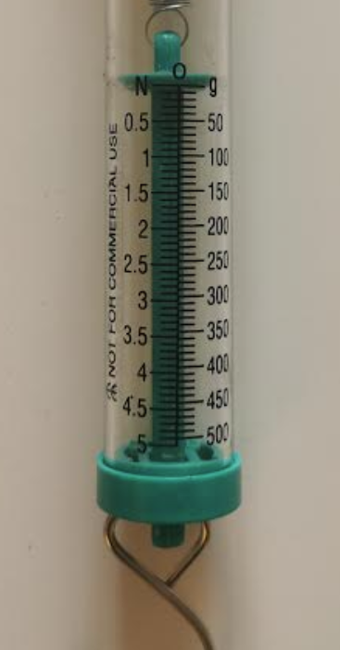
Write down how much force has been measured on each of the Newton meters below:

Slide 6
Answers
≈ 4N
≈ 15N
≈ 2.25N

Slide 7
Answer this question:
How do we measure the weight of an object with a Newton meter?

Slide 8
Activity: Measuring things in Newtons and grams
Item | Newtons (N) | Grams (g)
Can we make any generalisations based on our data?

