Slide 1
Unit 8 - Decimals
Recognising Decimal Hundredths
Independent Task
Mathematics
Lesson 8 of 15
Mr Whitehead

Slide 2
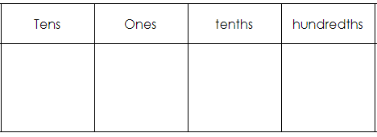
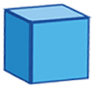
Represent each decimal as a fraction and using Dienes
1)
4)
0.82
0.03
2)
5)
0.23
0.38
Example:
3)
6)
15
0.15
0.6
0.49
100

