Slide 1
What effect does exercise have on the muscles?
Science- Lifestyle
Miss Hummel
Notes:
In this lesson we will learn about muscles and how they work. We will also learn what happens to our muscles when we exercise and how people strengthen and grow their muscles.

Slide 2
Fill in the gaps: What do we need in a balanced diet?
There are 7 essential nutrients needed by the body. These are:
C_______________
F__________
P_______
F_____
W______
M__________
V___________
Nutrient
Credit: Nutrition by Nithinan Tatah from the Noun Project

Slide 3
Match up the nutrient to its role in your diet:
Protein |  | Release energy when broken down.
Fibre |  | Growth and repair.
Carbohydrates |  | Stores energy, keeps you warm and protects your organs.
Fat |  | Keeps food moving through the gut.

Slide 4
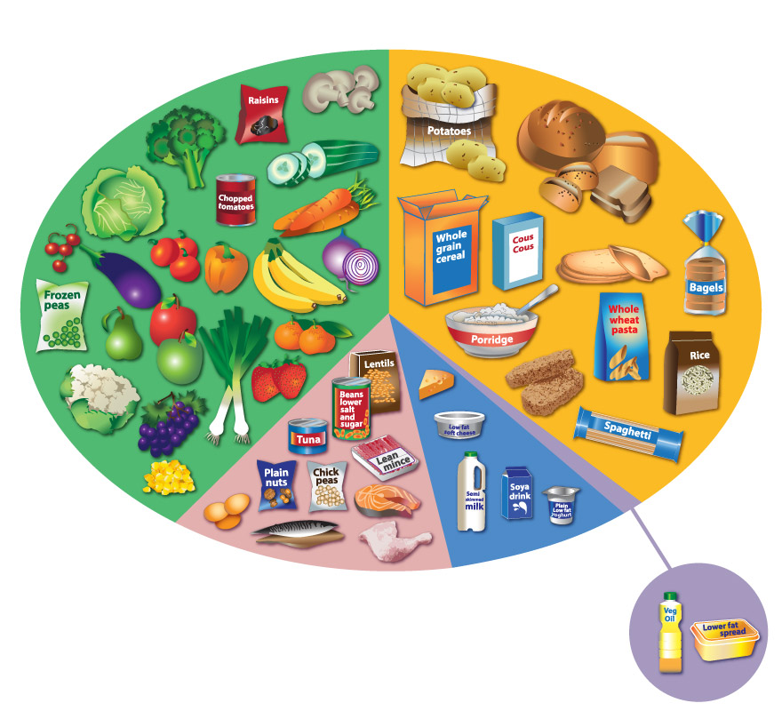
Activity: What is a balanced diet?
Credit: NHS - Eatwell plate

Slide 5
Who needs the most energy?
Activity: Who needs the most energy?
A teacher
An office worker
A builder
Credit: Teacher by Arif Fajar Yulianto from the Noun Project; Office worker by Mundo from the Noun Project; builder by Wilson Joseph from the Noun Project

Slide 6
What is a nutritional deficiency?
Activity: What is nutritional deficiency?
Nutritional deficiency
Credit: Cross by alvianwijaya from the Noun Project

Slide 7
Answer these questions:
How many muscles are there in the body?
What must a muscle do to pull on a bone?
When one muscle in a pair contracts, what does the other do?

Slide 8
Answers:
The human body contains more than 650 muscles.
To pull on a bone a muscle must contract.
When one muscle is contracting the other is relaxing.

Slide 9
Answer these questions:
4. Describe the appearance of contracted muscles.
5. Describe the appearance of relaxed muscles.

Slide 10
Answers:
4. Contracted muscles are shorter and fatter.
5. Relaxed muscles are longer and thinner.

Slide 11
Answer this question:
What happens to the fibres in our muscles when they are used a lot or they need to create a large force?

Slide 12
Answer these questions:
What happens to muscle fibres when they are used a lot?
Which phrase means ‘tightness’ of muscles?
Which food group is needed to provide the material to repair muscles?

Slide 13
Answers:
When muscle fibres are used a lot they tear a little.
The phrase muscle tone means ‘tightness’ of muscles.
Proteins are required to repair muscles.

Slide 14
Thinking Task:
For muscles to contract they need energy.
Energy comes from the food we eat – how does it get to our muscles?

