Slide 1
Integer Addition and Subtraction: Solving multi-step addition and subtraction problems
Mathematics
Ms Jeremy

Slide 2
Pause the video to complete your task
Resume once you’re finished
Use the counting back and counting on strategies to solve:
10 000 - 7890 =
Counting back:
Counting on:

Slide 3
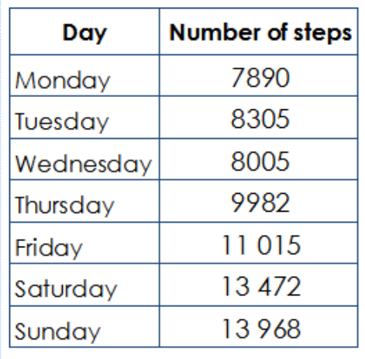
Pause the video to complete your task
Resume once you’re finished
My target has increased to 15 000 steps.
How far was I from my target on Monday?

Slide 4
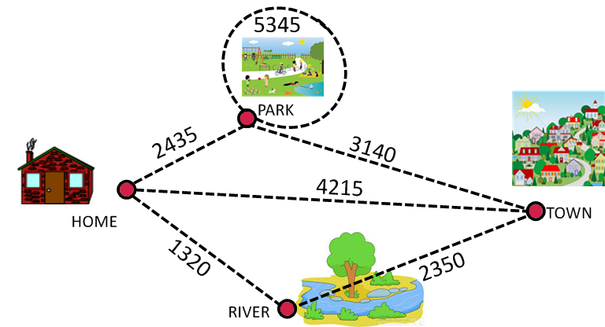
Applying strategies
How could I reach the target of
15 000 steps?
Estimate and Calculate

Slide 5
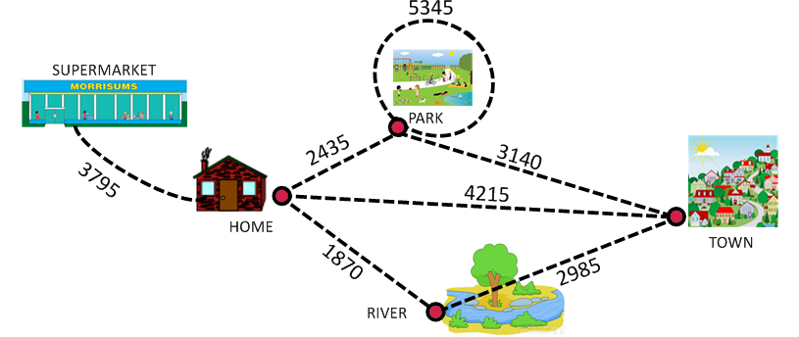
Pause the video to complete your task
Resume once you’re finished
Independent Task
Find as many routes as possible to reach the target amount of 15 000 steps. Don’t forget to estimate before calculating:

