Slide 1
Conditions of Congruent Triangles
Maths
Mr Bond

Slide 2
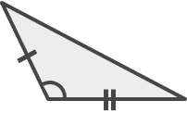
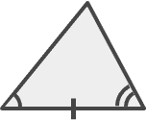
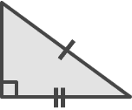
Conditions of congruent triangles.
1. Each pair of triangles is congruent.
State the condition of congruency used.
a)
b)
c)
2. Robbie says that two triangles must be congruent because all three angles are equal.
Do you agree with Robbie?
Explain your answer.
‹#›

Slide 3
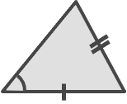
Conditions of congruent triangles.
3.
Abi says the triangles must be congruent.
Amir says they could be congruent.
Who is correct? Explain why.
4. Both triangles have a perimeter of
1.47 cm.
Are the triangles congruent? State any conditions used.
3.88 mm
6.71 mm
4.11 mm
6.71 mm
‹#›

Slide 4
Answers

Slide 5
Conditions of congruent triangles.
1. Each pair of triangles is congruent.
State the condition of congruency used.
a)
b)
c)
2. Robbie says that two triangles must be congruent because all three angles are equal.
Do you agree with Robbie?
Explain your answer.
SAS
ASA
RHS
No, they could be similar. There isn’t enough information to know if they’re congruent.
‹#›

Slide 6
Conditions of congruent triangles.
3.
Abi says the triangles must be congruent.
Amir says they could be congruent.
Who is correct? Explain why.
4. Both triangles have a perimeter of
1.47 cm.
Are the triangles congruent? State any conditions used.
3.88 mm
6.71 mm
4.11 mm
4.11 mm
6.71 mm
3.88 mm
Amir
The angle isn’t between the sides so there isn’t enough information.
Yes, SSS
‹#›

