Slide 1
Fractions
Lesson 5: Compare fractions greater than one
Independent Task
Mathematics
Miss Parsons

Slide 2
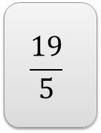
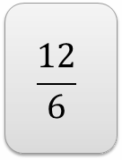
Question 1
Draw a pictorial representation of the improper fractions below.

Slide 3
Question 2
Convert the improper fractions to mixed numbers.

Slide 4
Question 3
Convert the mixed numbers to improper fractions.

Slide 5
Question 4
Order these fraction from smallest to largest.
Hint: convert them all to improper fractions first.

Slide 6
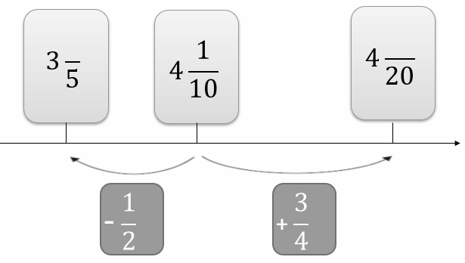
Question 5
The diagram shows part of the number line. Two of the fractions are not complete, write the missing numerators on the incomplete fractions.
Hint: the common denominator is 20.

