Slide 1
Missing angles and length:
Find the value of missing angles in quadrilaterals.
Independent Task
Mathematics
Year 6
Miss Parsons

Slide 2
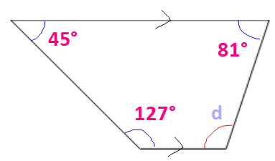
Question 1
Calculate the size of angle d.

Slide 3
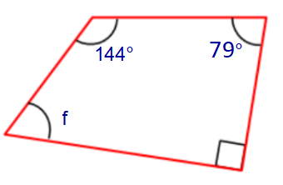
Question 2
Calculate the size of angle f.

Slide 4
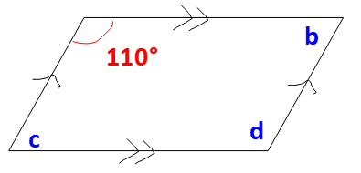
Question 3
Calculate the size of angles b, c and d.

Slide 5
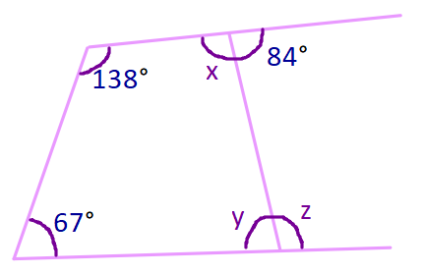
Question 4
Calculate the size of angles x, y and z.

Slide 6
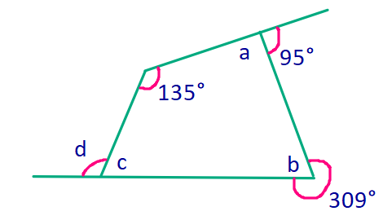
Question 5
Calculate the size of angles a, b, c and d.
Hint: work them out in alphabetical order.

