Slide 1
Condensation polymers
GCSE Chemistry - Chemistry - Key Stage 4
Organic chemistry
Dr Patel

Slide 2
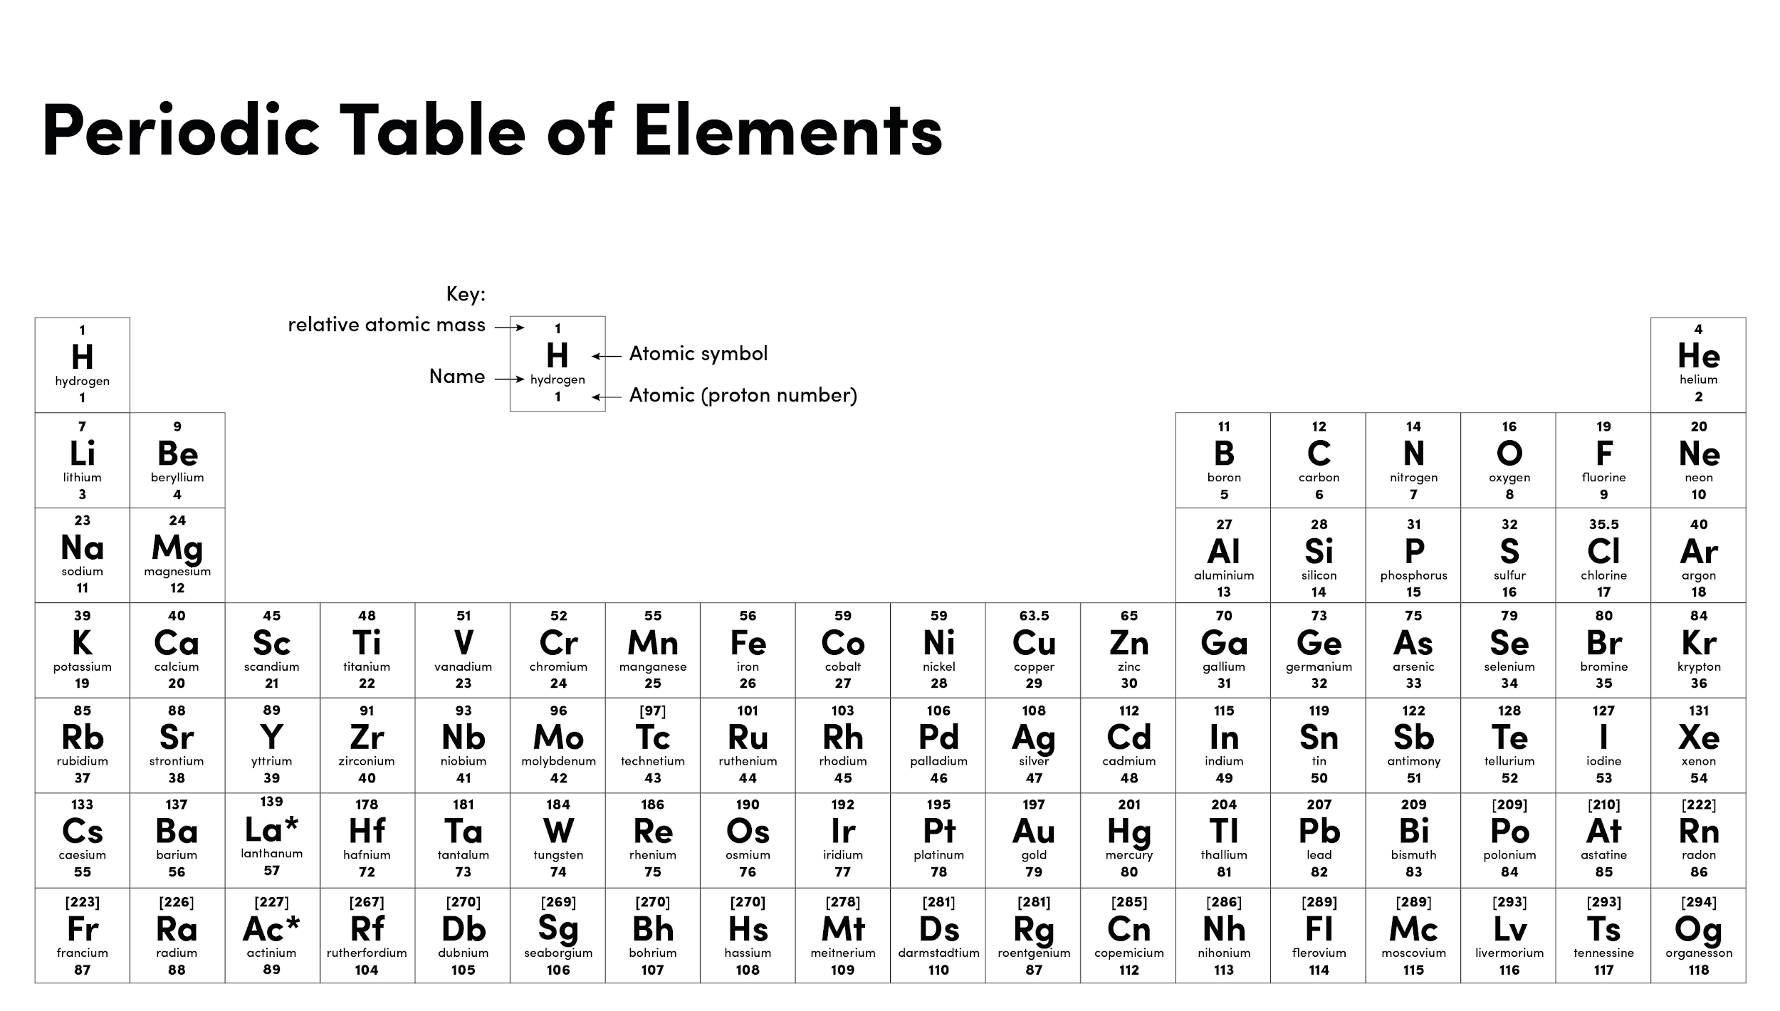
Source of image: Oak

Slide 3
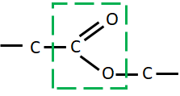
Warm up
Homologous series | Functional group
 | C-C
 | C=C
Alcohol
Carboxylic acid

Slide 4
Pause point
What are the monomers make up polyesters?
During condensation polymerisation, what small molecule is release?
How many of those small molecules are released when two monomers join?
How many functional groups must each monomer have for condensation polymers to form?
Name the following monomers.
HOOC
COOH
HO
OH

Slide 5
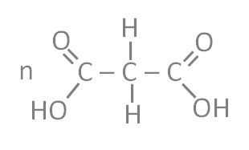
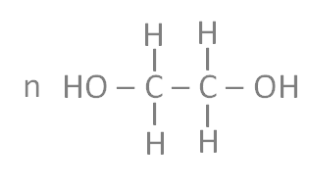
Pause point
Draw the polymer formed from the monomers below.
+

Slide 6
Pause point
What are the monomers make up polypeptides?
During condensation reactions between these monomers, what small molecule is released?
How many of those small molecules are released when two monomers join?
Name the functional groups present in the monomer below
HOOC
NH₂

Slide 7
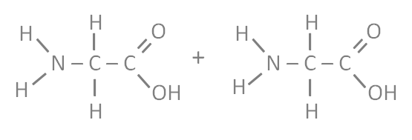
Pause point
Glycine is an amino acid. Draw the polymer formed from glycine monomers.

Slide 8
Independent task
 | Addition | Condensation
Number of monomer types
Number of products
Functional group involved

Slide 9
Independent practice
Compare addition polymerisation and condensation polymerisation

