Slide 1
Making arrangements to go out [2/3]
Using vouloir + infinitive
French
Mr Hodgson

Slide 2
[ eu ]
deux

Slide 3
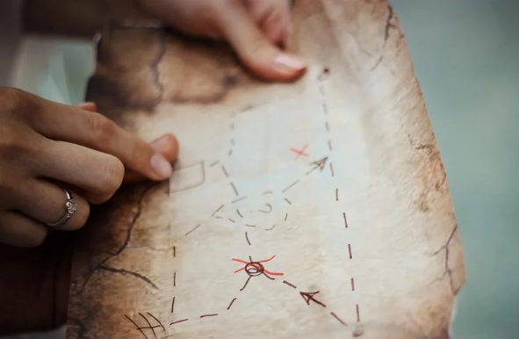
[ eu ]
un peu
jeu
[a little]
lieux

Slide 4
[ ou ]
nous

Slide 5
[ ou ]
trouver
toujours
jouer
[always; still]

Slide 6
[ eu ]
[ ou ]
deux
nous

Slide 7
faire | to do
les magasins | the shops
voir | to see
un spectacle | a show
venir | to come
chez moi | to/at my house
rendre visite à | to visit (for a person)
visiter | to visit (for a location)
aller en ville | to go to town
pratiquer | to practise

Slide 8
Using verb + infinitive constructions
Aller + infinitive = I’m going to ___
Vouloir + infinitive = I want to ___
Je vais = I go/I’m going
Je veux = I want/I’m wanting
Tu vas = You go/You’re going
Tu veux = You want/You’re wanting
Il va = I go/I’m going
Il veut = He wants/He’s wanting
Elle va = I go/I’m going
Elle veut = He wants/He’s wanting
On va = You go/You’re going
We go/We’re going
On veut = You want/You’re wanting
We want/We’re wanting

Slide 9
Making arrangements to go out
To say what we’re going to do, we use the verb __________ with an infinitive.
To say ‘I want to’ we use the verb vouloir with an ____________.
I want = ____________
I go/I’m going = ______________
you want = _______________
he/she wants = _______________
aller
infinitive
je veux
je vais
tu veux
il/elle veut

