Slide 1
Shopping for clothes and presents [1/3]
Using radical changing verbs in the first person
Spanish
Señorita Brown

Slide 2
Fonética

Slide 3
La fonética
[rr]
[r]
perro
pero

Slide 4
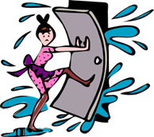
La fonética
[rr]
barrio
correr
perro
cerrar
correcto
correo

Slide 5
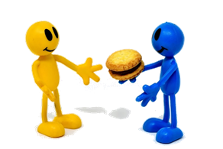
[r]
abrir
dar
rico
pero
seria
sobre
[about; on top of]

Slide 6
preferir | to prefer, preferring
querer | to want, wanting
poder | to be able to
soler | to usually
el almacén | store
encontrar | to find, finding
hacer cola | to queue, queuing
de todo | everything

Slide 7
Gramática Using radical changing verbs in the 1st person singular and plural

Slide 8
Radical Changing Verbs
Radical changing verbs are verbs which have a change in the stem of the verb in the 1st person singular, 2nd person singular and 3rd person singular and plural.
E.g.
Querer - to want
Quiero Queremos
Quieres Queréis
Quiere Quieren
In this lesson we are going to focus on the 1st person plural and 1st person singular. This is the I form and the we form.
N.B. Endings on radical changing verbs work in the same way as other verbs and depend on whether the verb is AR, ER or IR.

Slide 9
Soler - to usually
Poder - to be able to
The O in Soler changes to a UE in the forms it needs to change.
Poder works in the same way as Soler. The O changes to a UE.
How would you say:
I am able to
Puedo
How would you say
We are able to
Podemos
Remember: today we are looking at the 1st person singular (I) form which does have the radical change, and the 1st person plural (we) which doesn’t.
To say I usually we would say:
Suelo
And to say we usually we would say:
Solemos

Slide 10
Preferir
In preferir the stem change is e -> ie. Note that the stem change happens on the second e.
I prefer:
Prefiero
We prefer:
Preferimos

Slide 11
Shopping for presents and clothes [3 /3]
I prefer = ____________ , We prefer = ___________ .Prefiero
I usually = ___________ , We usually = ____________ .
I want = ____________ , We want = ____________ .
When you have two verbs together the second will be in the ___________,
Choose the correct ending to the following sentence: In radical changing verbs a stem change occurs in the __________________.
Prefiero
Preferimos
Suelo
Solemos
Quiero
Queremos
infinitive
1st person singular

