Slide 1
Which substances do not fit into one state of matter?
Science
Miss Couves

Slide 2
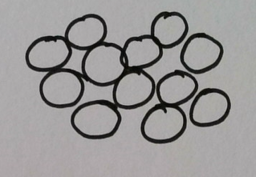
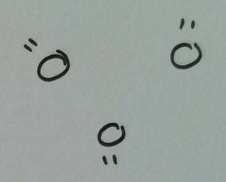
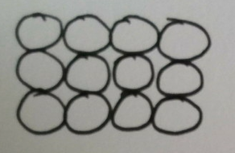
What do the particles look like in solids, liquids and gases?
Notes:
PP which of these diagrams shows a solid? How did you know?
PP What is the difference between the particles in a liquid and a gas?

Slide 3
Properties of solids
Solids cannot be c_________
Do not f______
Have a f_____ S_____

Slide 4
Properties of liquids
Liquids cannot be c_____________
Can f_____
Can take the shape of ________________________________________________________________________

Slide 5
Properties of gases
Gases can be c__________
Can f_________
Can f_______ the shape of their container

Slide 6
Draw lines to match the description to the correct state of matter.
Solid |  | Particles are touching and in ordered rows
Liquid |  | Particles are far apart from each other
Gas |  | Particles are touching in a random arrangement

Slide 7
Draw lines to match the description to the correct state of matter.
Solid |  | Particles can slide past each other
Liquid |  | Particles are moving constantly in all directions
Gas |  | Particles cannot move but can vibrate

Slide 8
What happens to the particles as they are heated?
___________ temperature - particles have _______ __________ - the substance ____________
Notes:
Particles in a solid are vibrating on the spot, in a liquid they are sliding past each other and in a gas they are moving fast in all directions. As a susbstance is heated the temperature increases. When the temperature increases the particles have more energy and move around more.

Slide 9
What happens to the particles as they are cooled?
___________ temperature - particles have _______ __________ - the substance ____________
Notes:
Particles in a solid are vibrating on the spot, in a liquid they are sliding past each other and in a gas they are moving fast in all directions. As a susbstance is heated the temperature increases. When the temperature increases the particles have more energy and move around more.

Slide 10
Which state change does each arrow represent?
Solid
Liquid
Gas
Notes:
Pause the video and complete the diagram in your notes

Slide 11
How do we measure temperature?
Temperature is measured using a scale called c________
0ºC is the temperature at which water ______
100ºC is the temperature at which water ______

Slide 12
What is a fixed point?
Notes:
Different temps - e.g. model ice vs candle melting

Slide 13
Is jelly a solid, a liquid or a gas?
Jelly is like a solid because………………………………………………………………………………………...
Jelly is like a liquid because……………………………………………………………………………………...

Slide 14
Is sand a solid, a liquid or a gas?
Sand is like a solid because……………………………………………………………………………………………...
Sand is like a liquid because…………………………………………………………………………………………….

Slide 15
How do you make a non-newtonian fluid
Equipment:
- 1 cup of water - a bowl
- 2 cups of cornflour - a spoon
Method:
1) Place the cornflour in the bowl
2) Add the water (and food colouring if you are using some)
3) Stir the flour together very slowly

Slide 16
Try: quickly grabbing your non-newtonian fluid
2. Try: slowly releasing your hand
3. Try: drag your hand through quickly then slowly
Write: When I tried to grab the non-newtonian fluid quickly, I found that...
Write: When I released my hand, I found that...
Write: When I dragged my hand quickly/ slowly, I found that...

Slide 17
Try: tip the bowl to the side quickly
2. Try: tip the bowl to the side slowly
3. Try: picking it up and squashing it into a ball
Write: When I tipped the non-newtonian fluid quickly, I found that...
Write: When I tipped the non-newtonian fluid slowly, I found that...
Write: When I squashed the non-newtonian fluid into a ball, I found that...

