Slide 1
Required Practical
Reaction Time - Part 1
Combined Science - Biology - KS4
Homeostasis and Response
Miss Ray
Please note these slides contain colour font.

Slide 2
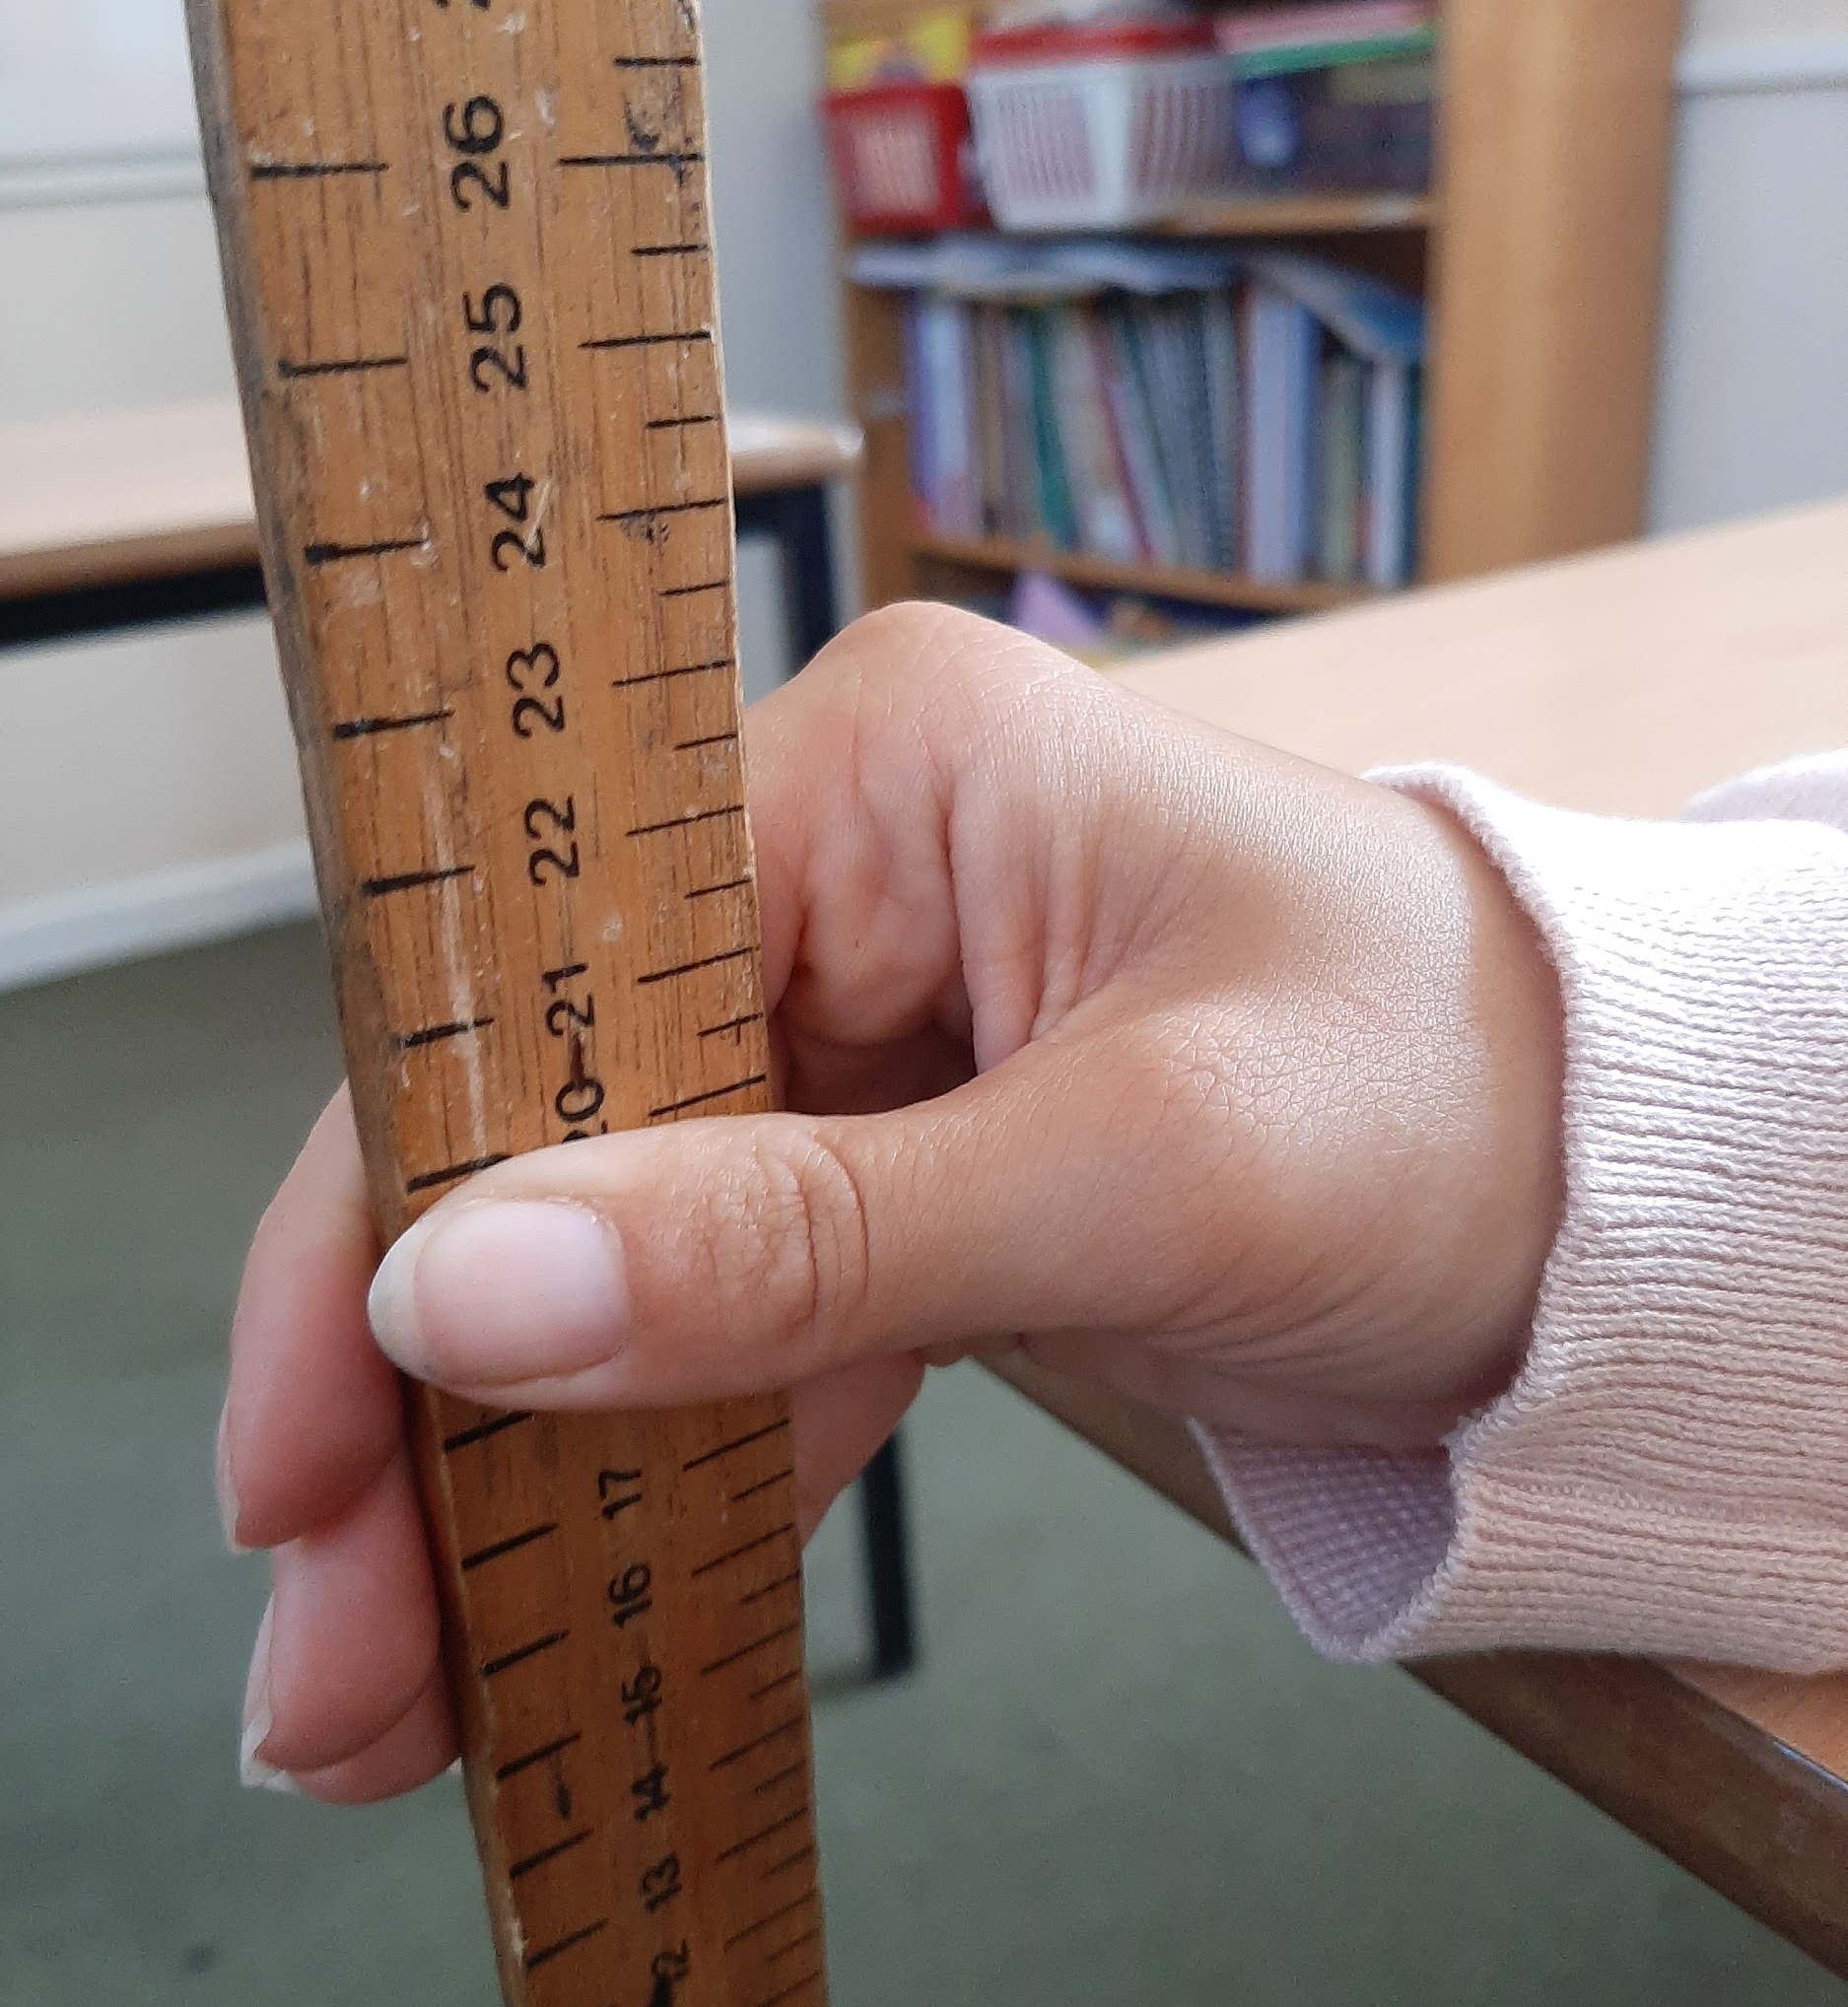
Method
Work with a partner.
Person A places their elbow on the table and opens their dominant hand.
Person B places the ruler in between the fingers and thumb with the ruler at 0 cm.
Person B drops the ruler whilst talking to person A and person A catches it.
The number level with the top of person A's thumb is recorded in a suitable table. Repeat this three times and calculate a mean.
Repeat the experiment with person B dropping the ruler silently.
Image - Oak National Academy.
Notes:
Video demo of method. Pause, students read it through/write it

Slide 3
Using the method, identify the independent, dependent and control variables.
Independent -
Dependent -
Control -

Slide 4
Answers
Presence of noise when dropping the ruler.
Independent variable -
Dependent variable -
Control variables -
Distance the ruler falls before it is caught.
Same starting height
Same mass of ruler
Same person catching the ruler
Always using dominant hand

Slide 5
Draw a results table
Dependent variable
Independent variable

Slide 6
Model results table
 | Distance (cm)
 | 1 | 2 | 3 | Average
With noise
Without noise

Slide 7
Calculate the means
 | Distance (cm)
 | 1 | 2 | 3 | Average
With noise | 4.6 | 5.3 | 6.0
Without noise | 2.7 | 3.5 | 3.4
Notes:
Calculate the means.

Slide 8
 | Distance (cm)
 | 1 | 2 | 3 | Average
With noise | 4.6 | 5.3 | 6.0
Without noise | 2.7 | 3.5 | 3.4
4.6 + 5.3 + 6.0 = 15.9
15.9 ÷ 3 = 5.3
5.3
2.7 + 3.5 + 3.4 = 9.6
9.6 ÷ 3 = 3.2
3.2
Notes:
Model how to calculate the mean. Discuss the importance of a larger sample size and link with reliability. Ask students to calculate their own means or the second column while video is paused. Draw attention to what to do if you encounter an anomalous result (repeat/leave out of mean)

Slide 9
Use this data to draw a line graph
 | Distance (cm)
 | 1 | 2 | 3 | Average
With noise | 4.6 | 5.3 | 6.0
Without noise | 2.7 | 3.5 | 3.4
4.6 + 5.3 + 6.0 = 15.9
15.9 ÷ 3 = 5.3
5.3
2.7 + 3.5 + 3.4 = 9.6
9.6 ÷ 3 = 3.2
3.2

