Slide 1
Me and My Friends 2
Lesson 6 of 6 : download
Music
Mrs Wright
Notes:
This needs to be changed to:
This is Me,
Lesson 1 of 6

Slide 2
Me and My Friends 2
Music Activity
Achievement Certificate
Board
It’s time to celebrate all the fun musical play we’ve enjoyed together over this unit.
You can colour in your own certificate and add some pictures of the things you really enjoyed.

Slide 3
You will need…..
Colouring pencils or pens
The print out of this worksheet download.
Plain paper if you cannot print this worksheet.
Instructions:
Colour in and write or draw your favourite things from the “All About Me” music unit. If you can’t print out the worksheet, try drawing your own! You can decorate it however you like. You should feel proud of yourself … well done!

Slide 4
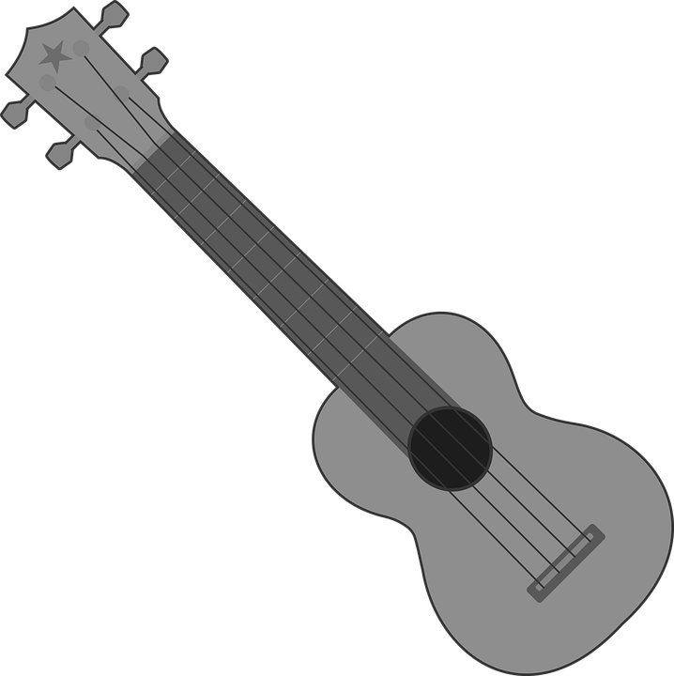
Star
___________ is a musical Super Star!

Slide 5
Note
A few of my favourite things:

Slide 6
References
Slide 2 - Gerd Altmann - Well done, PublicDomainPictures - thumbs up.
Slide 4 - Pixabay - Clker-Free-Vector-Images -Treble clef, Ukulele, quavers, semi quavers, Annalise Batista - star

