Slide 1
Unit 3 Multiplication and division
Multiplying three 1-digit numbers.
Mathematics
Independent Task
Miss Thomas

Slide 2
Independent Task
Create three 1-digit multiplication equations. Use the associative law to solve the equation.
_____ x _____ x _____ = _______
_____ x _____ x _____ = _______
_____ x _____ x _____ = _______
_____ x _____ x _____ = _______

Slide 3
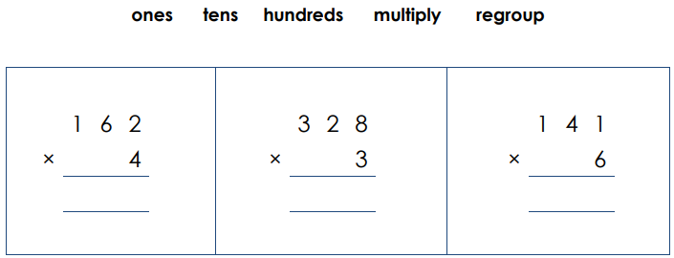
Independent Task
Solve the multiplication calculations. Explain each step using the key vocabulary below.

Slide 4
Independent Task
Solve the multiplication calculations. Explain each step using the key vocabulary below.
2
2
2
984
846
648

Slide 5
Example answers of some combinations
Create three 1-digit multiplication equations. Use the associative law to solve the equation.
4 x 1 x 2 = 8
2 x 1 x 3 = 12
3 x 4 x 5 =60
5 x 6 x 7 = 210
7 x 8 x 9 = 504
6. 6 x 4 x 5 =120
7. 2 x 8 x 9 = 144
8. 7 x 3 x 5 = 105
9. 8 x 6 x 7 = 336
10. 7 x 8 x 3 = 163
11. 6 x 5 x 2 = 60
12. 2 x 5 x 3 = 30
13. 7 x 4 x 5 =140
14. 5 x 1 x 7 = 35
15. 1 x 8 x 2 = 16

