Slide 1
Representing information as a bar model
Mathematics
Miss Mitchell

Slide 2
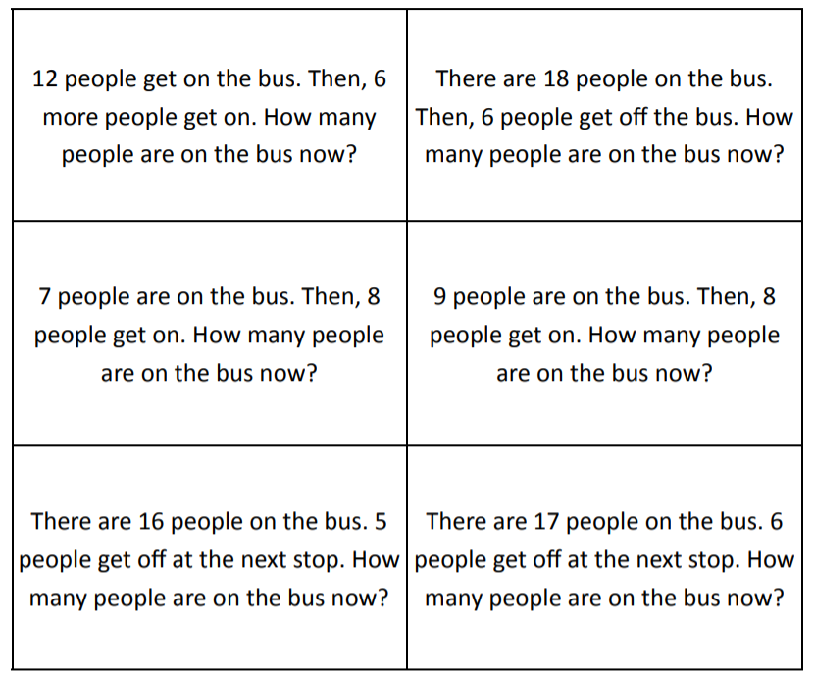
Question 1
A
C
E
B
D
F

