Slide 1
Lesson 2: Quick Calculations
Spreadsheets
Computing
Halima Bhayat
Materials from the Teach Computing Curriculum created by the National Centre for Computing Education

Slide 2
Task 1 Calculation practice
Credit: Google Sheets screenshot: Halima Bhayat

Slide 3
Your first formula?
A formula always starts with the = symbol
Symbol for multiplication: *
Symbol for division: /
For Task 1 can you enter formulas in column F to work out answers for Question 1 to 5?
Credit: Google Sheets screenshot: Halima Bhayat

Slide 4
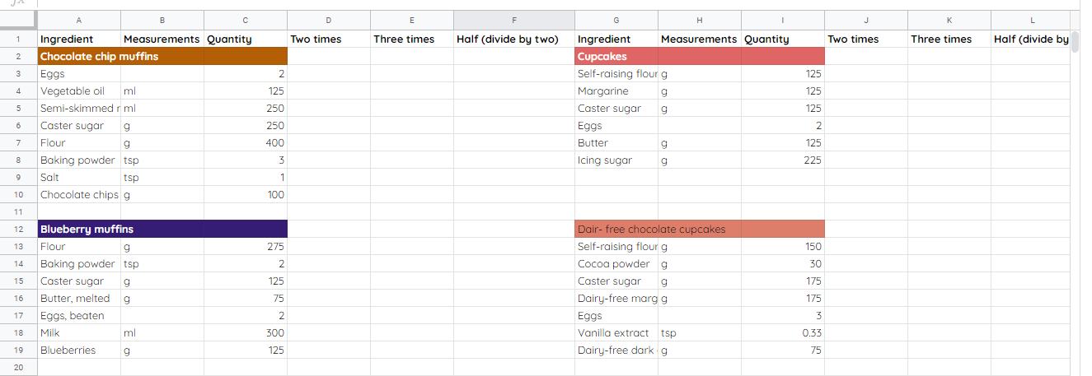
Task 2 Cake recipe
Credit: Google Sheets screenshot: Halima Bhayat

Slide 5
Autofill
What is it and why is it needed?
Look for the little square on the bottom right corner of a cell.
Task 2 - Create a formula which can double or divide a quantity and uses an autofill.
Save your cake recipe spreadsheet, you will need this again in lesson 4
Credit: Google Sheets screenshot: Halima Bhayat

