Slide 1
Add and Subtract Fractions Fluently
(Accurately, Efficiently and Flexibly)
Worksheet
Mathematics
Mr Kelsall

Slide 2
New learning: counting in fractions
Count forward/backwards, as a fraction, decimal, mixed number, improper fraction, in:
Tenths
Hundredths
Thousandths
Halves
Thirds
Quarters
Fifths

Slide 3
New learning: mentally adding and subtracting fractions
Find the (lowest) common denominator
Convert
add/subtract

Slide 4
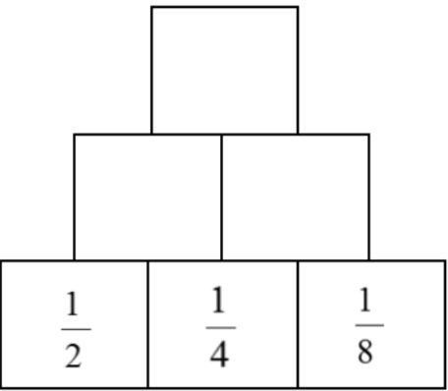
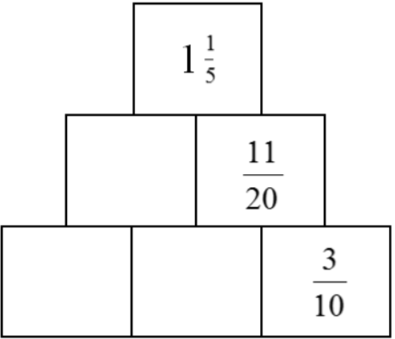
New: converting fractions to add/subtract
Add these fractions:
The sum of the two bricks is equal to the brick above

Slide 5
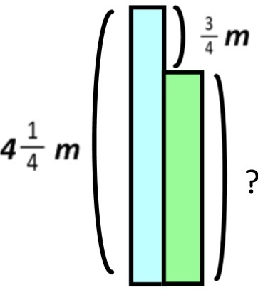
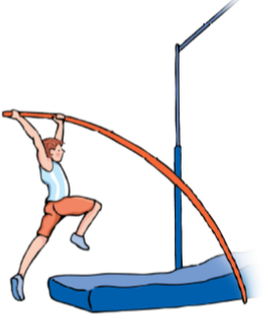
Develop learning: converting fractions to add/subtract
Luca pole vaults a height of 4¼ m and Marcus vaults ¾ m less. How high does Marcus jump?
Source of all images : Mr Kelsall or Oak National Academy

