Slide 1
Multiplication and division
Consolidation and review
Worksheet
Mr Ward

Slide 2
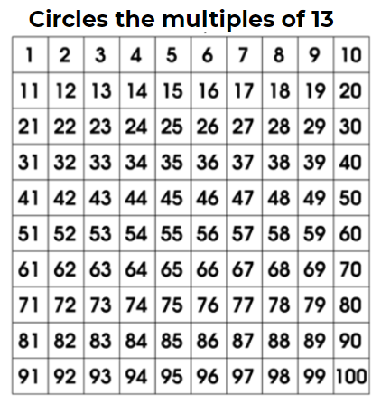
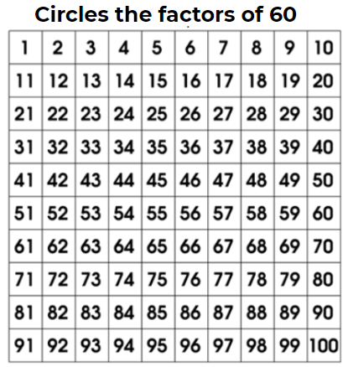
Multiples and factors
Can you identify the multiples and factors?

Slide 3
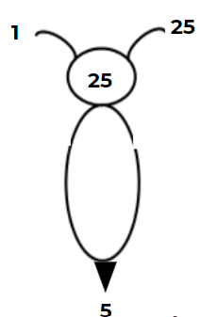
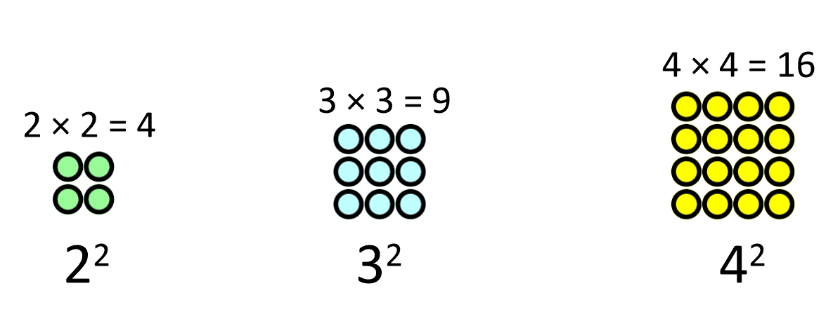
Multiples and factors
What would be the 6th product in this sequence of squared numbers?

Slide 4
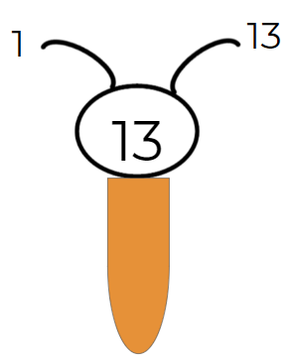
Multiples and factors
What number has been incorrectly circled as a prime number?

Slide 5
Multiply and divide by 10, 100, 1000
Which of the following statements are false?
60 ÷ 10 = 6
72 x 100 = 720
6320 ÷ 100 = 63.2
412 x 1000 = 412,000
7200 ÷ 100 = 72
21 x 1000 = 2100
4855 ÷ 10 = 485.5
192 x 100 = 192,000

Slide 6
Mental Strategies for multiplying and dividing
Complete these calculations
7 x 8 = ? 13 x 8 = ?
16 x 8 = ? 22 x 8 = ?

Slide 7
Mental Strategies for multiplying and dividing
Complete these calculations
64 ÷ 8 = ? 152 ÷ 8 = ?
192 ÷ 8 = ? 480 ÷ 8 = ?

Slide 8
Mental Strategies for multiplying
Distributive Law
Which statements are inaccurate?
32 x 17
30 x 10 + 2 x 17 + 2 x 7
32 x 10 + 30 x 7 + 2 x 7
30 x 10 + 2 x 10 + 30 x 7 + 2 x 7
30 x 10 + 2 x 10 + 2 x 7 + 2 X 17

Slide 9
Formal methods
Complete the following calculations using the formal methods shown.
1) 624 x 40 5) 27 x 16
2) 1211 x 70 6) 32 x 21
3) 2742 x 3 7)1,960 ÷ 8
4) 931 x 7 8) 1,684 ÷ 4

