Slide 1
To explore irregular metre
Lesson 5 of 6
Music
Miss Miner

Slide 2
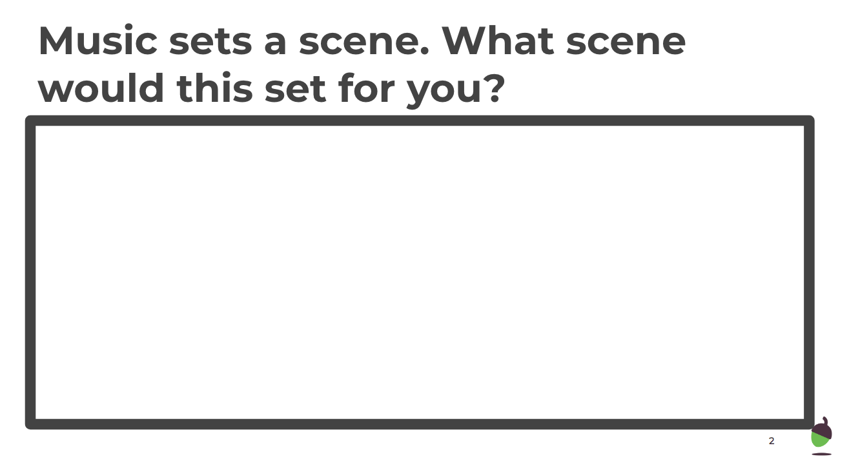

Slide 3
Composing in an irregular metre
Can you compose your own 5 beat rhythm?

