Slide 1
Fractions:
Multiply and divide with improper fractions.
Independent Task
Mathematics

Slide 2
Question 1
Complete the calculations, giving each answer either as a proper fraction in its simplest form or as a mixed number.

Slide 3
Question 2
Complete the calculations, giving each answer either as a proper fraction in its simplest form or as a mixed number.

Slide 4
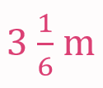
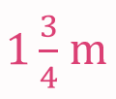
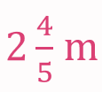
Question 3
Find the area of each shape.
a)
b)

Slide 5
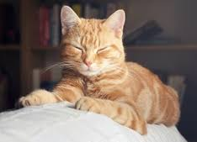
Question 4
Aleeyah has a pet cat, Marmalade.
Each day Marmalade eats cans of cat food.
How many cans of cat food should Aleeyah buy to last a week?

