Slide 1
Mr Lund
Maths
‹#›

Slide 2
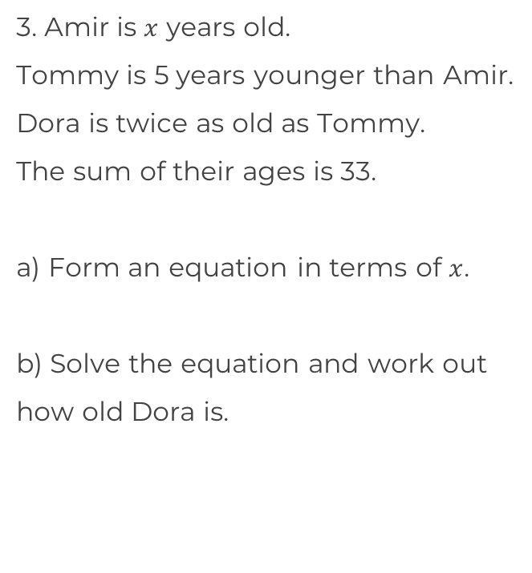
Solve equations that first involve simplification
1. Which equation is not represented by the bar model? Explain why.
2. Solve the equations
2(a + 3) + 5 = 15
b) 5 + 2(a – 3) = 15
15 = 2(a + 3) – 2.5
3(y+2) + 5y = 22
3y + 6 + 5y = 22
3(y+6) + 5y = 22
8y + 6 = 22
3y
+ 6
5y
22
‹#›

Slide 3
Solve equations that first involve simplification
4. Solve the equations.
2(a + 3) + 5 = - 15
b) 5 – 2(a – 3) = 15
– 15 = – 2(a + 3) – 2.5
5. Spot the mistake.
6. Solve the equations.
6(y + 2) – 3y = – 15
b) 2(y + 2) – y = – 5
c) – 10 = 4(y + 2) – 2y
y – 2(y + 2) = – 5
What do you notice about
The questions above?
6(y + 2) – 3y = – 15
2(y + 2) – y = – 15
‹#›

Slide 4
Answers
‹#›

Slide 5
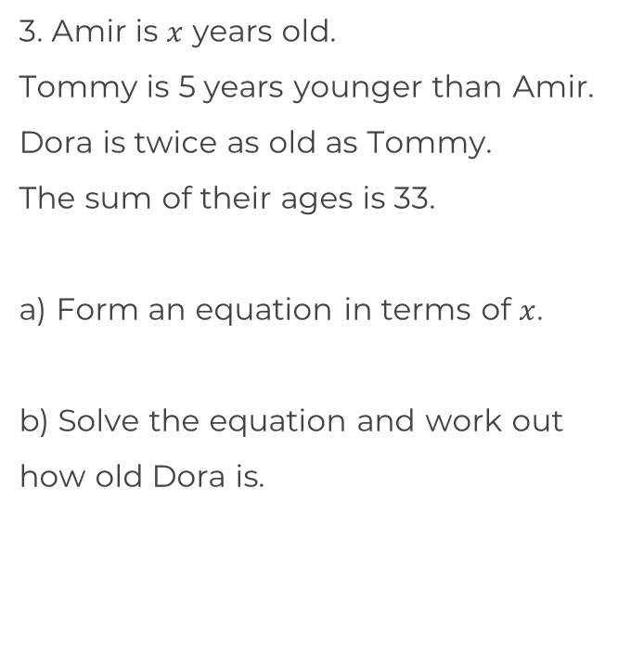
Solve equations that first involve simplification
1. Which equation is not represented by the bar model? Explain why.
2. Solve the equations
2(a + 3) + 5 = 15
b) 5 + 2(a – 3) = 15
15 = 2(a + 3) – 2.5
3(y+2) + 5y = 22
3y + 6 + 5y = 22
3(y+6) + 5y = 22
8y + 6 = 22
3y
+ 6
5y
22
a = 2
a = 8
a = 5.75
‹#›

Slide 6
Solve equations that first involve simplification
4. Solve the equations.
2(a + 3) + 5 = - 15
b) 5 – 2(a – 3) = 15
– 15 = – 2(a + 3) – 2.5
5. Spot the mistake.
6. Solve the equations.
6(y + 2) – 3y = – 15
b) 2(y + 2) – y = – 5
c) – 10 = 4(y + 2) – 2y
y – 2(y + 2) = 5
What do you notice about
the questions above?
a = – 13
y = – 9
a = – 2
a = 3.25
y = – 9
y = – 9
6(y + 2) – 3y = – 15
y = – 9
2(y + 2) – y = – 15
Only one side of the equation has been divided by three
All are rearrangements of the same equation.
‹#›

