Slide 1
Reasoning with pattern and sequences:
Number sequence.
Independent Task
Mathematics
Mr Critchlow

Slide 2
To Start
Times table speed challenge
 | 4 | 8 | 3 | 2 | 5 | 6 | 9 | 10 | 7
4
7
8
10
11
9
6
12
5

Slide 3
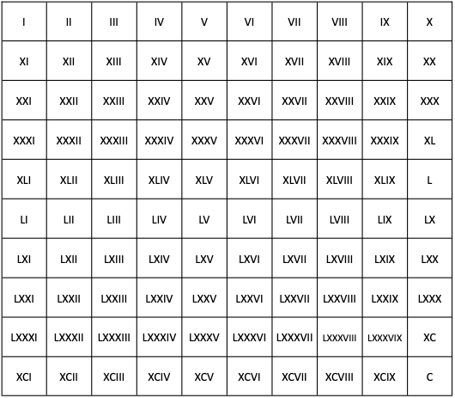
Moving on
Can you remember the Roman Numerals for these numbers?
Arabic Numeral | Roman Numeral | Arabic Numeral | Roman Numeral
100 |  | 25
54 |  | 36
48 |  | 13

Slide 4
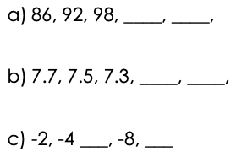
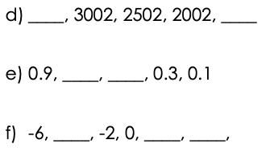
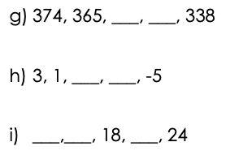
Main Task
Can you work out the rule for each of these sequences and fill in the missing terms?

Slide 5
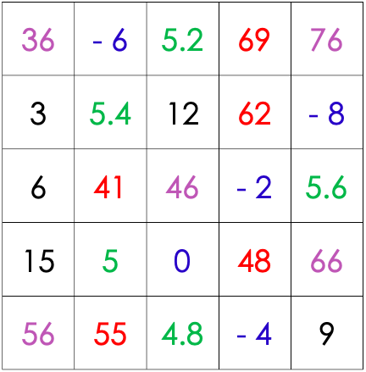
Main Task
You can see different coloured numbers. They form 5 different sequences. Can you arrange them into increasing sequences?

