Slide 1
Applying and consolidating: Using bar models and solving word problems
Mathematics
Mrs Crane
Mrs Crane

Slide 2
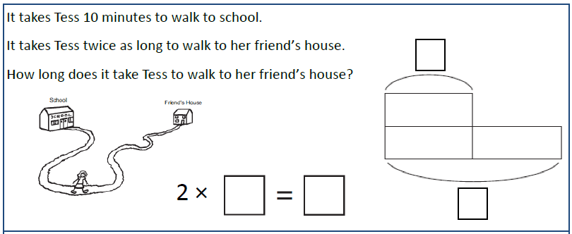
Independent Task
Q1
Solve the word problems using bar models to represent them.
Remember: use counters to help you!

Slide 3
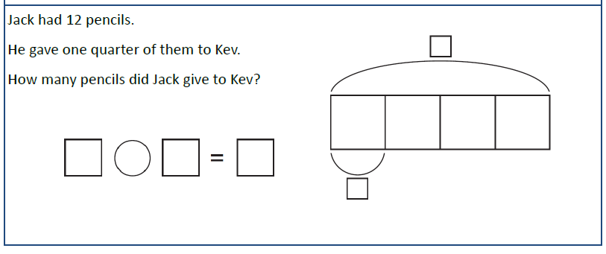
Independent Task
Q2
Solve the word problems using bar models to represent them.
Remember: use counters to help you!

Slide 4
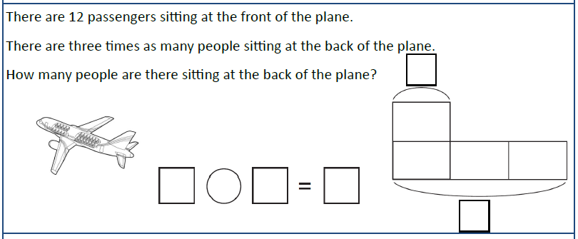
Independent Task
Q3
Solve the word problems using bar models to represent them.
Remember: use counters to help you!

