Slide 1
Rotate an Object around a Given Point
Maths
Miss Davies

Slide 2
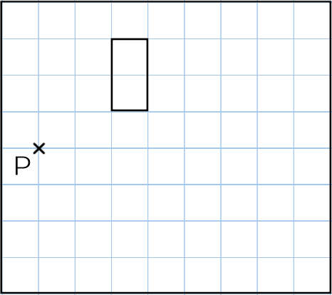
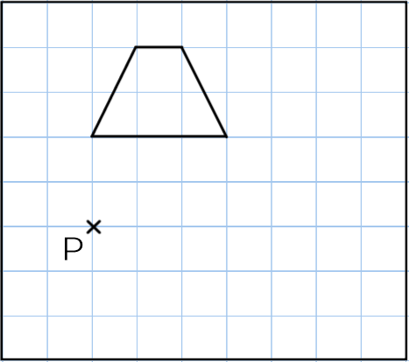
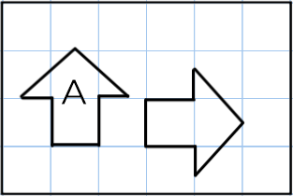
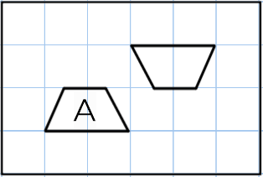
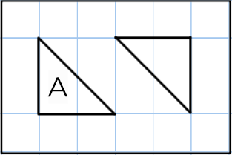
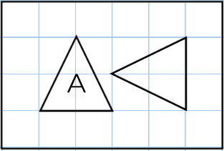
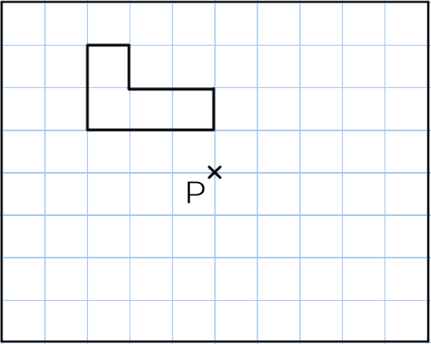
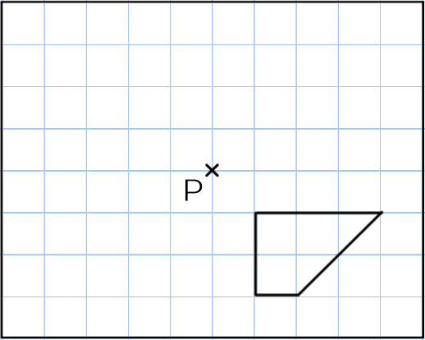
Rotate an Object around a Given Point
1. For each shape A identify
the angle of rotation
the direction of turn.
a) b)
c) d)
2. Rotate each shape 90º clockwise, around centre point P.
a) b)
3. Rotate each shape 180º, around centre point P.
a) b)

Slide 3
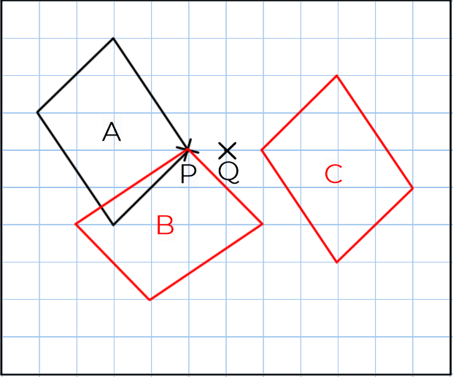
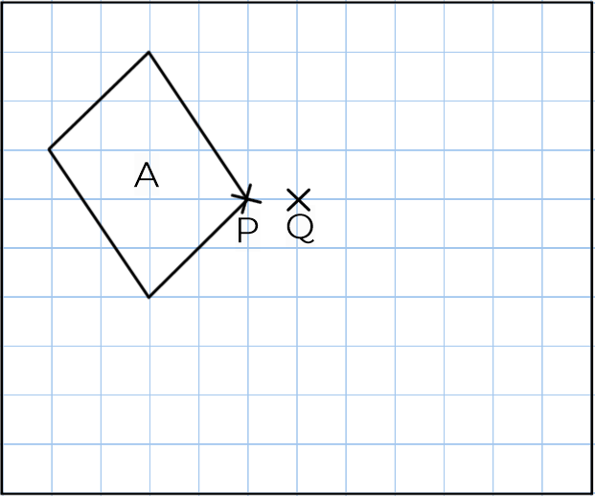
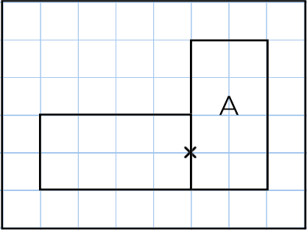
Rotate an Object around a Given Point
4. Carl has rotated shape A 90º anticlockwise, and has marked an incorrect centre of rotation.
Mark the correct centre of rotation.
5. Rotate shape A 90º anticlockwise, around centre point P. Label this B.
Rotate shape A 180º around centre point Q. Label this C.

Slide 4
Answers

Slide 5
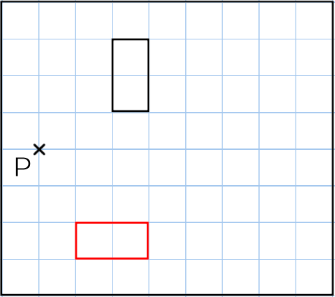
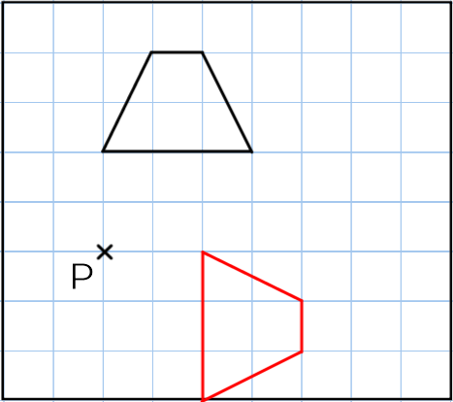
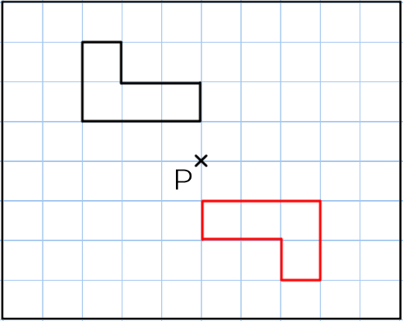
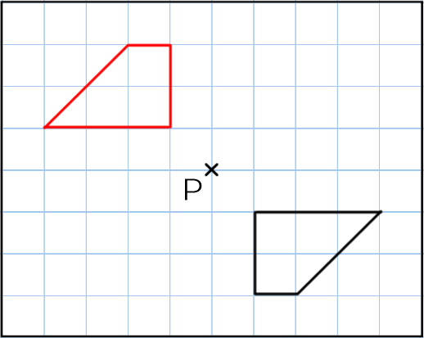
Rotate an Object around a Given Point
1. For each shape A identify
the angle of rotation
the direction of turn.
a) 90º clockwise b) 180º
c) 180º d) 90º anticlockwise
2. Rotate each shape 90º clockwise, around centre point P.
a) b)
3. Rotate each shape 180º, around centre point P.
a) b)

Slide 6
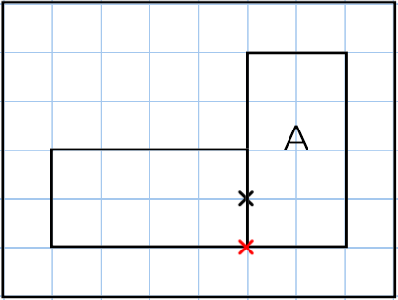
Rotate an Object around a Given Point
4. Carl has rotated shape A 90º anticlockwise, and has marked an incorrect centre of rotation.
Mark the correct centre of rotation.
5. Rotate shape A 90º anticlockwise, around centre point P. Label this B.
Rotate shape A 180º around centre point Q. Label this C.

