Slide 1
Reading and Interpreting Line Graphs
Worksheet
Mathematics
Mr Ward

Slide 2
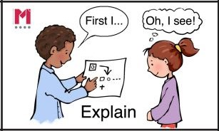
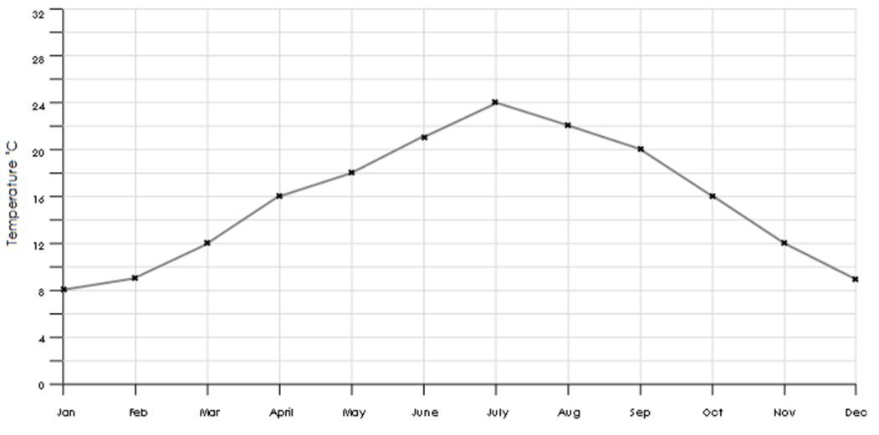
Average Temperature in England
Talk Task
Use the line graph to correctly complete the table below?
Can you think of three factual statements you can make about the line graphs?
Temperature Degrees C
Months of the Year
Time
Temperature

Slide 3
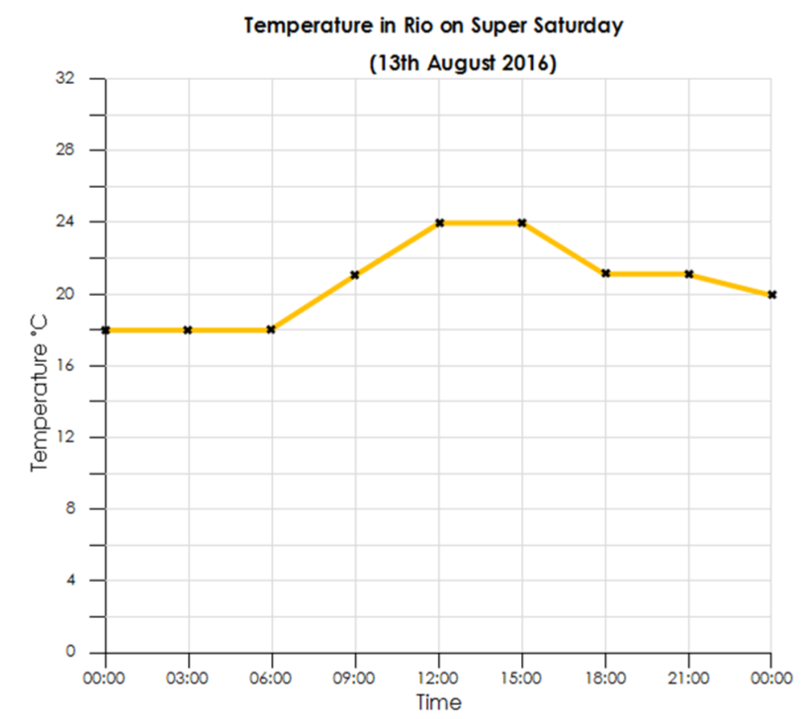
Read the line graph carefully and answer the questions below
Temperature in Rio on Saturday 13th August 2016
How do you know that between 12 p.m. and 3 p.m. was the hottest time of the day?
2) The temperature decreases across the morning, reaching a low of 24 degrees between 12:00 and 15:00. It then increases through the evening and finishes at a lower temperature than the night before.
Is this statement True? Correct any errors you can see.
3) Between which time intervals does the temperature increase the most?
4) Sketch a graph showing your predictions for the week between the Saturdays.
Temperature Degrees C
Time (24 hour clock)

