Slide 1
Solving word problems by using bar models
Mathematics
Mrs Crane
Mrs Crane

Slide 2
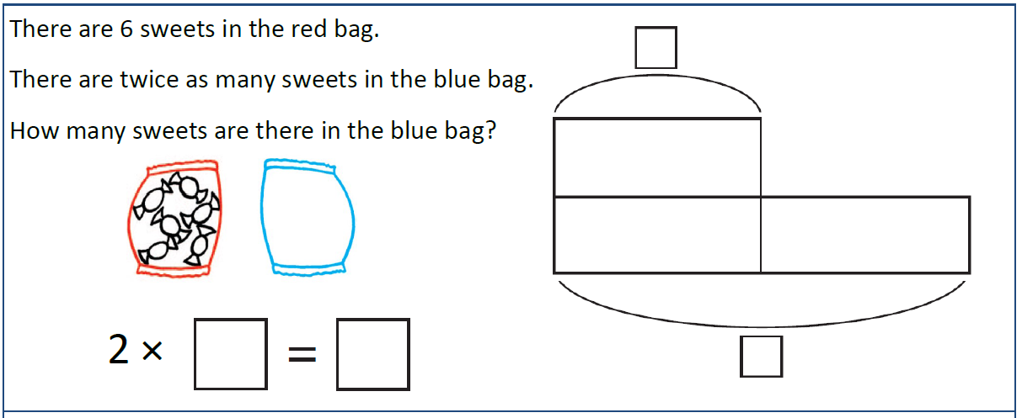
Independent Task
Q1
Solve the word problems using bar models to represent them.
Remember: use counters to help you!

Slide 3
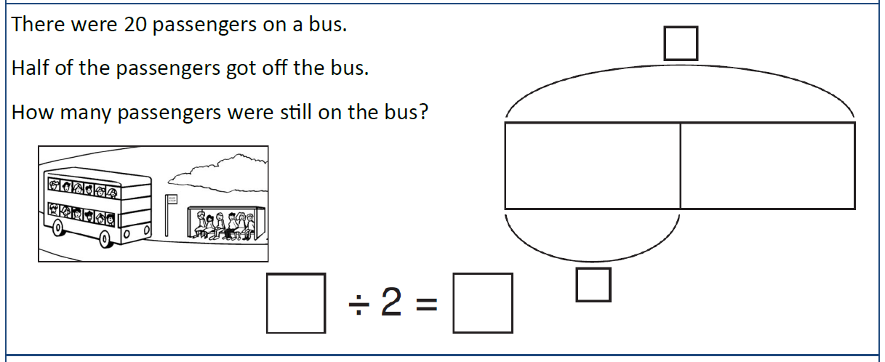
Independent Task
Q2
Solve the word problems using bar models to represent them.
Remember: use counters to help you!

Slide 4
Independent Task
Q3
Solve the word problems using bar models to represent them.
Remember: use counters to help you!

