Slide 1
Unit 2: Multiplication and Division
Written Multiplication
Independent Task
Mathematics
Lesson 13 of 20
Mr Whitehead

Slide 2
Independent Task
Question 1
There is a special offer on an African safari. It is currently £2569. There are 100 spaces on the safari and Oak Travel have currently sold 36 of them. How much money have they made on the offer so far?
Question 2
A group of 6 friends book to go on the African safari. One friend, James, pays the total with his bank card. The rest of the group will pay James at the end of the month. How much money is James owed?

Slide 3
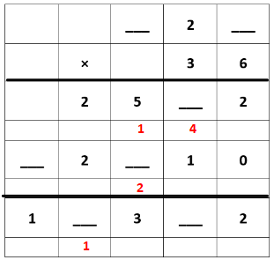
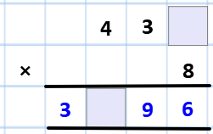
Ready for a Challenge?

