Slide 1
Talking about more than one (Part 2/2)
Plural rules 1, 2 and 3
Sein in the 3rd person plural
Downloadable Resource
German
Frau Johnson

Slide 2
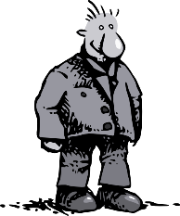
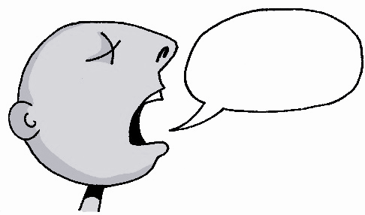
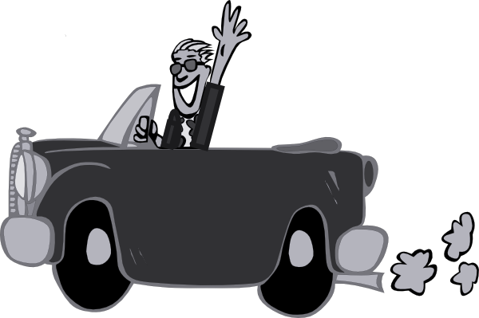
a
sagen
Paar
haben
Tag
fahren

Slide 3
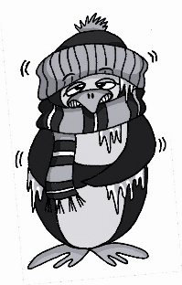
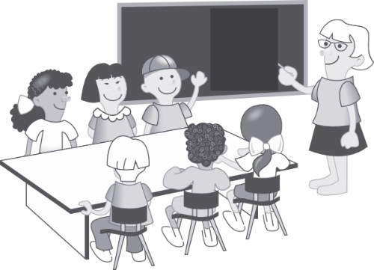
a
Mann
6 Meter
kalt
lang
danke
Klasse

Slide 4
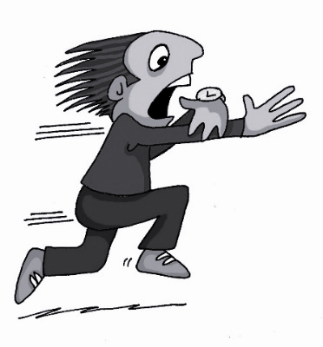
ä
1, 2, 3, …100
spät
ähnlich
zählen
Berlin 1KM
Nähe
wählen

Slide 5
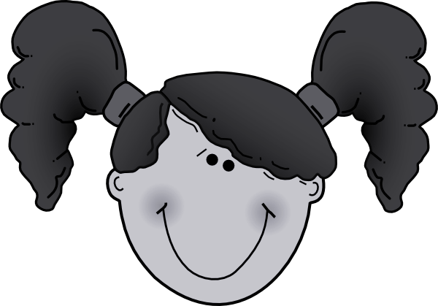
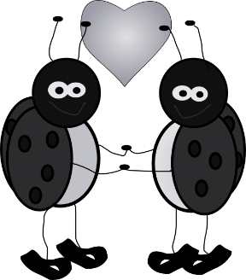
ä
Verhältnis
lächeln
Mädchen
ändern
Hälfte

Slide 6
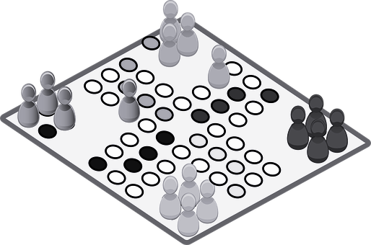
More than one- Rule 1
In German there are several ways to make plural nouns.
Most masculine and neuter nouns either:
The word for ‘the’ for ALL plural nouns is die
1 Add -e to the end
das Spiel
die Spiele

Slide 7
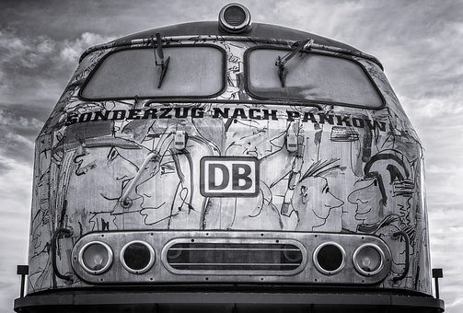
Or:
2 Add an -e to the end and an umlaut on the vowel
der Zug
die Züge
90% of masculine plurals work like this.

Slide 8
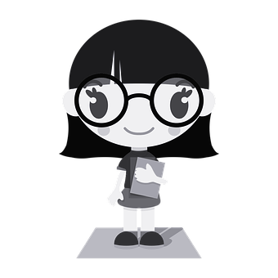
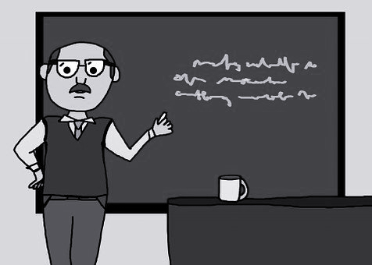
More than one- Rule 2
Words ending in -EL, -EN or ER often remain the same in the plural.
das
Mädchen
die Mädchen
der Lehrer
die Lehrer
You can tell whether it is the singular or plural form from the plural ‘die’.

Slide 9
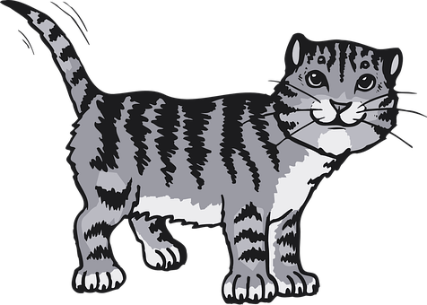
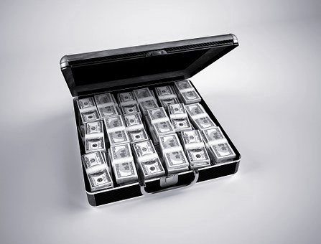
More than one- Rule 3 Feminine nouns
.
Most feminine nouns make a plural by adding -n or -en.
die Katze
die Katzen
die Million
die Millionen
Remember the plural word for ‘the’ is ‘die’ for ALL genders.

Slide 10
Sein in the 3rd person plural
In German when you want to describe what one thing is like you use the 3rd person singular:
Die Katze ist klein. The cat is small.
This is the ‘he/ she/ it’ form of the verb.
When you want to describe what more than one thing is like you use the 3rd person plural:
Die Katzen sind klein. The cats are small.
This is the ‘they’ form of the verb.

Slide 11
Talking about more than one
1 To make a plural most masculine or neuter nouns either: add an _____ to the end.
2 Or Add an ‘e’ to the end and an _______ to the vowel.
3 Nouns ending in el/ en/ er often _______ the same.
4 To make a plural most feminine nouns add _____ or ______.
5 The 3rd person plural of sein is ______.
e
umlaut
stay
-n
-en
sind

