Slide 1
Distance-time graphs
Maths
Mr Clasper

Slide 2
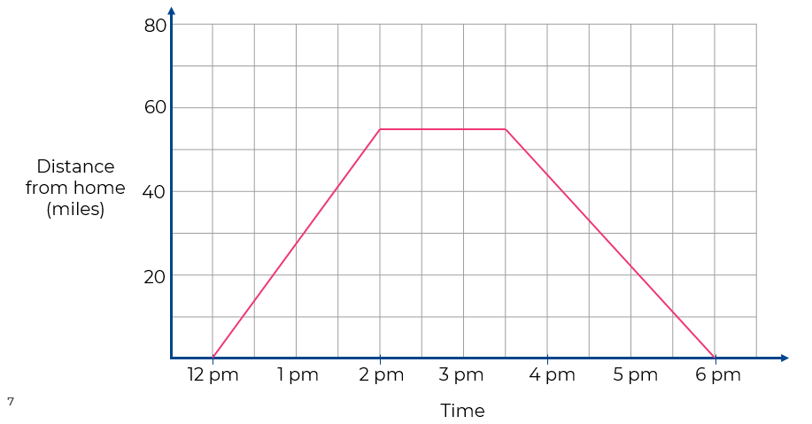
Distance-time graphs
1. Yasmin is driving on a straight road.
The graph opposite shows her journey.
a) How far did she travel after 2 hours?
b) How far from home was she at 4.30pm?
c) How long was she stopped?
d) How long did the journey take?
e) What is the total distance Yasmin drives

Slide 3
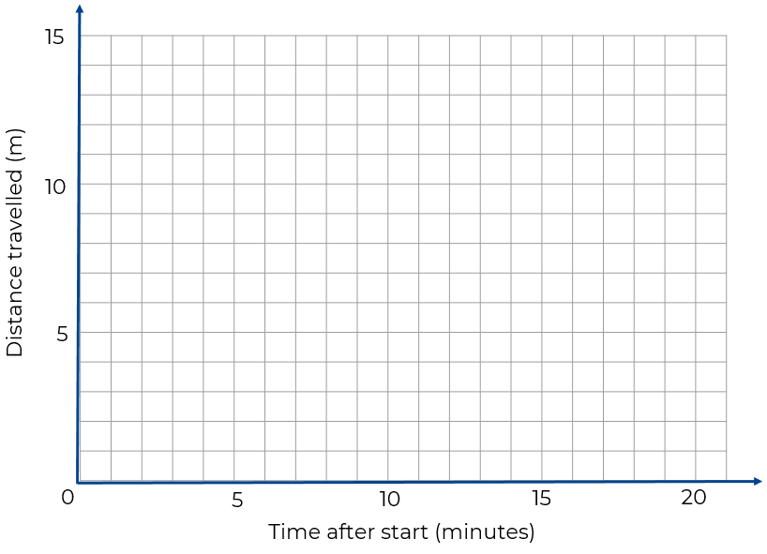
Distance-time graphs
Draw a graph to represent the following journey.
A tortoise walks 10 m in 7 minutes.
He then pauses for 6 minutes.
He then walks a further 4 m in 5 minutes.
He stops and rests.

Slide 4
Answers

Slide 5
Distance-time graphs
1. Yasmin is driving on a straight road.
The graph opposite shows her journey.
a) How far did she travel after 2 hours?
b) How far from home was she at 4.30pm?
c) How long was she stopped?
d) How long did the journey take?
e) What is the total distance Yasmin drives?
55 miles
33 miles
1 hour 30 minutes
6 hours
110 miles

Slide 6
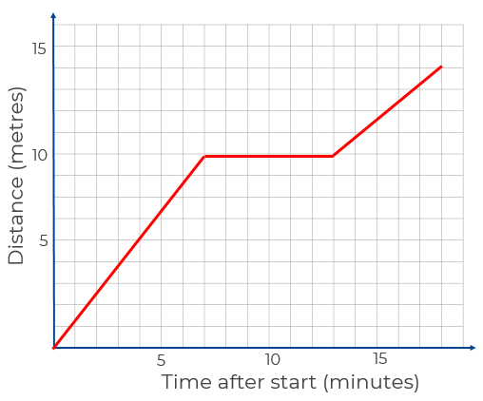
Distance-time graphs
Draw a graph to represent the following journey.
A tortoise walks 10 m in 7 minutes.
He then pauses for 6 minutes.
He then walks a further 4 m in 5 minutes.
He stops and rests.

