Slide 1
Activities of Daily Living (ADLs) -
Getting dressed
Occupational Therapy
Aniesa Blore

Slide 2
USE SCISSORS SAFELY
This lesson includes the use of scissors, so please:
Make sure you are sitting down to do your cutting.
Make sure an adult is with you while you are cutting.
Cut away from your body.
Carefully watch what you are cutting.
Hold scissors by the handles.
Don’t run while holding scissors.
Only cut things which an adult has said is okay to cut.

Slide 3
ACTIVITY: WHAT SHALL I WEAR?
Draw and cut out the pictures in the next two slides OR print and cut them out. You can also colour in the pictures.
Play a game with an adult and match the clothes to the weather and occasion.
Draw pictures of other clothes and accessories and match them.

Slide 4
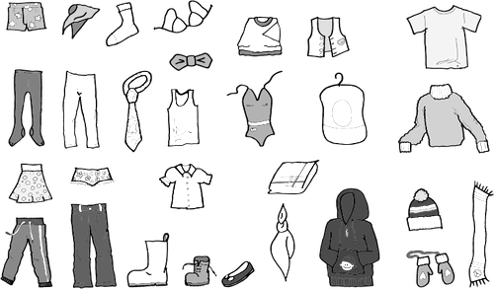
ACTIVITY: WHAT SHALL I WEAR?
Images: Free SVG

Slide 5
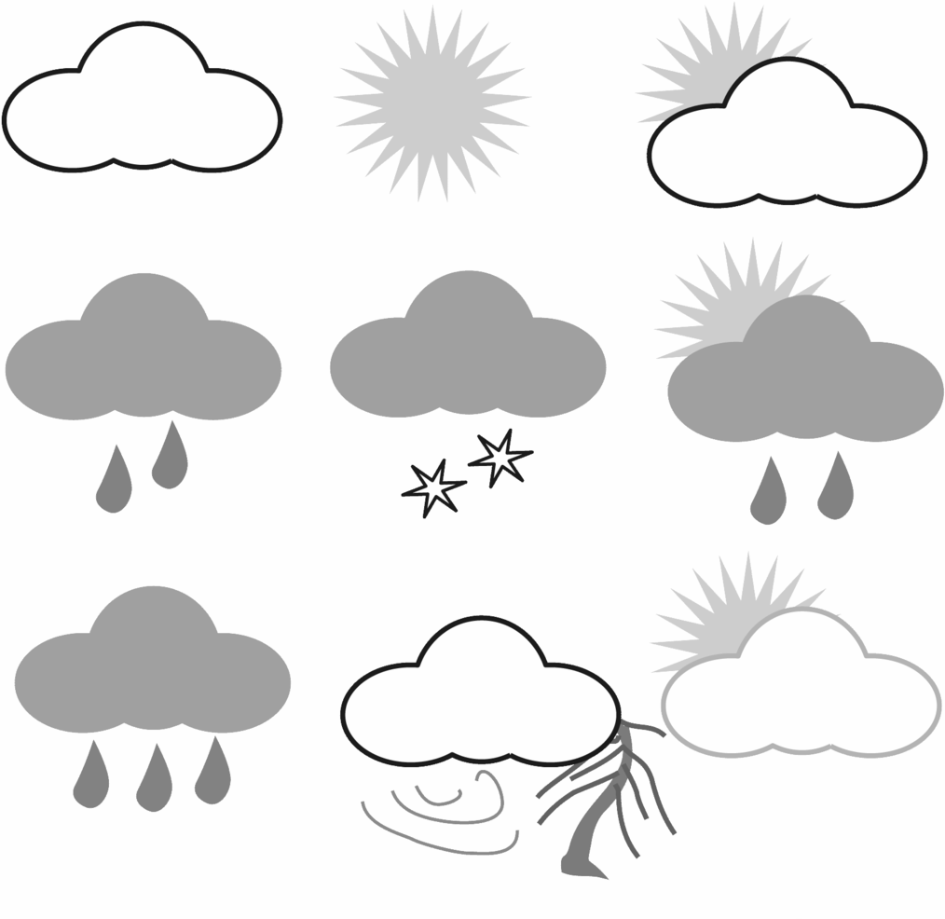
ACTIVITY: WHAT SHALL I WEAR?
To school | To a party
To the beach | For shopping
To bed | For the playground
To the zoo
Images: Faager / Public Domain

