Slide 1
Mathematics
Modelling fractions by division 1
Downloadable Resource
Mr Langton

Slide 2
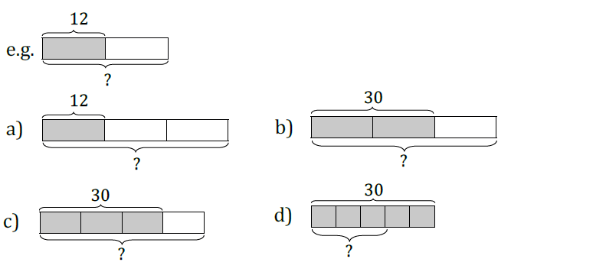
Modelling Fractions by Division 1
1. For each bar model write a matching sentence and division:
2. Calculate the following. Draw a bar model if you need to:
3. Calculate the following:

