Slide 1
Comparing fractions II
Mathematics
Mr Coward

Slide 2
Try this
Notes:
These paths are of a movements going clockwise and anti clockwise from C. It might be a bit surprising to Ss that the totals aren’t equal. The other interesting thing is that the 6 bearings can be paired to make 6 sums of 360. Ss might be prompted to notice which pairs make 360 which is somewhat interesting too

Slide 3
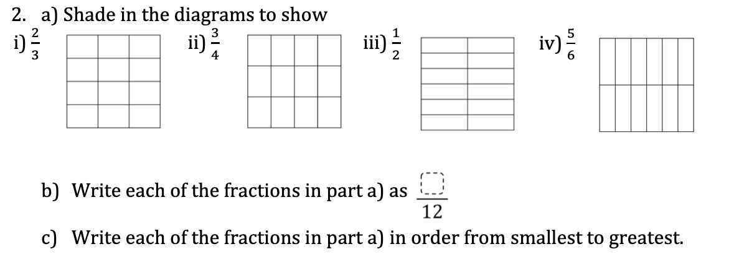
Independent task
1) a) Shade in the diagrams to show
Notes:
Students may notice that 5/6 and 3/4 can also be compared by denominating by 12ths

Slide 4
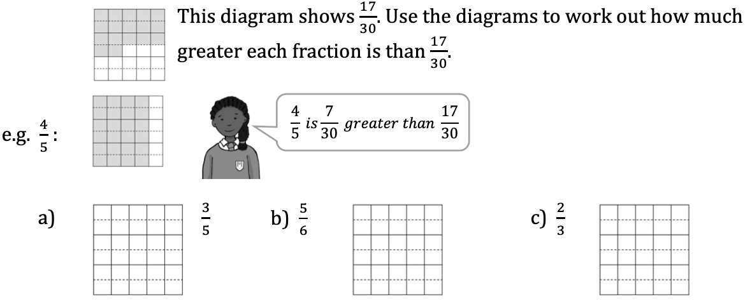
Independent task
2)
Notes:
Students may notice that 5/6 and 3/4 can also be compared by denominating by 12ths

Slide 5
Independent task
3) Use a similar method to decide which of the fractions is greater, and how much greater:
Notes:
Students may notice that 5/6 and 3/4 can also be compared by denominating by 12ths

Slide 6
Explore
A quarter of the circle is shaded blue
Two fifths of the circle is shaded yellow
What fraction remains unshaded
Notes:
Students may notice that 5/6 and 3/4 can also be compared by denominating by 12ths

