Slide 1
Use the numbers 2, 3, and 4 once to fill the calculation frames.
What different calculations can you write?
How many different answers are possible?

Slide 2
Function machines
Why are brackets necessary for one calculation but not the other?

Slide 3
Use the cards to fill in the gaps in the function machine.
Cards
Function machine
How many different machines can you make?
When do function machines give the same answers?
When do function machines give different answers?
Write each function machine as an equation.

Slide 4
2 x 3 + 7 =
4 x (5 – 3) =
8 ➗ 4 x 2 =
8 ➗ 4 + 4 =
8 ➗ (4 + 4) =
Add brackets to make the following calculations true
2 x 3 + 5 = 16
2 + 3 x 4 + 5 = 45

Slide 5
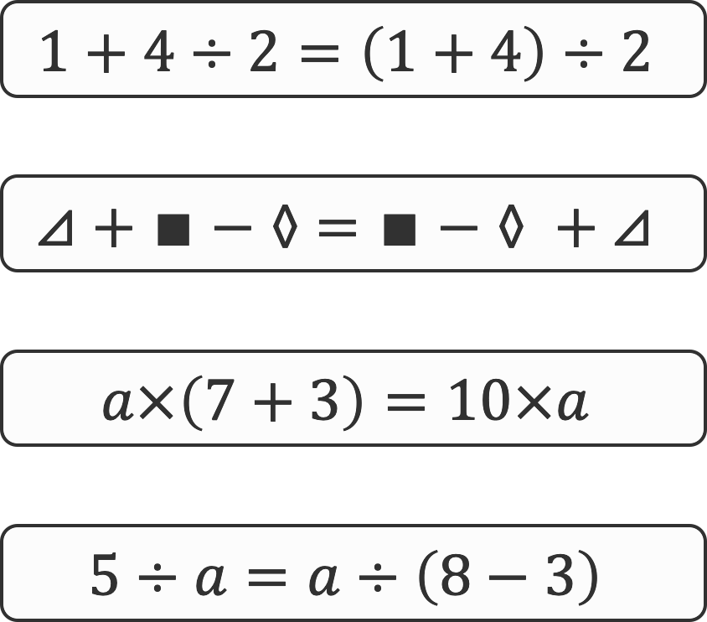
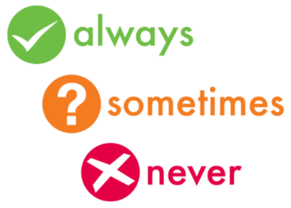
Consider each of the following statements and equations.
Decide for each if it is always, sometimes or never true.
Explain your answers.

