Slide 1
Explaining what you did/used to do (Part 2/2)
Further comparisons
Downloadable Resource
German
Herr Scales

Slide 2
häufig | frequent
ruhig | quiet
laut | loud, noisy
spannend | exciting
entspannend | relaxing
ernst | serious
locker | relaxed, easy going
faul | lazy
nützlich | useful
nutzlos | useless

Slide 3
Here is a reminder on rules for forming the comparative
Add -er to an adjective or adverb to form the comparative:
Das Auto ist billig
= the car is cheap.
Note: English uses ‘more’ to make the comparative with most adjectives of more than one syllable. German always adds -er.
Dieses Auto ist billiger
= this car is cheaper.
Das Haus ist teuer
= the house is expensive
Dieses Haus ist teurer
= this house is more expensive.
Spelling differences: -e 🡪 -er – müde 🡪 müder -el 🡪 -ler – dunkel 🡪 dunkler -er 🡪 -rer – teuer 🡪 teurer (if -er preceded by a vowel).

Slide 4
You may recall that to compare two things, we use als to mean than:
Die Busse fahren häufiger als damals
= the buses travel more frequently than back then.
Ich verstehe mehr als früher
= I understand more than in former times/before.
Use mehr (more) on its own as an adverb but never before an adjective.
So in English useful usefuler more useful
But in German nützlich mehr nützlich nützlicher

Slide 5
Der Komparativ
Most single syllable adjectives and adverbs do this: oft, alt, jung, kalt, warm, kurz, nah.
Some comparatives add an umlaut to the vowel (a, o, u):
Das Spiel war lang
= the game was long
Dieses Spiel war länger
= this game was longer
But not all!
Mein Bruder ist laut
= my brother is loud
Dein Bruder ist lauter
= your brother is louder.

Slide 6
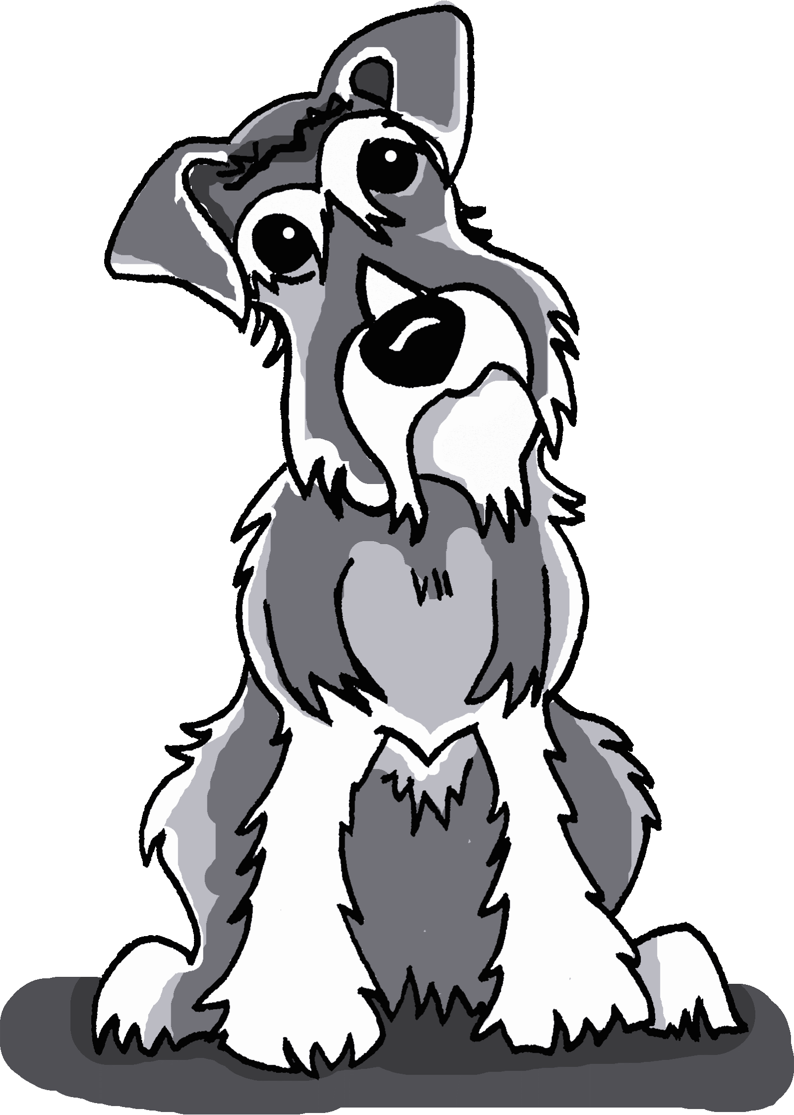
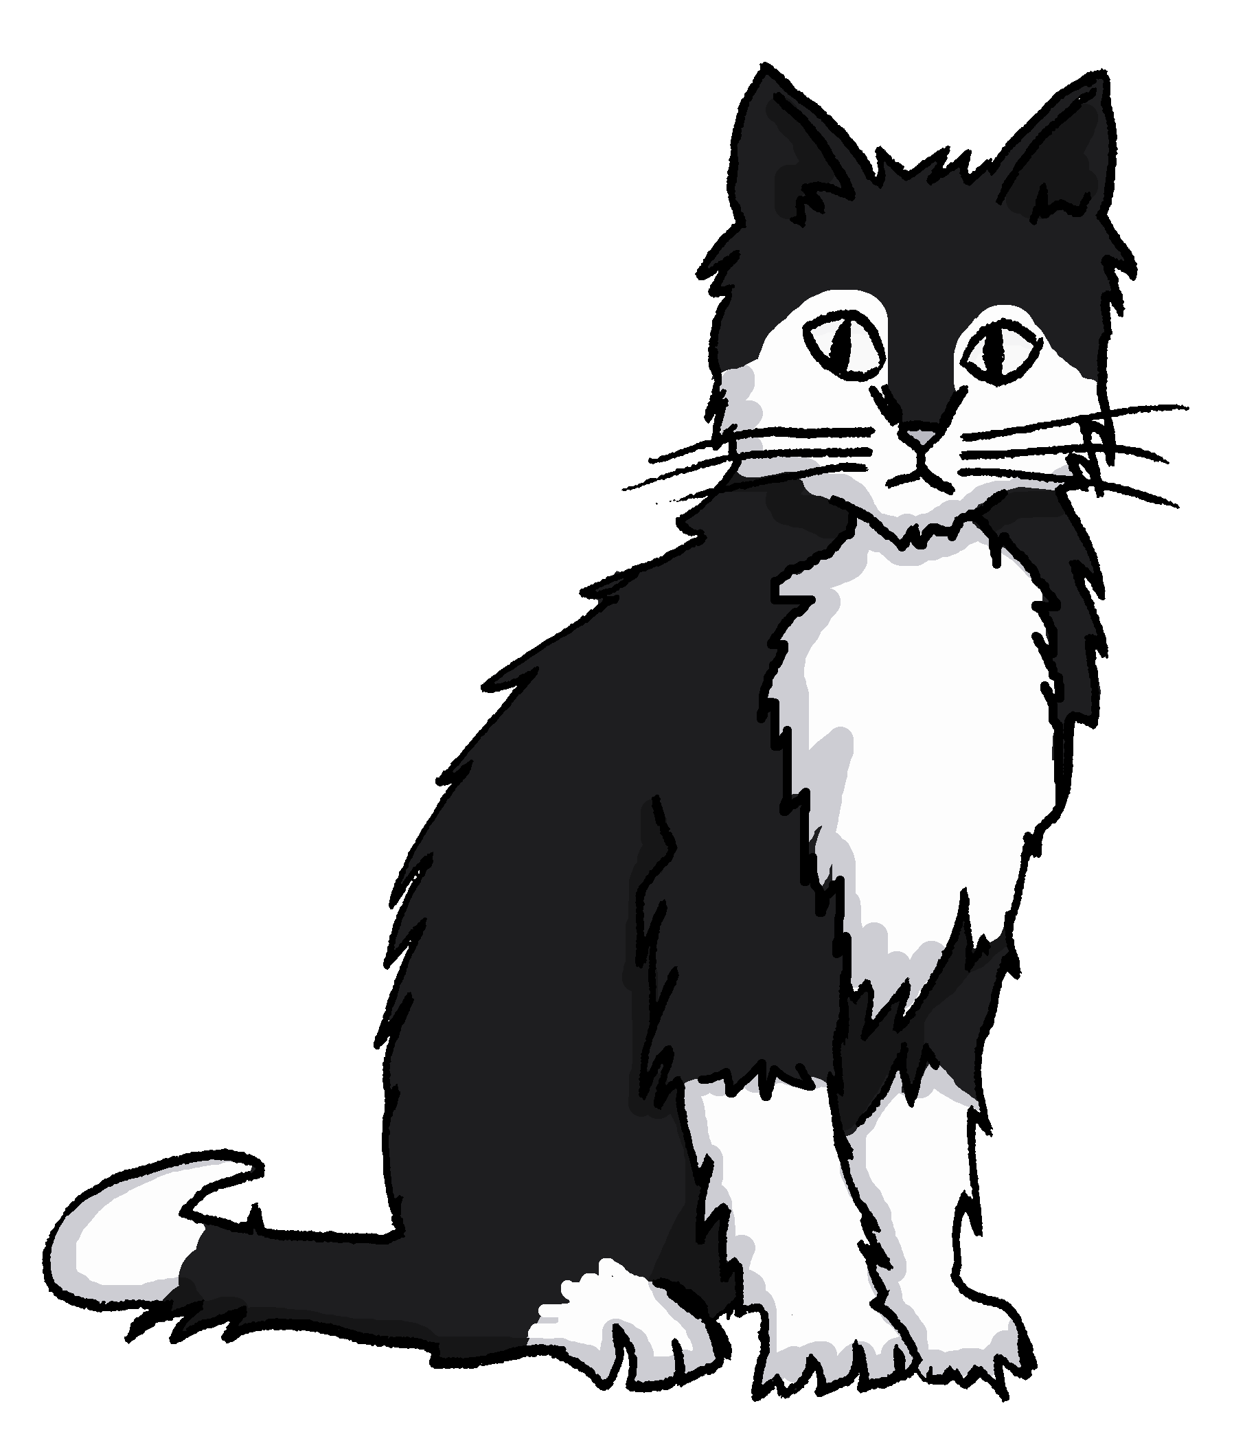
Although we might compare like this:
Einstein ist größer als Mieze.
Einstein is bigger than Mieze.
Note: we use the basic form of the adjective here
We can also turn it round and compare like this:
Mieze ist nicht so groß wie Einstein
Mieze is not as big as Einstein

Slide 7
You already know other meanings for so (so, in that way) and wie (how).
Also note the following:
Einstein ist so groß wie Mieze.
Einstein is as big as Mieze.
On its own, genau means "exactly"
Germans often add genau to the so like this:
Mieze ist genauso groß wie Einstein
Mieze is just as big as Einstein

Slide 8
Summary of learning
In German, comparatives are formed by adding - er to the adjective
Eg faul
fauler
However, sometimes you can compare using the basic form of the adjective
Eg not as lazy as =
nicht so faul wie
just as lazy as =
genauso faul wie

