Slide 1
Prime Factor Decomposition
Mr Lund
Maths
‹#›

Slide 2
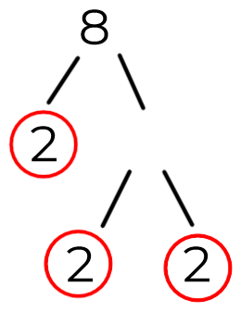
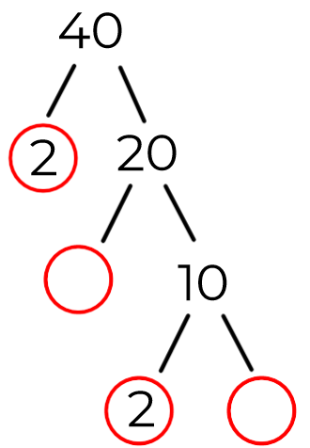
Prime Factor Decomposition
1. Work out.
a) 2 x 2 x 2
b) 3 x 3 x 7
c) 3 x 5 x 5 x 11
2. Match the number cards with their index form.
3. Complete these prime factor trees.
a) b)
2 x 2 x 2
3 x 3 x 7
3 x 5 x 5 x 11
‹#›

Slide 3
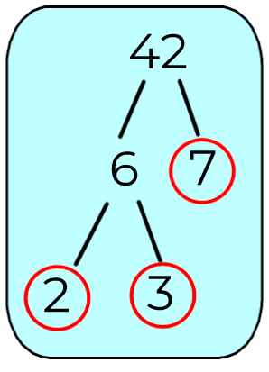
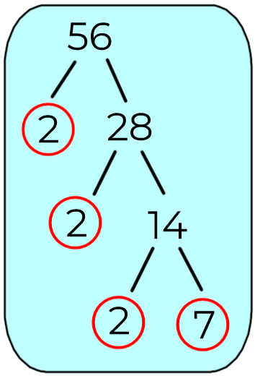
Prime Factor Decomposition
4. Match the factor trees to the correct expressions in index form.
Which expression doesn’t match? Why?
5. Amir uses a table to find the prime factors of 63.
Draw a prime factor tree for 63
Which method do you prefer?
6. In Index form find the product of prime factors.
a) 105 b) 81 c) 52
‹#›

Slide 4
Answers
‹#›

Slide 5
Prime Factor Decomposition
1. Work out.
a) 2 x 2 x 2
b) 3 x 3 x 7
c) 3 x 5 x 5 x 11
2. Match the number cards with their index form.
3. Complete these prime factor trees.
a) b)
= 8
= 63
= 825
4
2
2 x 2 x 2
5
3 x 3 x 7
3 x 5 x 5 x 11
‹#›

Slide 6
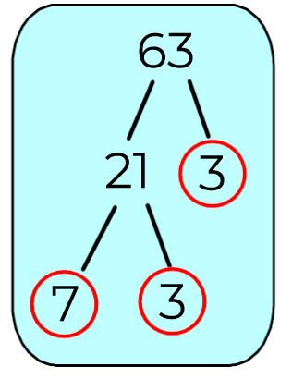
Prime Factor Decomposition
4. Match the factor trees to the correct expressions in index form.
Which expression doesn’t match? Why?
5. Amir uses a table to find the prime factors of 63.
Draw a prime factor tree for 63
Which method do you prefer?
6. In Index form find the product of prime factors.
a) 105 b) 81 c) 52
8 x 7, it is not a product of primes.
‹#›

