Slide 1
Following a route around a map
Independent Task
Mathematics
Miss Mitchell

Slide 2
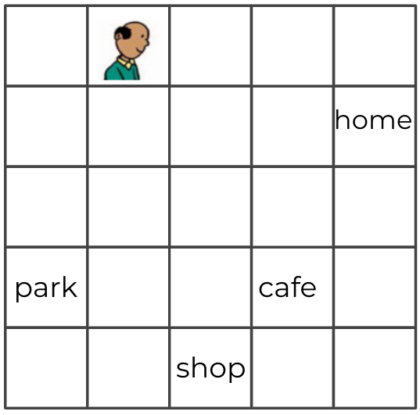
1. Tom walks 3 steps down and turns 1 step to the left. Where is he?
2. Tom walks 4 steps down and turns 1 step to the right. Where is he?
Notes:
Why do we use standard units? Why not non standard units?

Slide 3
3. Tom walks 2 steps to the right and 3 steps down. Where does he end up?
4. Finally, Tom walks 3 steps to the right and one step down. Where does he go?
Notes:
Why do we use standard units? Why not non standard units?

Slide 4
Challenge - Describe the route from Tom’s home to the park.
Notes:
Why do we use standard units? Why not non standard units?

