Slide 1
Mathematics
Partitioning 2-digit numbers
Miss Hughes

Slide 2
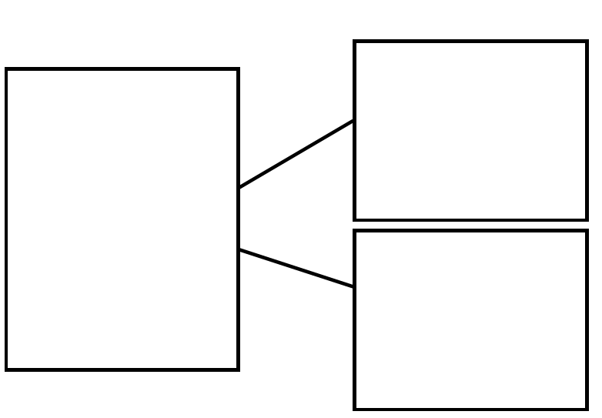
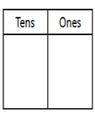
Independent Task
Make 68 using a
bead string and/or
Dienes.
Partition 68 in as
many different ways
as you can.
Use place value
charts, part-whole
models and
equations to
represent how you
have partitioned 68.
+
=
Notes:
Let’s have a look at our lesson agenda to see our learning journey for today.
We are going to start off by looking at grouping different items into tens and ones (New learning),
Then we will be thinking about the different strategies we can use when problem solving,
Next, we will explore groups and leftovers together and then you will get the opportunity to complete your independent task.
Finally, we check how much you have remembered in our final quiz.

Slide 3
Independent Task - Answers
Make 68 using a
bead string and/or
Dienes.
Partition 68 in as
many different ways
as you can.
Use place value
charts, part-whole
models and
equations to
represent how you
have partitioned 68.
60
+
8
=
68
10
+
58
=
68
50
+
18
=
68
0
+
68
=
68
40
+
28
=
68
30
+
38
=
68
20
+
48
=
68
Source: Miss ‘Hughes
Notes:
Let’s have a look at our lesson agenda to see our learning journey for today.
We are going to start off by looking at grouping different items into tens and ones (New learning),
Then we will be thinking about the different strategies we can use when problem solving,
Next, we will explore groups and leftovers together and then you will get the opportunity to complete your independent task.
Finally, we check how much you have remembered in our final quiz.

