Slide 1
Oak Specialist
Independent Living Unit 5 - World of Work
Applying Learning

Slide 2
Unit 5- World of Work
Lesson 1 - The benefits of work
Lesson 2 - Different types of work
Why do we work? This lesson explores what’s good about getting a job.
Not all jobs are the same. This lesson looks at understanding what a job family is and the different types of tasks that can be done.
Option 3
Lesson 4 - Routes into employment
Lesson 3 - Vocational profiling
Option 4
What is a vocational profile and how can it help you?
What are the different ways to get a job. Which route is right for you?
Lesson 5 - Getting a job
Lesson 6 - Workplace behaviour
Option 3
Option 4
Where should you look for jobs? Understanding Interviews and reasonable adjustments
How is work different to school or college? What rules are the same and what ones are different?
Notes:
Depending on how many lessons for each unit, there could be a 2nd page for lesson 5…etc

Slide 3
Lesson 2 - Different types of work

Slide 4
Teacher notes- Lesson 2
-Learning intention:
To understand that there are many different types of businesses that can be grouped into ‘job families’.
To know that some businesses have lots of different types of Job.
The student will be helped to group jobs by their ‘family’
The student will learn what types of task a job involves
Learning will be reinforced through a question and answer game
This lesson should be taught before moving onto the Vocational Profile lesson found in this Unit as it will prepare the learner to be able to answer: ‘what job family and task type would suit you? Think of some businesses local to you that match these.’
Resources needed: Pen and paper

Slide 5
World of Work
Different types of work
Applying Learning

Slide 6
Lesson Activity Stages
This lesson will be taught in 3 parts-
Grouping similar types of business
Understanding the types of task each job has
“I’m a job, i’m a job what job am I?”
Notes:
Share with the student the purpose of the lesson and the things you will be doing together

Slide 7
Part 1 - Job families
Businesses that do a similar thing to each other are said to be in the same ‘Job Family’
For example:
Primark, M & S, Sports Direct and Argos all sell things (products) to customers for them to use themselves. These shops are said to be in the retail job family.
Notes:
Does the student recognise any of the images below? Could they suggest another example of a ‘retail’ outlet?

Slide 8
Job families
Over the next 3 slides you will see 6 different pictures of businesses.
3 pictures on each slide belong to one job family and 3 from a different family.
Can you identify which pictures go together?
Do you know the name of the job family?
Notes:
In the slides there will be overlap with some jobs having similarities but belonging to different job families. It is important to discuss this and whether this forms the ‘main part’ of the job.

Slide 9
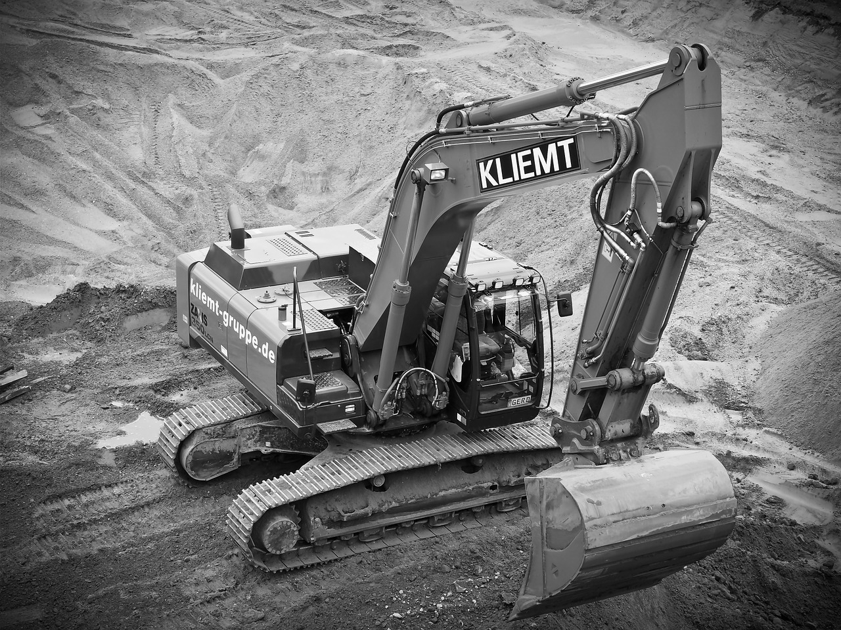
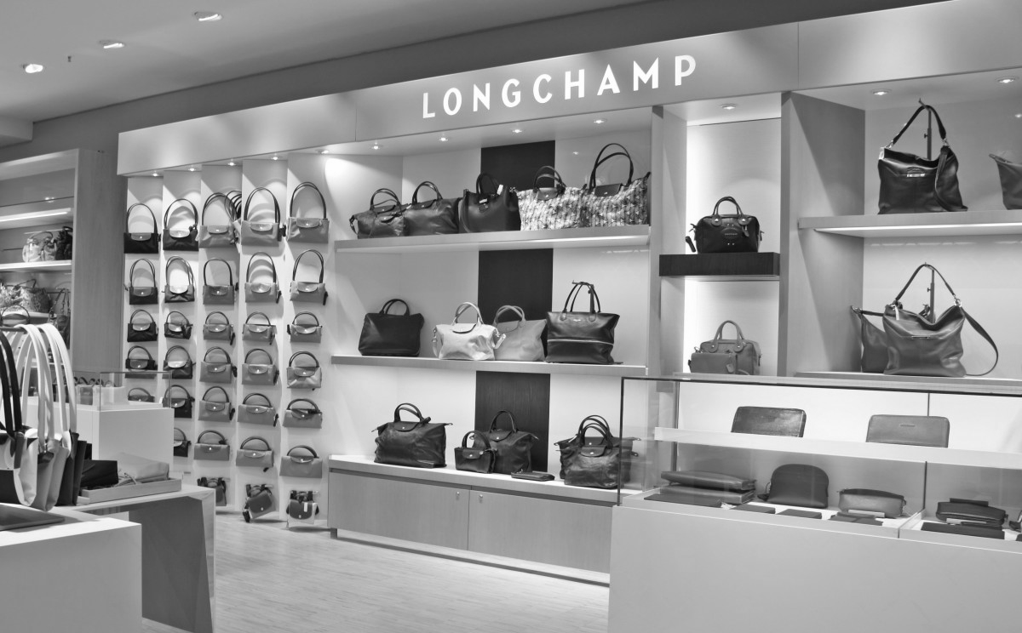
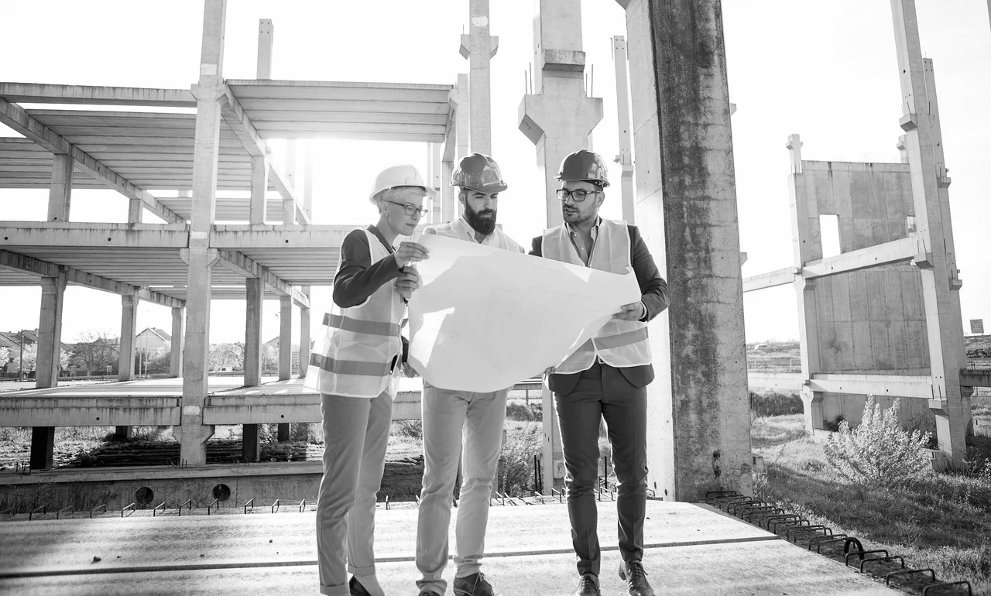
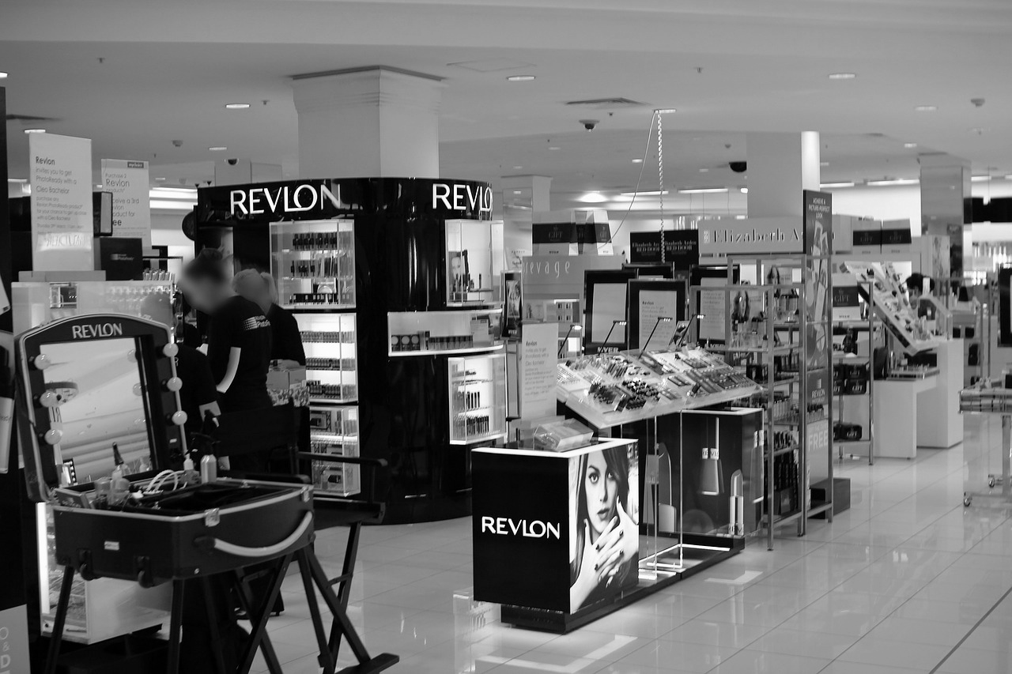
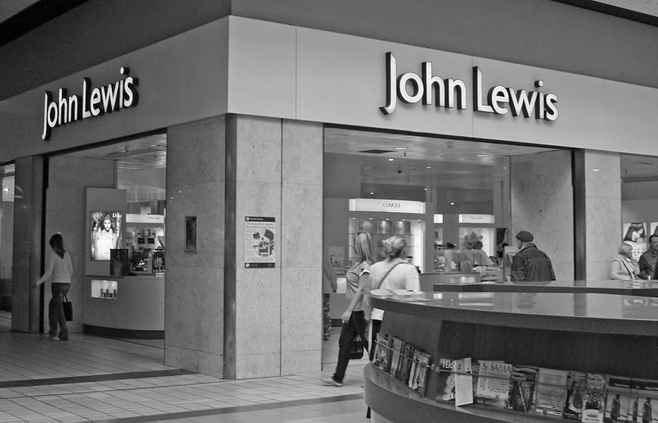
Job families
Which pictures go together to make a job family?
Notes:
Talk through each picture in turn. What is happening in the image? If they can spot the familiarity can they suggest a title for the job family for example ‘building’.

Slide 10
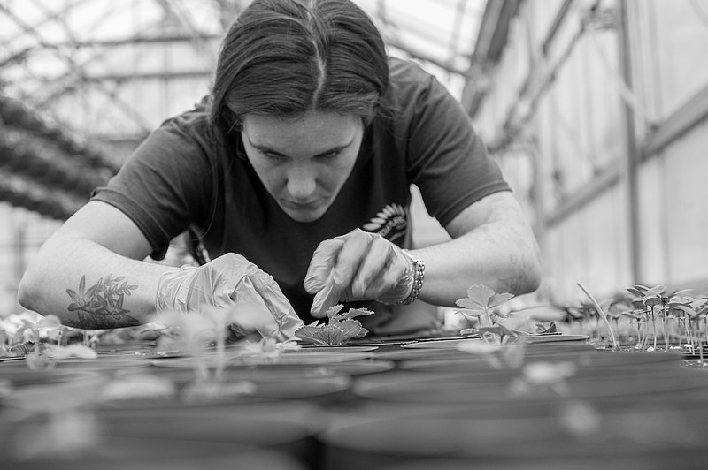
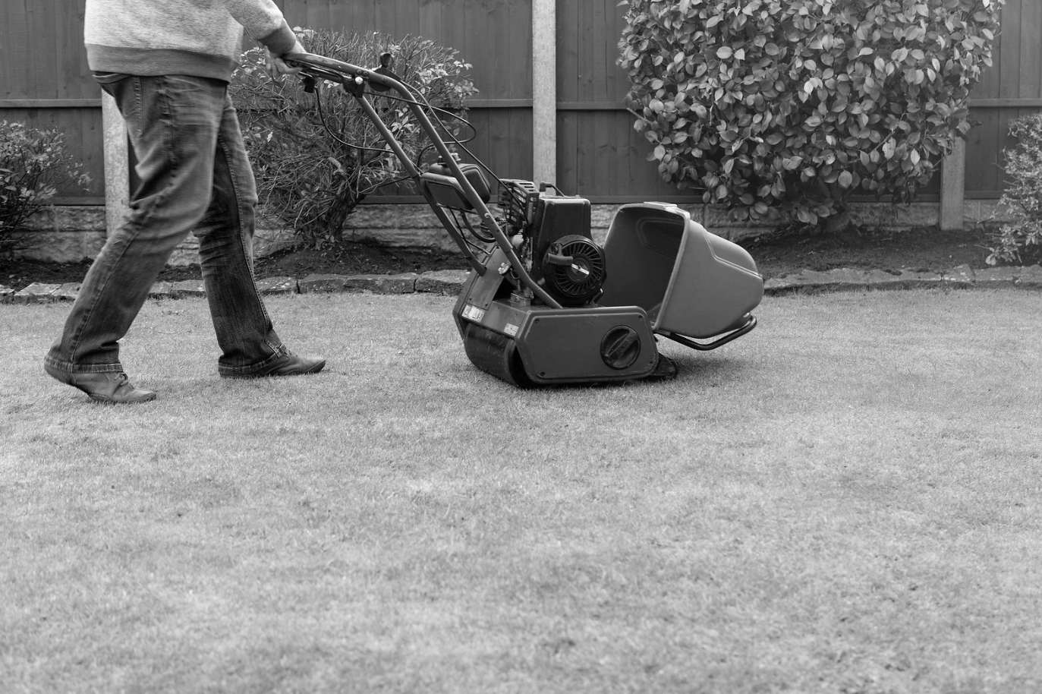
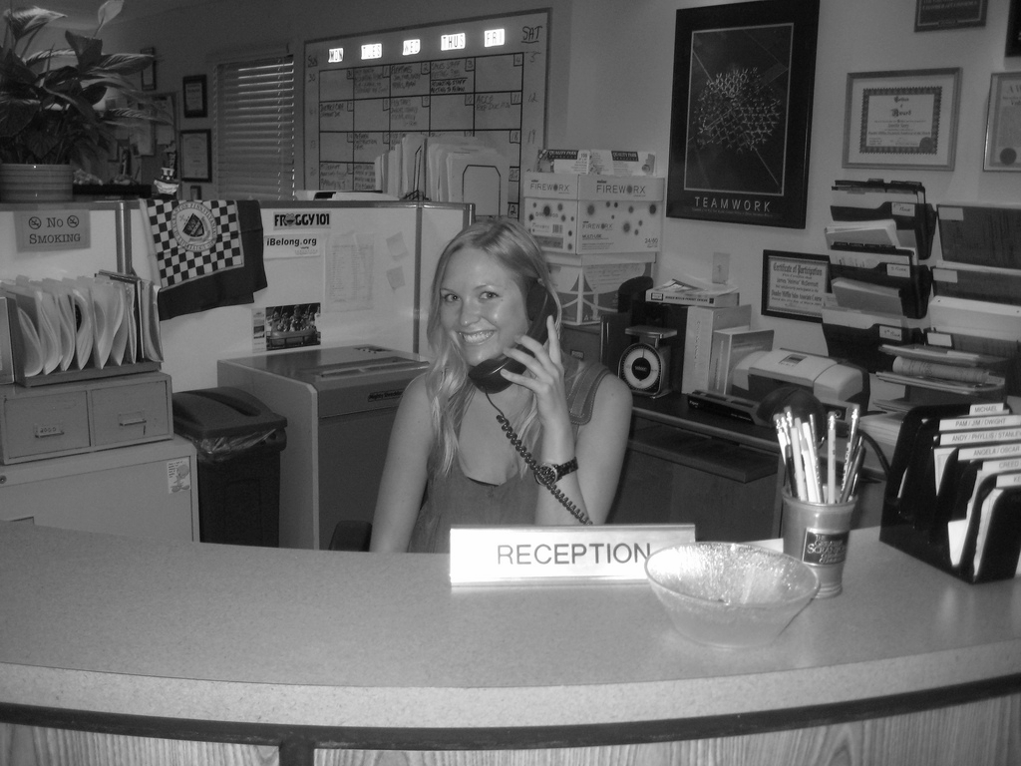
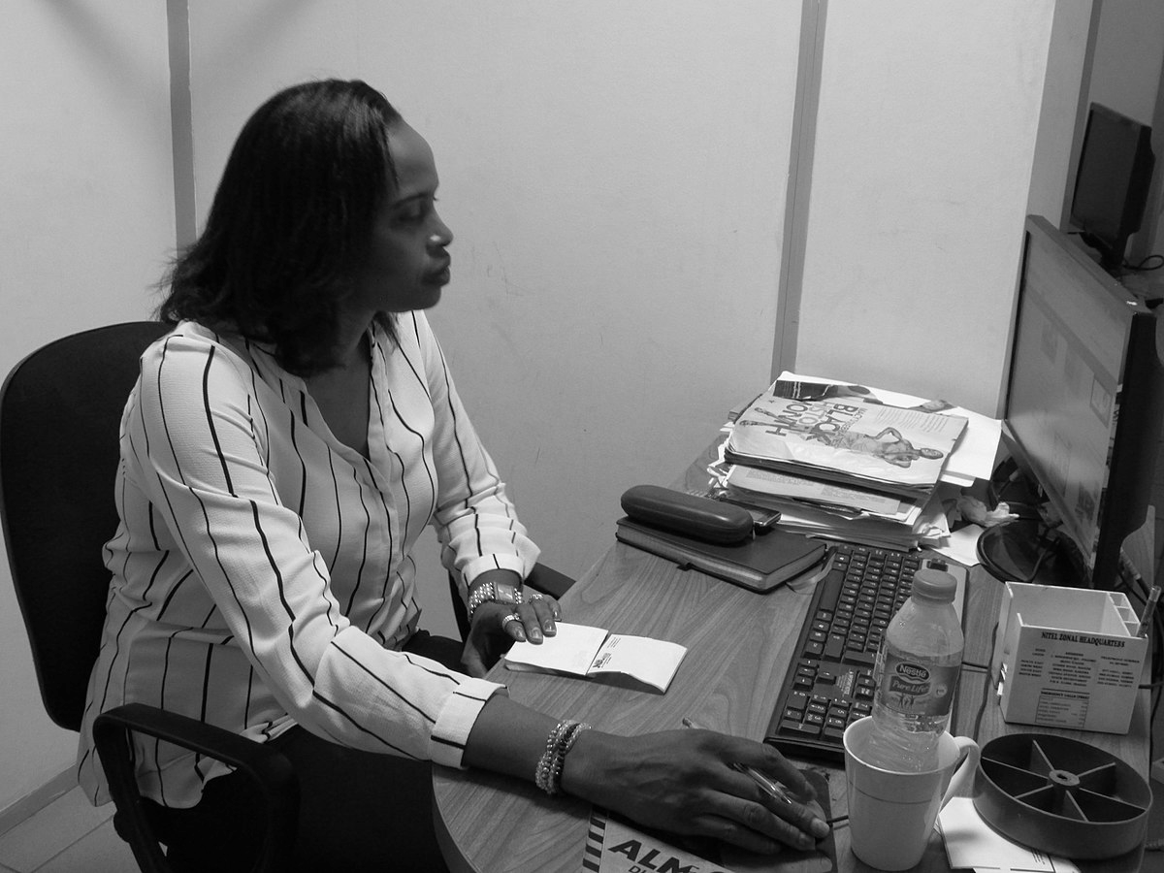
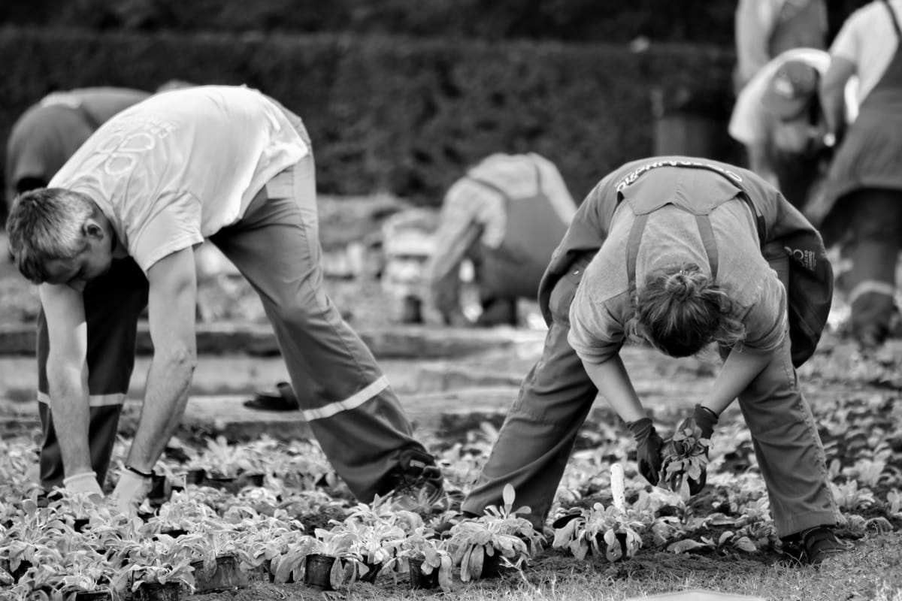
Job families
Which pictures go together to make a job family?
Notes:
Talk through each picture in turn. What is happening in the image? If they can spot the familiarity can they suggest a title for the job family for example ‘building’.

Slide 11
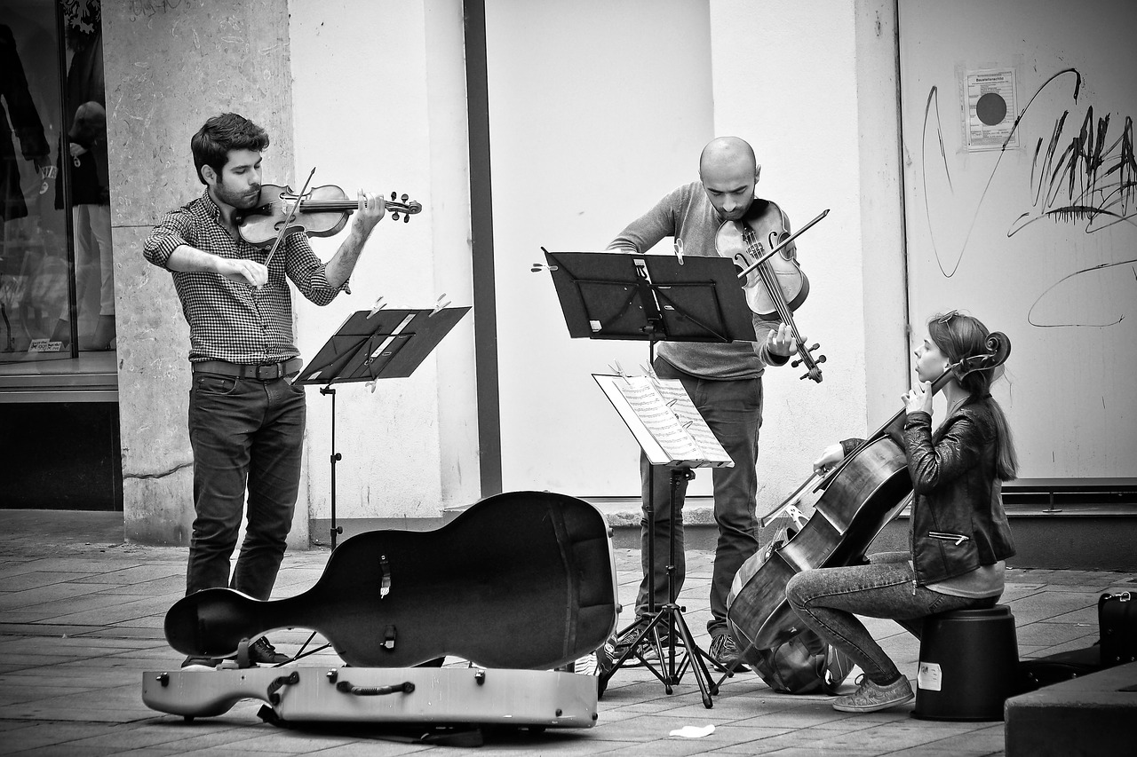
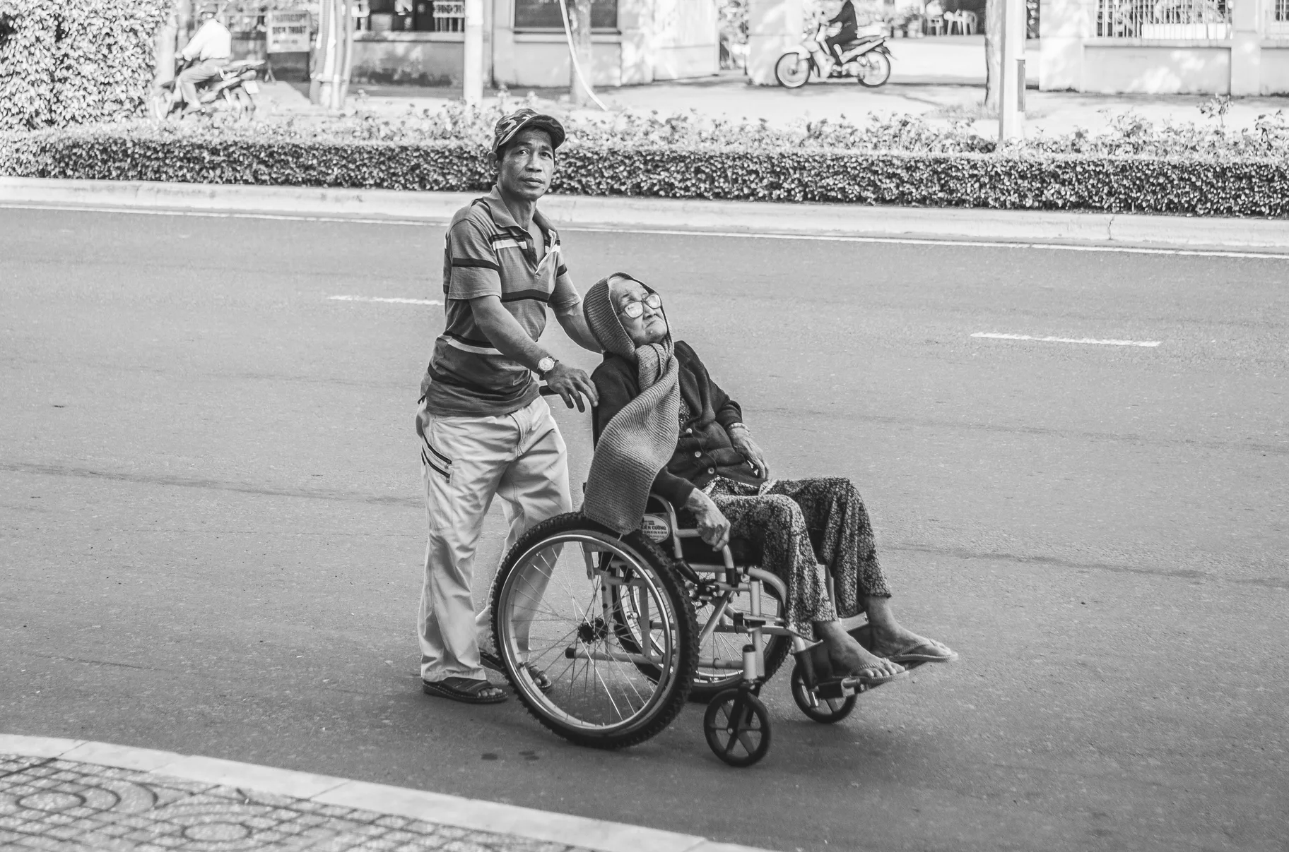
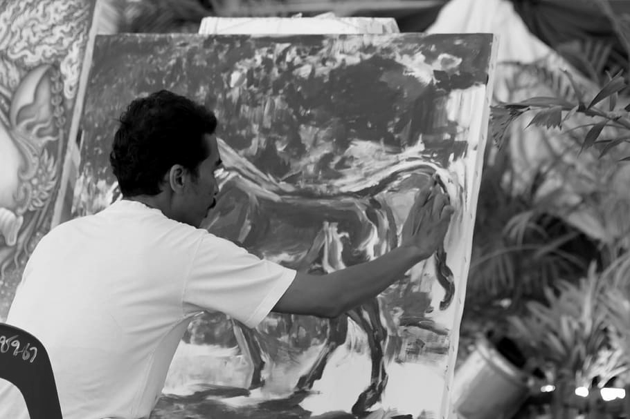
Job families
Which pictures go together to make a job family?
Notes:
Talk through each picture in turn. What is happening in the image? If they can spot the familiarity can they suggest a title for the job family for example ‘building’.

Slide 12
Job families
How did you do? Check your answers on the following slides.

Slide 13
Job Families
Construction
Notes:
Did they spot the job family? Were there any that surprised them as going together. See if the job family names match up to the ones you had.

Slide 14
Job Families
Retail
Notes:
Did they spot the job family? Were there any that surprised them as going together. See if the job family names match up to the ones you had.

Slide 15
Job Families
Administration
Notes:
Did they spot the job family? Were there any that surprised them as going together. See if the job family names match up to the ones you had.

Slide 16
Job Families
Horticulture
Notes:
Did they spot the job family? Were there any that surprised them as going together. See if the job family names match up to the ones you had.

Slide 17
Job Families
Care
Notes:
Did they spot the job family? Were there any that surprised them as going together. See if the job family names match up to the ones you had.

Slide 18
Job Families
Creative
Notes:
Did they spot the job family? Were there any that surprised them as going together. See if the job family names match up to the ones you had.

Slide 19
Part 2 - Task Type
There is normally more than just one task taking place in a business, but often these tasks can be grouped together by type.
For example:
As a gardener you may plant seeds, put plants in pots or turn over the compost. As a builder you might lay a concrete slab, dig a hole or carry bricks.
All these tasks are examples of manual labour meaning that you would be expected to use your hands and body to complete the task.
Notes:
This task activity is designed to get the student understanding that there are different types of task in one job. Through discussion encourage the student to think about the types of task they enjoy and don’t enjoy or find more challenging.

Slide 20
Task type
Over the next three slides you will see different pictures of tasks.
Can you spot what the similarity is between all of these pictures?

Slide 21
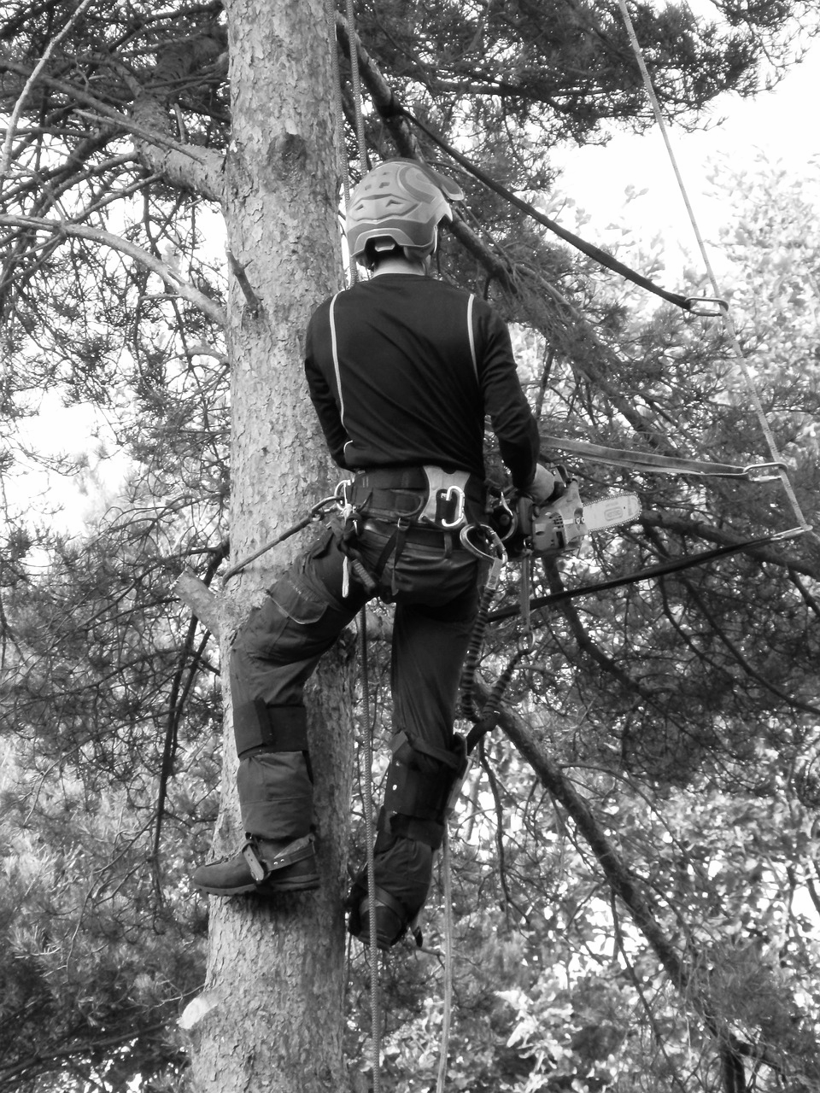
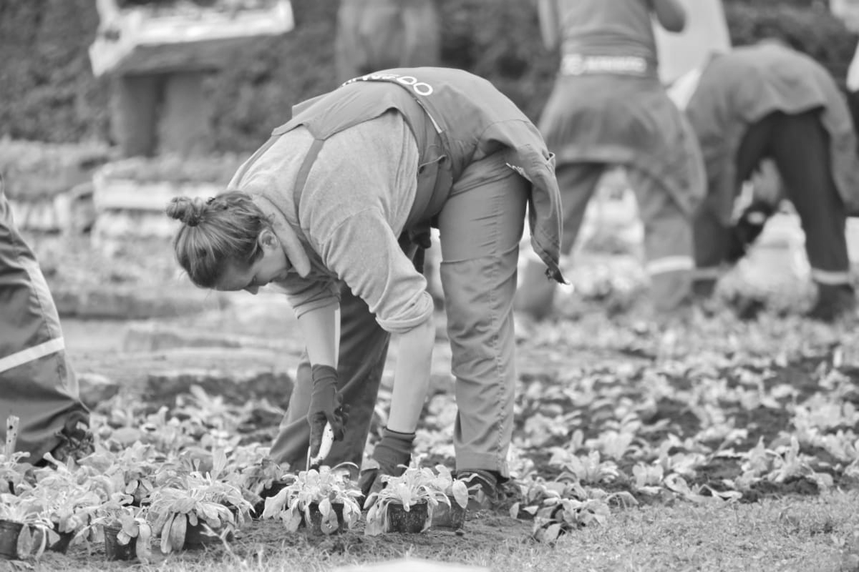
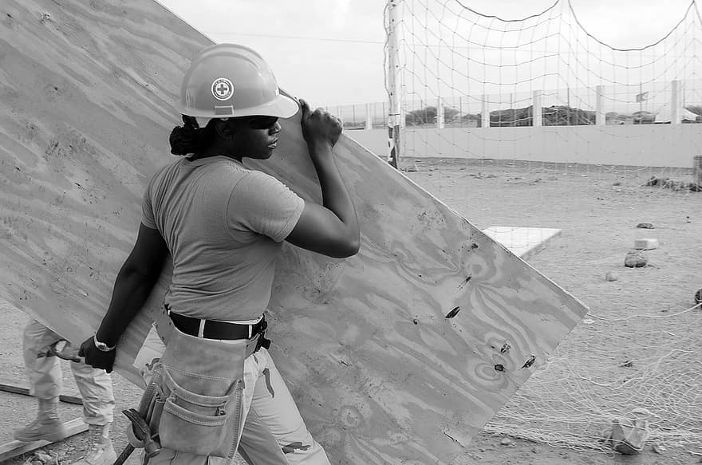
Task type
Can you spot a similarity?
Notes:
Discussion point: working with your hands, working outdoors.
This task activity is designed to get the student understanding that there are different types of task in one job. Through discussion encourage the student to think about the types of task they enjoy and don’t enjoy or find more challenging.

Slide 22
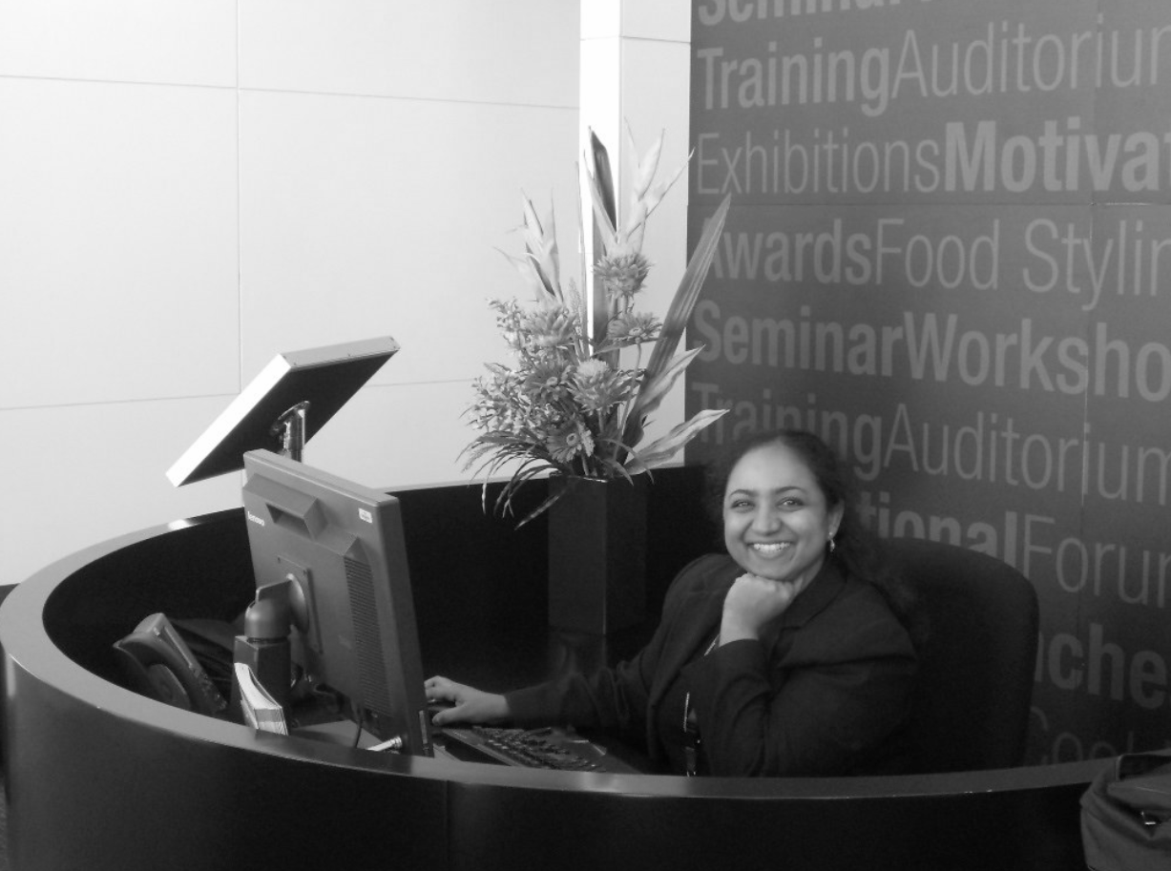
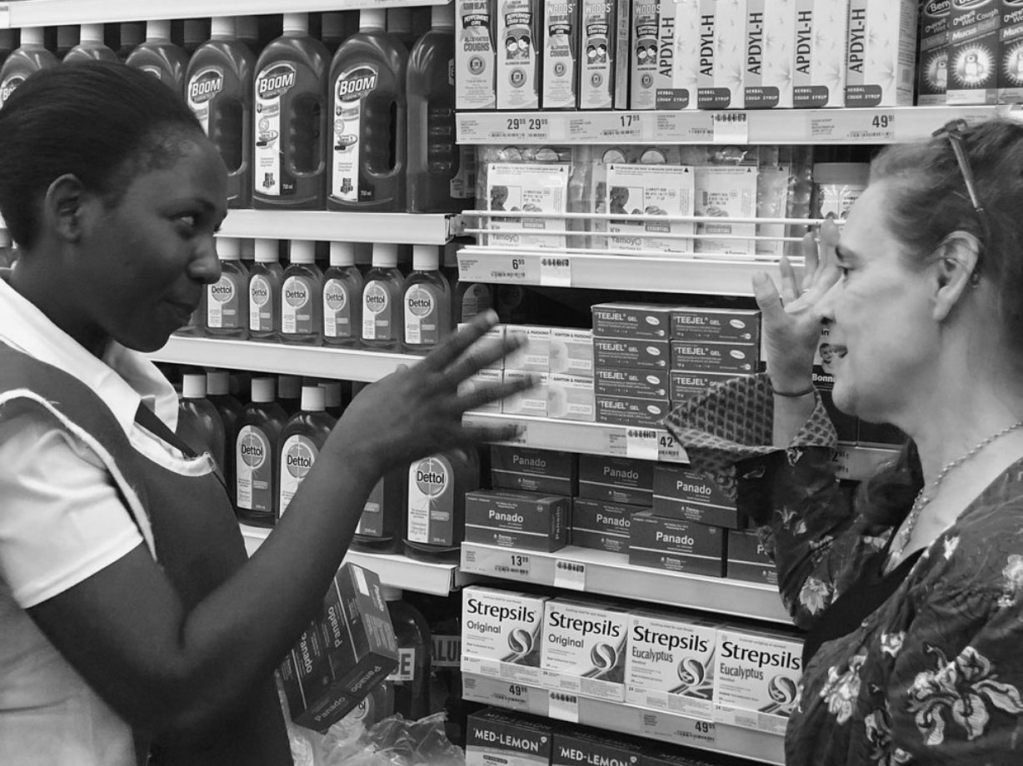
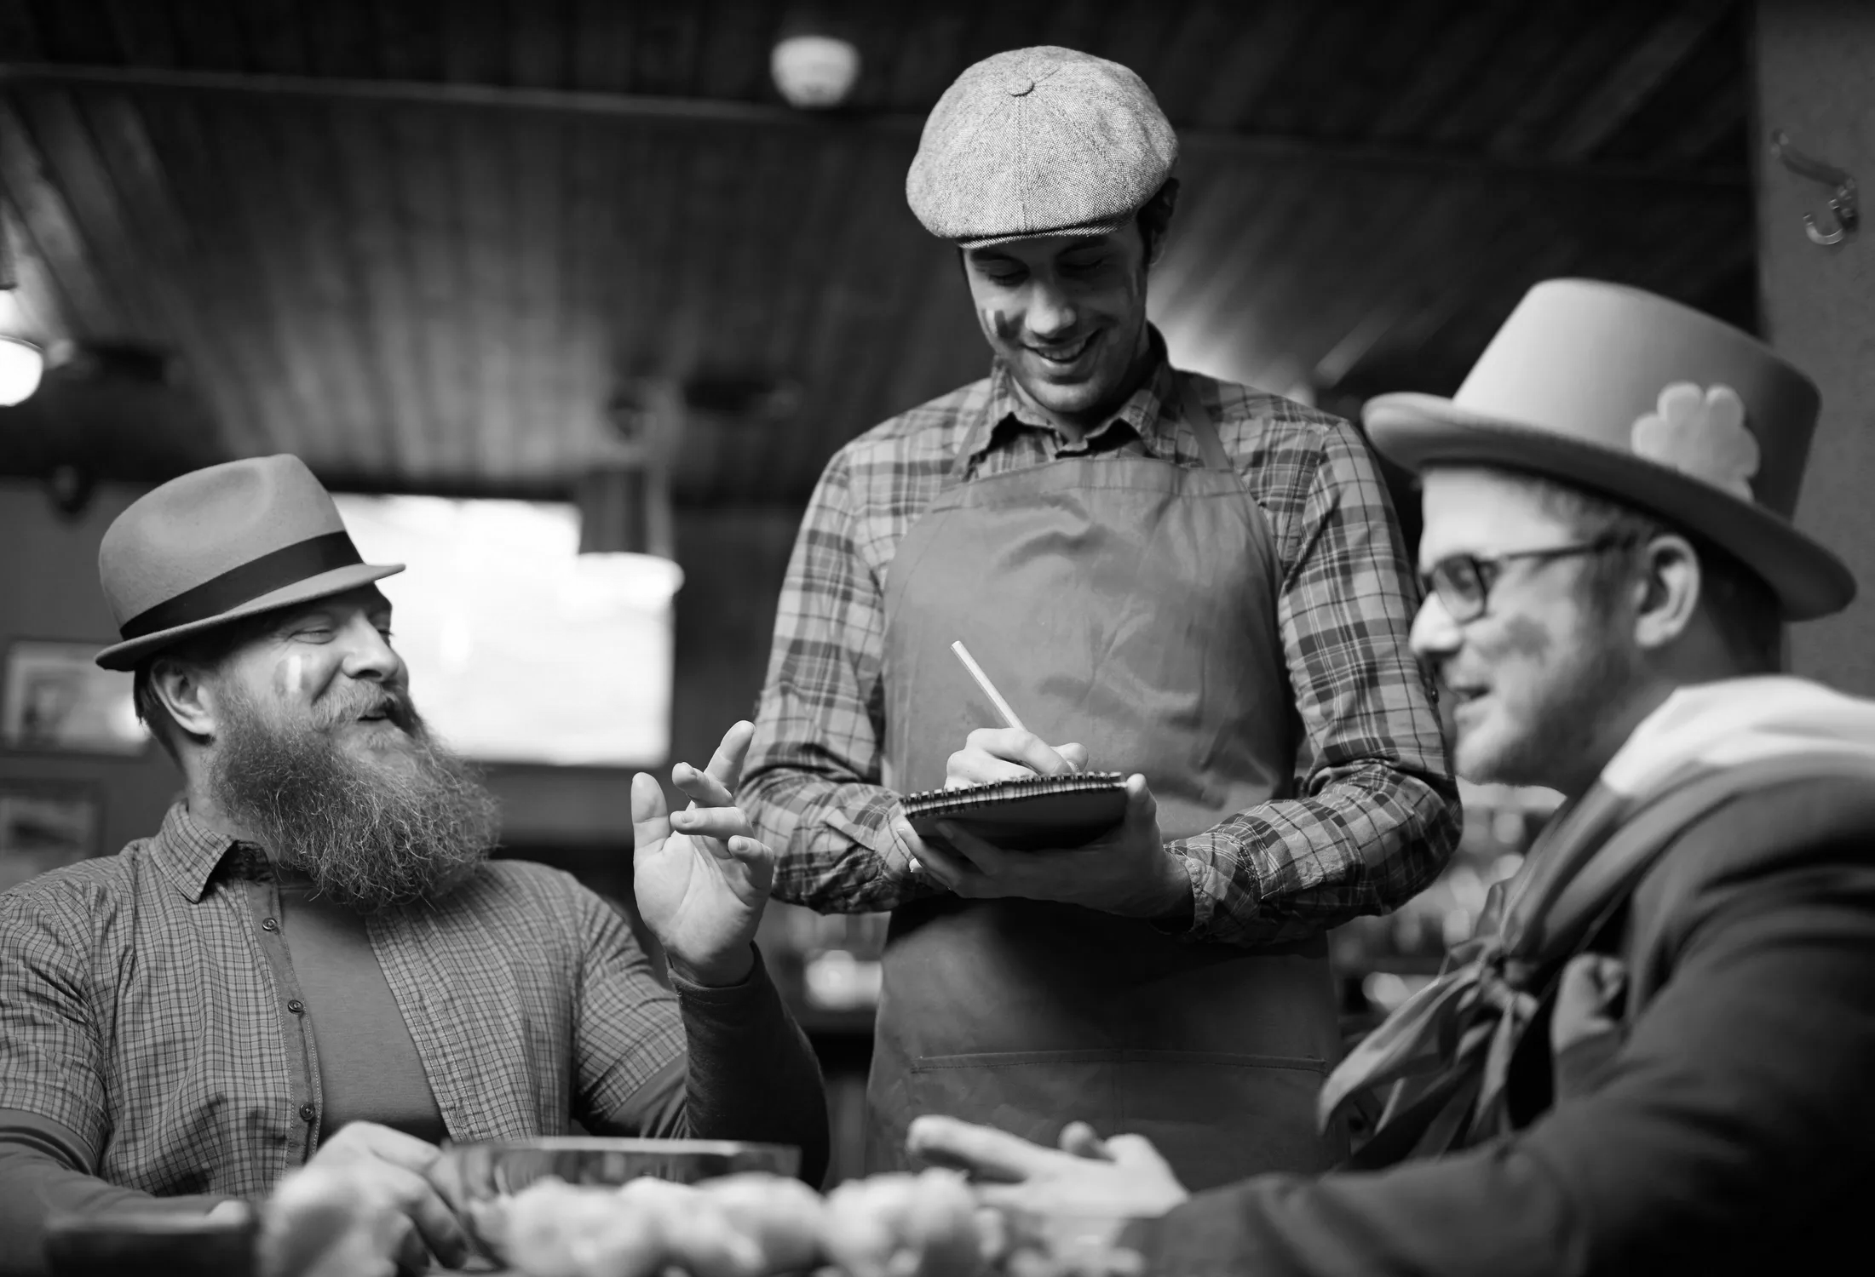
Task type
Can you spot a similarity?
Notes:
Discussion point: customer facing roles, interacting with people, communicating.
This task activity is designed to get the student understanding that there are different types of task in one job. Through discussion encourage the student to think about the types of task they enjoy and don’t enjoy or find more challenging.

Slide 23
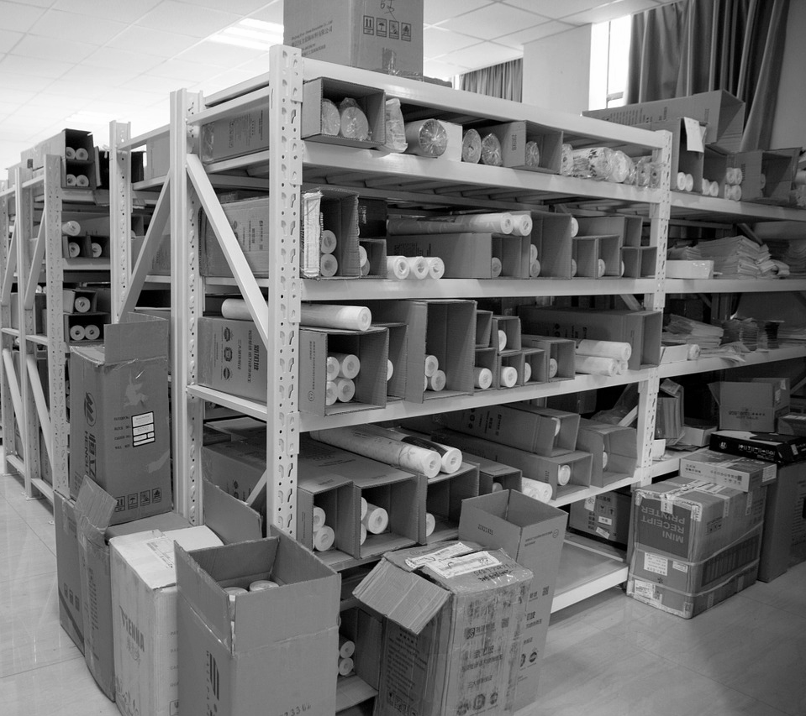
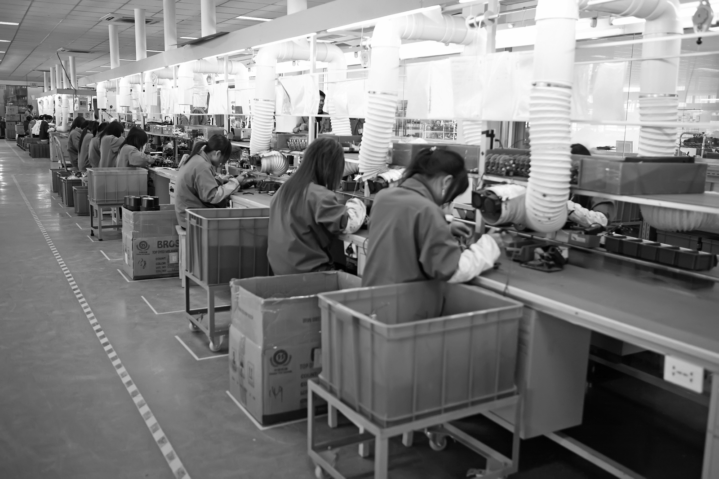
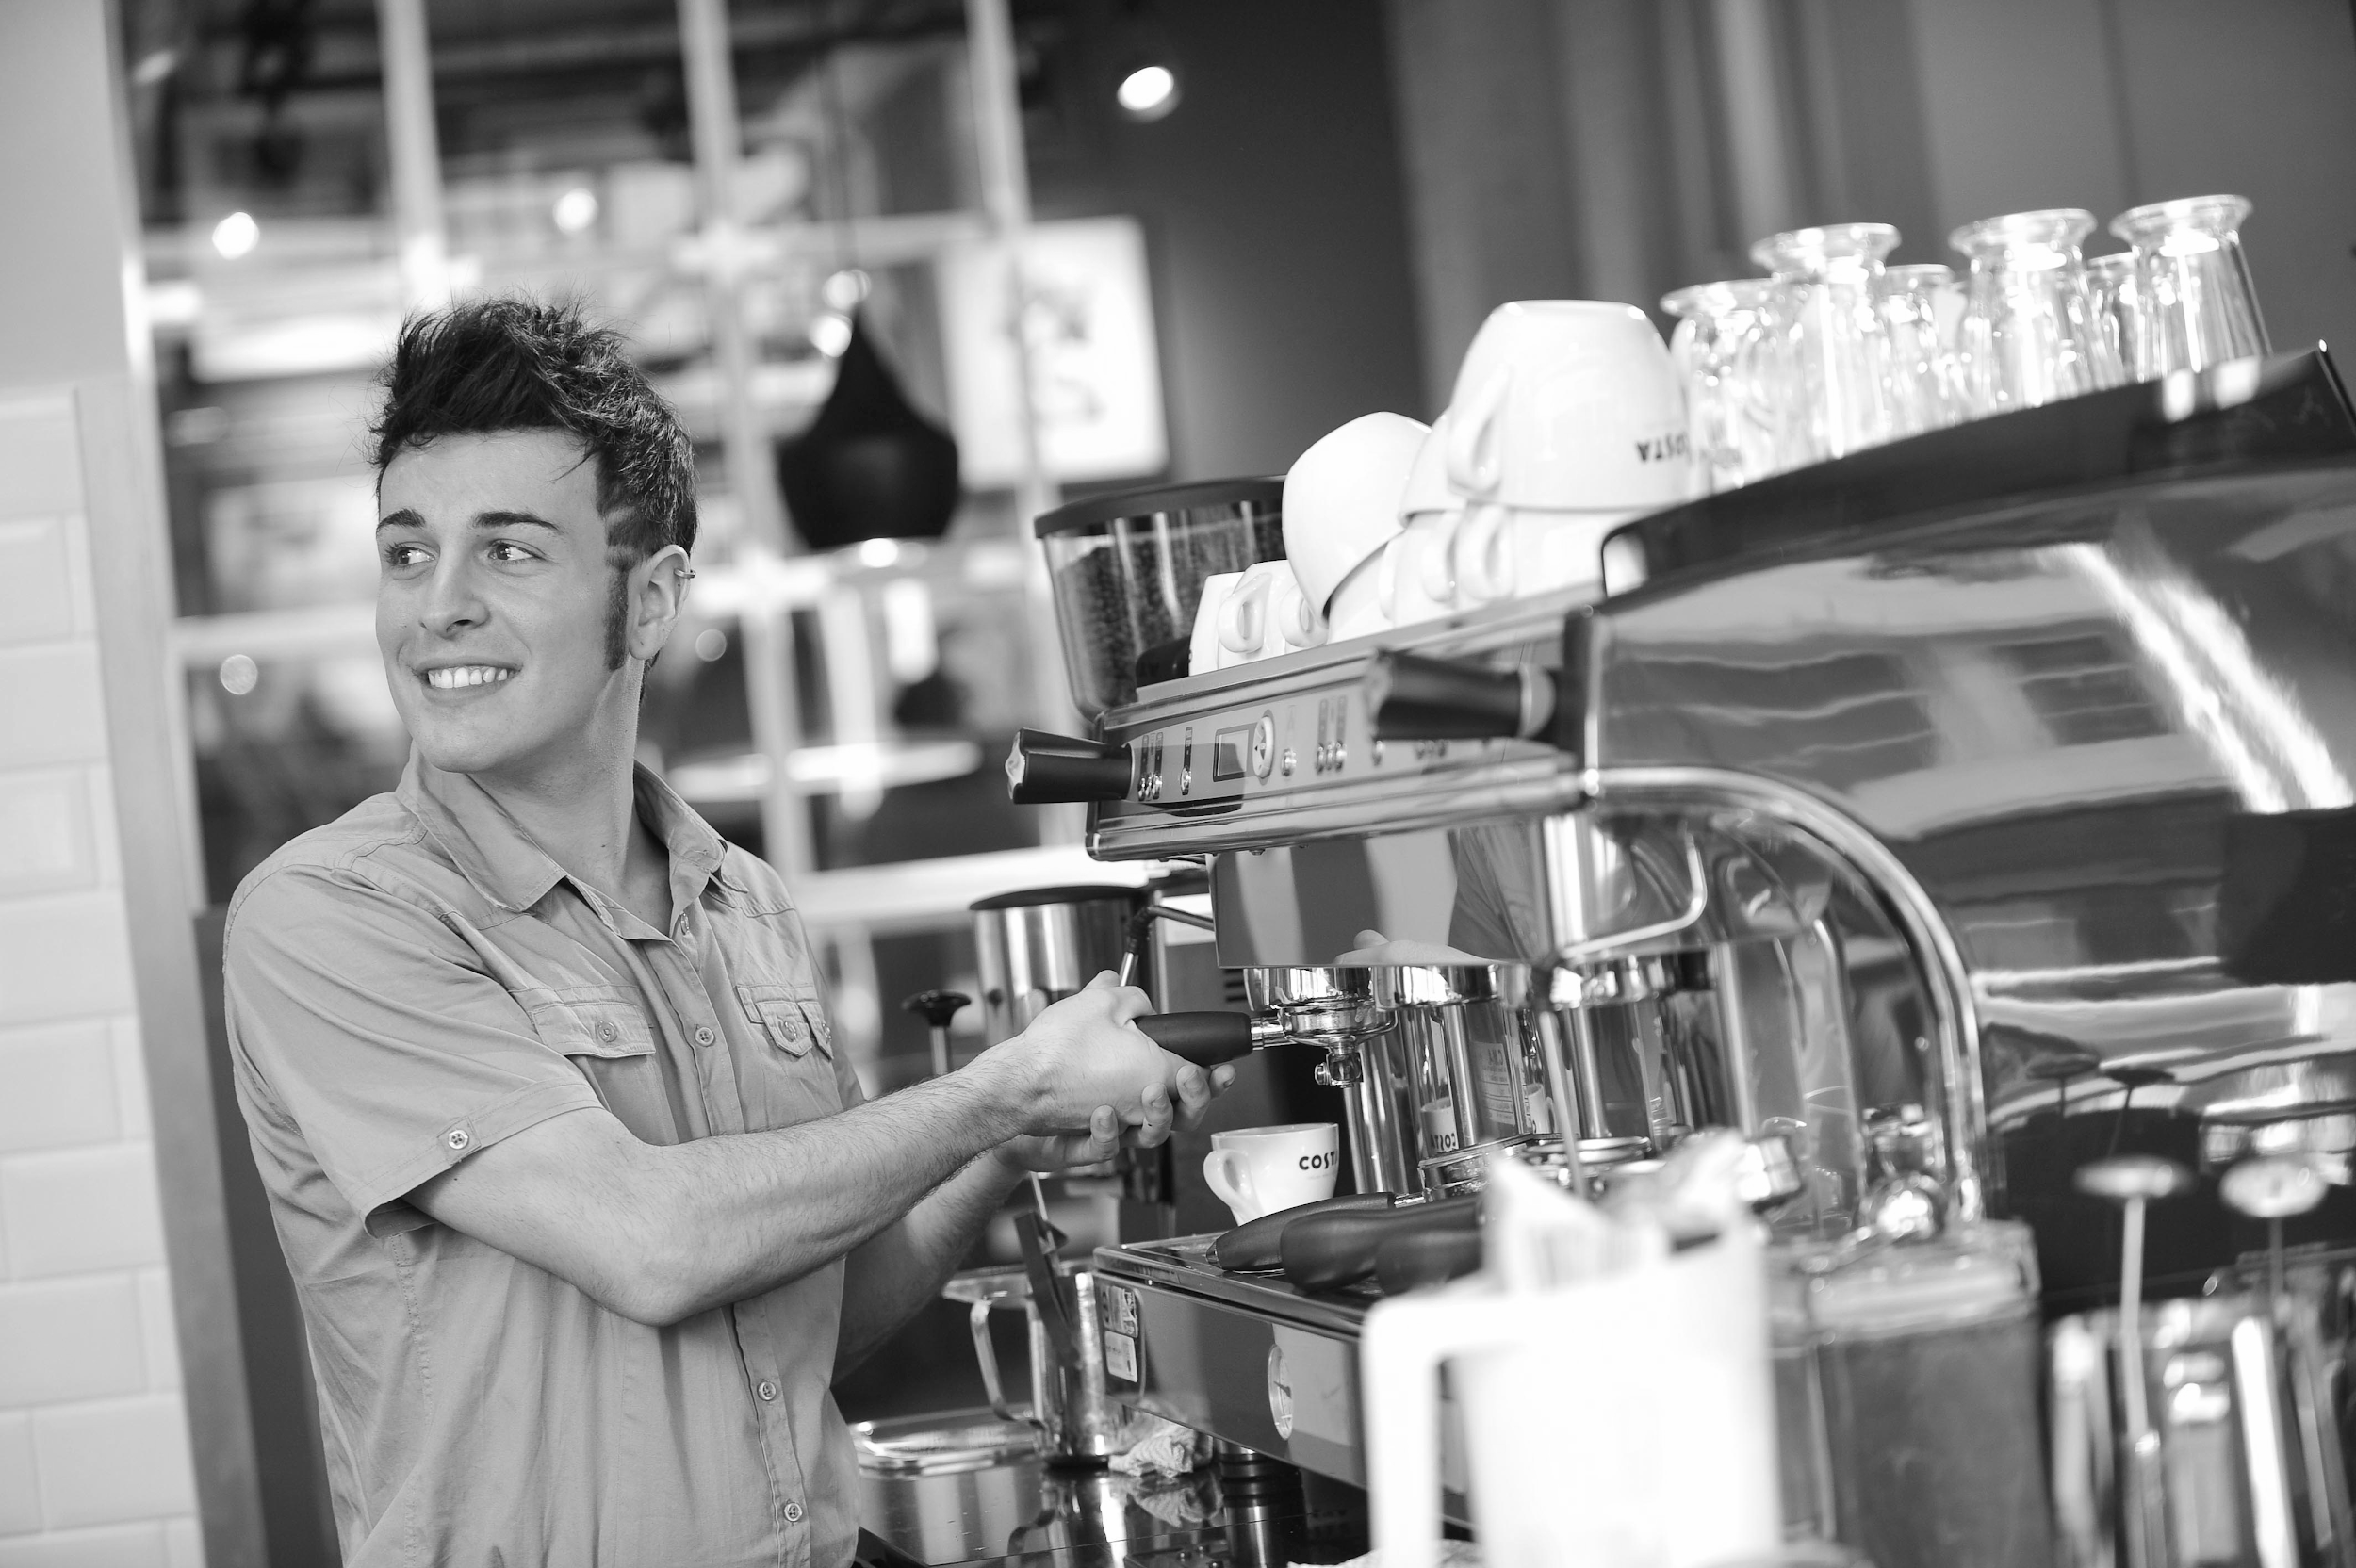
Task type
Can you spot a similarity?
Notes:
Discussion point: Manual task, indoors, often repetitive.
This task activity is designed to get the student understanding that there are different types of task in one job. Through discussion encourage the student to think about the types of task they enjoy and don’t enjoy or find more challenging.

Slide 24
Task Type | Explanation | Examples of jobs
Manual | Involves working physically with your hands or body | Builder, gardener, refuse collector, porter, baggage handler
Customer facing | Interacting with customers | Customer services, checkout operator, sales assistant, receptionist, waiter
Organising | Routine tasks that sort items or information by category | Librarian, Administrator, Warehouse operative
Production | The process of making something | Chef, barista, production line operative,
Problem solving/fixing | Having to apply knowledge to overcome an issue | Mechanic, Emergency engineer (e.g.Plumber), Locksmith
Creative | Coming up with something new or expressing something through performance or display | Performer, artist, graphic designer, photographer
Notes:
Here are some of the different types of task most commonly found in businesses, the examples given have been put in the category that describes the majority of their work.

Slide 25
Part 3 - I’m a job, I’m a job what job am I?
Guessing the job game: using what you have learnt about job families and types of task can you guess what job your partner has selected?
On the next slide are 8 pictures of jobs
The rules
Play in pairs, take it in turns to be the ‘job’ or the ‘guesser’
The ‘job’ partner has to select a job from the picture grid (but don’t share it with your partner!)
The ‘guesser’ has to ask questions that will help them work out which job their partner has selected
The ‘job’ partner may only answer ‘yes’ or ‘no’
Good Luck!
Notes:
Have a bit of fun with this game. Make it as easy or hard as is required for the student. When you are the ‘guesser’ model task and job family language in the questions you ask.

Slide 26
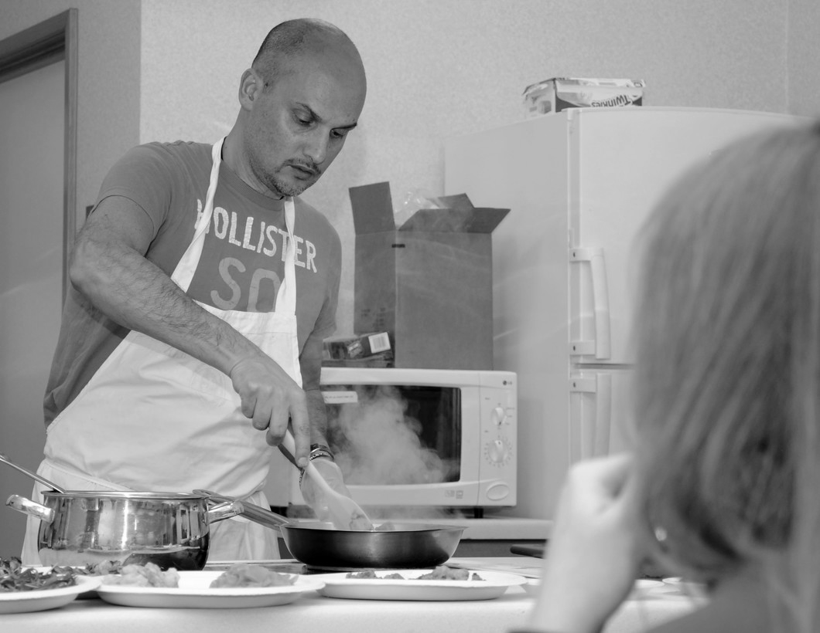
I’m a job, I’m a job what job am I?
Builder | Shop assistant | Dancer | Cleaner
Cook | Receptionist | Plumber | Production line operative
Notes:
Example ‘do you have to speak to customers?’ ‘Do you work outside?’
To extend the game pick jobs that are not shown on the grid.

Slide 27
Independent Living
World of Work
Different types of work
Make it easier
Make it harder
More ideas
Just do parts 1 and 2. Can the student think of any other examples for each job family?
Can the student think of different ways of grouping jobs or task types and can they explain their reasons?
Can the student think of and research a job family that has a role that suits their skills, interests and task type preference?
Notes:
Final slide of the lesson. Suggest adaptations for teachers/parents.

Slide 28
Further Learning with Oak National
Independent Living:
World of Work- Vocational Profiling (Unit 5)
Notes:
Insert info for subject/lesson name/stage (if appropriate)

Slide 29
References
Slide 7- Primark,Broadgate, Coventry, Hazel Nicholson, Flickr Attribution 2.0 Generic (CC BY 2.0) / Sports Direct, Centrale, Croydon CR0, Kake, Flickr Attribution 2.0 Generic (CC BY 2.0) / Marks & Spencers- The mall Athens, Gianni.M, Wikimedia Commons / Argos Logo, Argos Careers, Wikimedia Commons
Slide 9- Excavators construction site, Pixabay / Architect, Pixabay / Bricklaying, Torange / Bricks heap pile, Pixabay / Department store, Pixabay / Bag room, Pxhere / John Lewis Newcastle, Mankind 2k, Wikimedia Commons
Slide 10- Horticulturist Amy Boul by Lance Cheung, Artix Kreiger 2, Wikimedia Commons / Lawn Mowing with Green Lawn Mower, Rattan Direct, Flickr Attribution 2.0 Generic (CC BY 2.0) / Agriculture gardening, Pixnio / Office work, Pixabay / Office Work, Deinsam, Wikimedia Commons / Megan Masters on the set of The Office (3818390208), Kristin Dos Santos, Wikimedia Commons
Slide 11- Musician street scene, Pixabay / Woman and man dancing, Wallpaper Flare / Man painting, Piqsels / Nurse, Public domain pictures / Dentist, Pxhere / Man pushing a woman, Pexels
Slide 21- Tree surgeon, Pixabay / Gardening, Pixnio / Construction worker, Pixist
Slide 22- Waiter taking an order, Pexels / Beaming, Michael Coghlan, Flickr Attribution 2.0 Generic (CC BY 2.0) / Jane and Shop Assistant in Shoprite Sep-19, Simon Berry, Flickr Attribution 2.0 Generic (CC BY 2.0)
Slide 23- Jinbei production line, Xu Hongzhi, Wikimedia Commons / Barista COSTA COFFEE, Anonoymous work for hire for CHI Polsk, WIkimedia Commons / Factory Warehouse, Pixabay
Slide 26- Cleaning, Pixabay / 100th FSS provides cooking lessons, Gina RandallReleased, ROYAL AIR FORCE MILDENHALL / Plumber, Public domain vectors

