Slide 1
Wired and wireless networks Lesson 3 of 6
Computing
Allen Heard

Slide 2
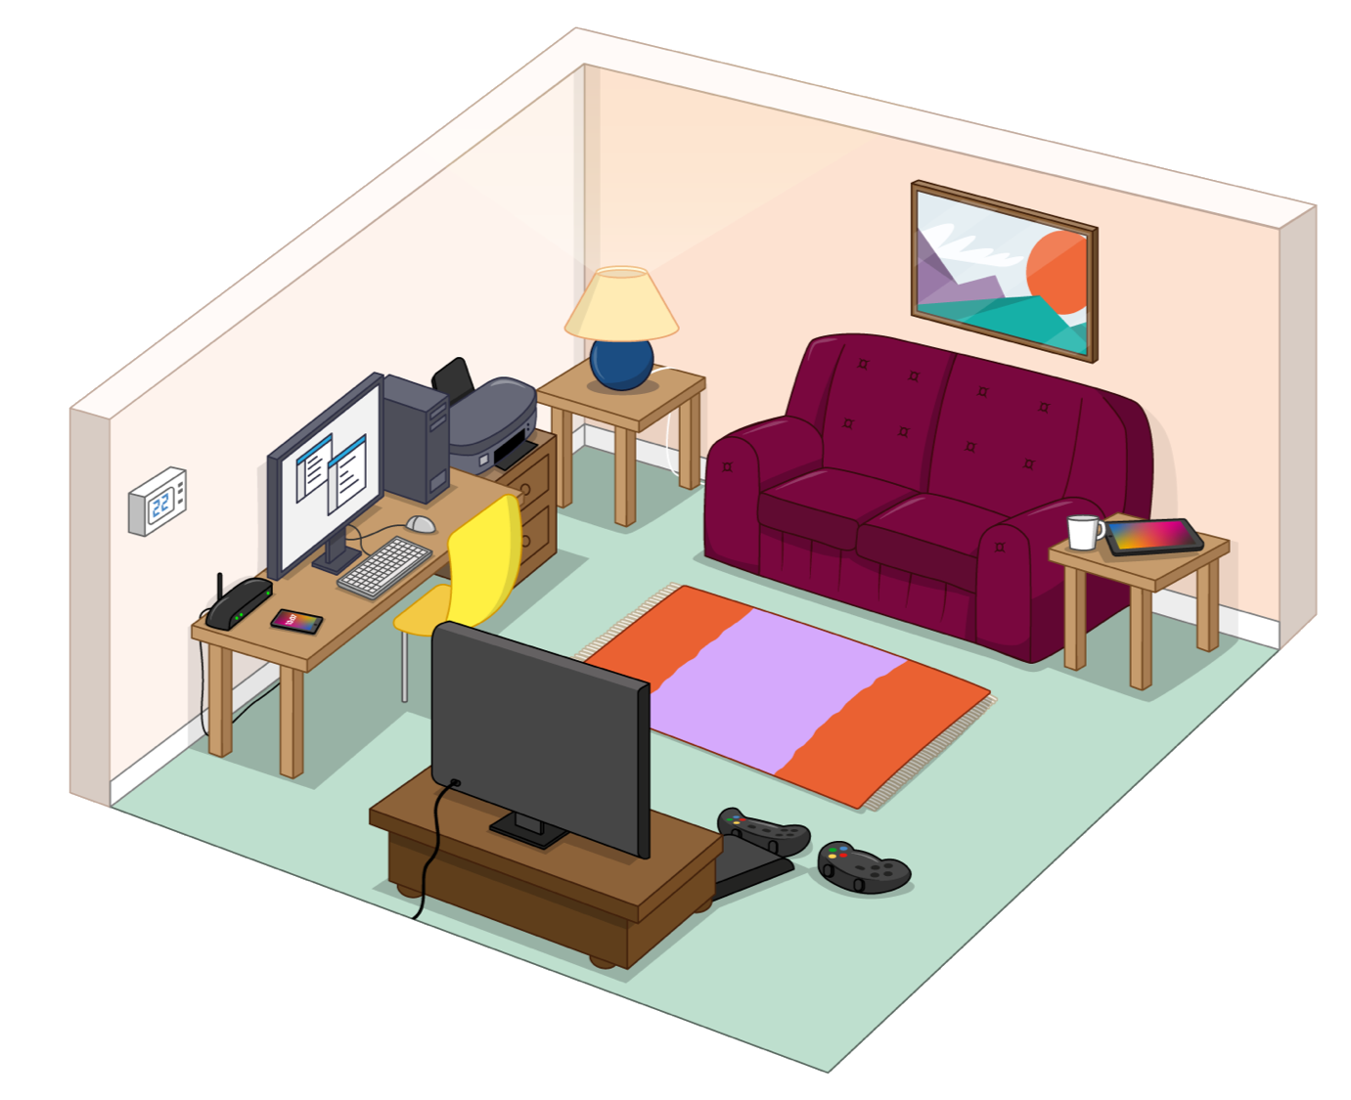
Task 1 - Wired or wireless?
Identify the devices in the picture connected to the network and the method they can use to connect.
Device | Wired, wireless or both?

Slide 3
Task 2 - Measuring bandwidth
Put the following technologies in order of speed starting with lowest to highest:
4G
3G
Broadband
Position | Technology
1 (Fastest)
2
3 (Slowest)

Slide 4
Task 3 - Bandwidth matters
Some online activities use more data than others. Can you identify which activities use more bandwidth? Look at each activity and place a tick in the correct column to identify whether it is a light-, medium-, or high-bandwidth activity.
Activity | Light | Medium | High
Reading online news
Checking the weather
Online gaming
Checking social media
Emailing regularly
A vlogger uploading videos to her channel daily

