Slide 1
What can a human voice do?
Music
Miss Al-Hanoush

Slide 2
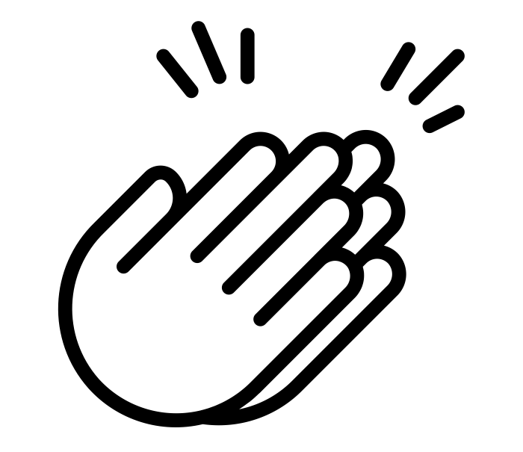
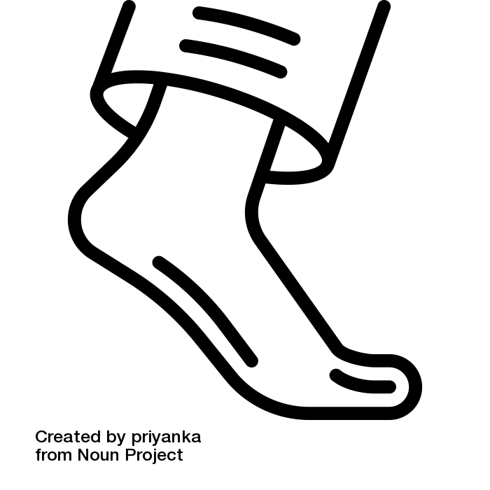
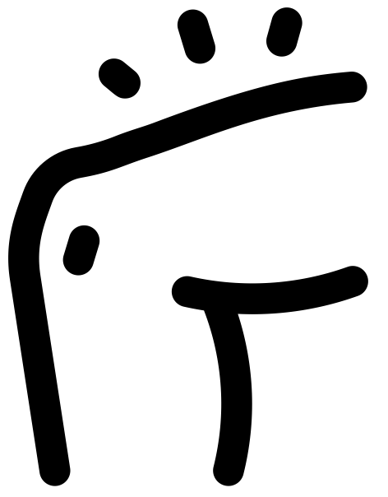
Watch the clip on the worksheet
Body percussion to ‘Bring Me a Little Water Sylvie’
1 | 2 | 3 | 4 | 5 | 6 | 7 | 8
Clap Chest Stamp Clap Brush Brush
Chest
[The Noun Project] - [Berkah Icon] - [clap]
[The Noun Project] - [priyanka] - [foot]
[The Noun Project] - [Tuk Tuk Design] - [User]
[The Noun Project] -[omeneko] - [thigh]

