Slide 1
Lesson 4: Making holes
3D modelling
Computing
Josh Crossman
Materials from the Teach Computing Curriculum created by the National Centre for Computing Education

Slide 2
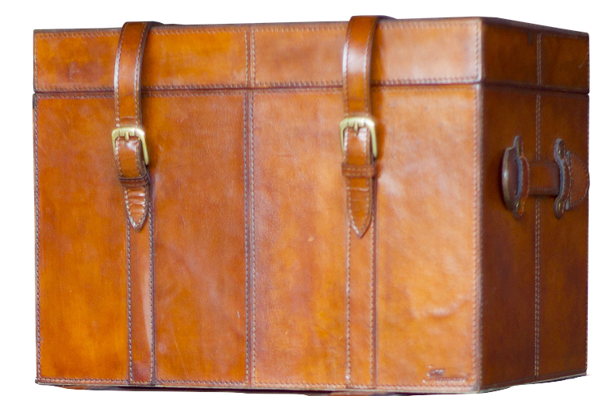
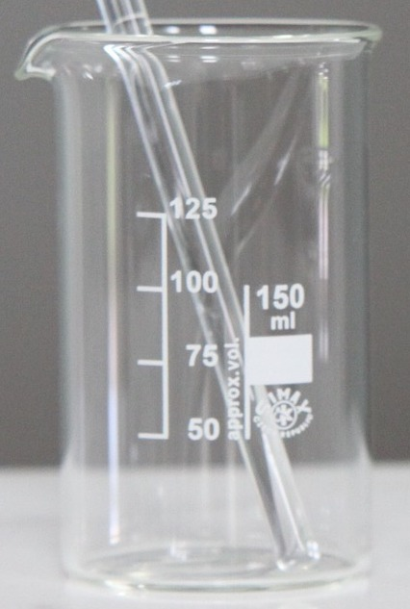
Task 1 - Dimensions of 3D objects
Create the 3D shapes using the given dimensions:
Credit: PIxabay
Cuboid | Rectangular pyramid | Cylinder
Width: 100 mm . | Width: 20 mm . | Width: 45 mm .
Depth: 20 mm . | Depth: 20 mm . | Depth: 30 mm .
Height: 80 mm . | Height: 70 mm . | Height: 40 mm .

Slide 3
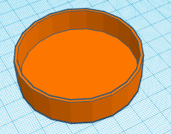
Task 2 - Grouping 3D objects
What happens when you try to move grouped 3D objects?
Can grouped 3D objects be moved in the same way as ungrouped 3D objects?
Once 3D objects have been grouped, can they be ungrouped?
How can you alter the size of a hole in a solid 3D object?
Credit: Tinkercad

Slide 4
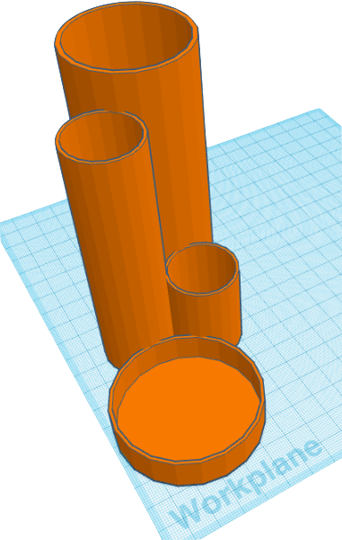
Task 3 - Creating a model of a 3D pencil holder
Open oaknat.uk/comp-tinkercad
Create a model that looks like the image.
Use the dimensions on the following slides to help you.
Credit: Tinkercad

Slide 5
Task 3 - Creating a model of a 3D pencil holder
D
The height of each section’s base is 2 mm
.
The width of each section’s side is 1 mm .
C
A | B
Width: 60 mm . | Width: 30 mm .
Depth: 60 mm . | Depth: 30 mm .
Height: 15 mm . | Height: 40 mm .
B
A
Credit: Tinkercad

Slide 6
Task 3 - Creating a model of a 3D pencil holder
D
The height of each section’s base is 2 mm
.
The width of each section’s side is 1 mm .
C
C | D
Width: 30 mm . | Width: 50 mm .
Depth: 30 mm . | Depth: 50 mm .
Height: 110 mm . | Height: 125 mm .
B
A
Credit: Tinkercad

