Slide 1
Mathematics
Identifying Number Patterns
Miss Hughes

Slide 2
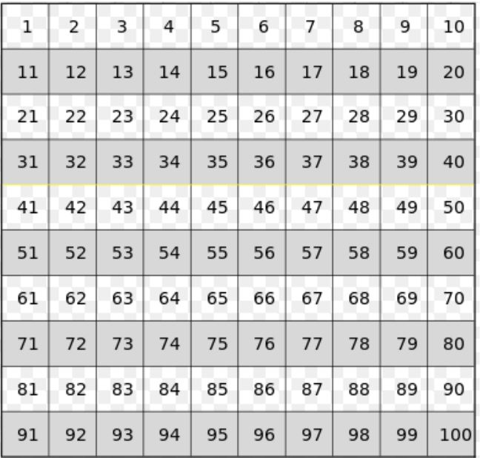
100 Square
Notes:
TO start off our Develop Learning, we are going to look at this question. Sally landed on 22 when she was counting in threes - What number could she have started on. I’m going to give you 5 second to find as many numbers Sally could have started on to have landed on 22 when counting in threes. Off you go. WAIT. Have you got any ideas? Great!
Well It;s important to notice that in this question it does not say that sally is counting frwards or backwards - so she could of started on a number that comes after 22 or that comes before 22. She may have started close to 22, so for example, she could have started on 19 - which is 3 fewer than 22 or 25 which is 3 more than 22. She could have started on a number that was far from 22. She could have started on 4 - which if we count forwards in thress from, we would reach 22.

Slide 3
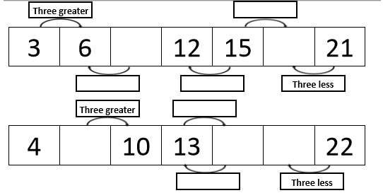
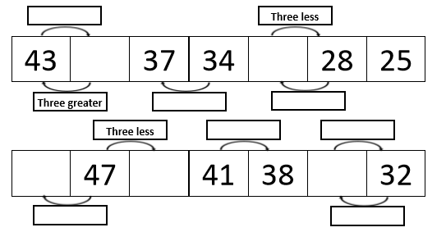
Independent Task
Look at the
missing parts on
the number track.
Complete the
missing parts.
Use a 100 square and counters to help you check your answers.
Notes:
You are now going to have a go yourselves at this task and identify the missing numbers on each sequence. You can use a 100 square and counters to help you check your answers. There a a printable hundred square that you can use if you do not have your own.

Slide 4
Independent Task
Look at the
missing parts on
the number track.
Complete the
missing parts.
Use a 100 square and counters to help you check your answers.

Slide 5
Answers
9
18
Look at the
missing parts on
the number track.
Complete the
missing parts.
Use a 100 square and counters to help you check your answers.
7
16
19
40
31
Notes:
You are now going to have a go yourselves at this task and identify the missing numbers on each sequence. You can use a 100 square and counters to help you check your answers. There a a printable hundred square that you can use if you do not have your own.

Slide 6
Answers
Look at the
missing parts on
the number track.
Complete the
missing parts.
Use a 100 square and counters to help you check your answers.
50
44
35
72
75
81

