Slide 1
Describing work experience [1 / 3]
Using the modal verb “müssen” in the imperfect tense
German
Frau Sichla

Slide 2
[ie]
Brief
tief
sie
Liebe

Slide 3
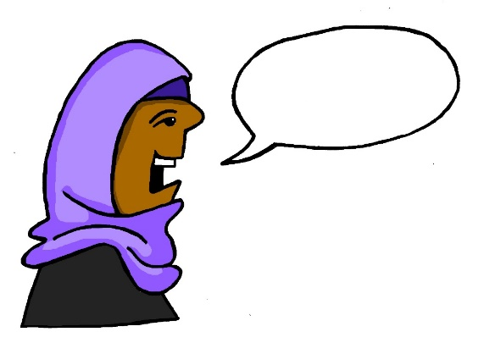
[r]
Beruf
rot
warum
reden

Slide 4
beim Arbeitspraktikum | on work experience
Telefonanrufe machen | to make phone calls
Dokumente organisieren | to organise documents
Dokumente abheften | to file documents
Formulare ausfüllen | to fill in forms
E-mails schreiben | to write e-mails
Gäste bedienen | to serve guests
Autos waschen | to wash cars
Termine organisieren | to make appointments
müssen | to have to

Slide 5
müssen - to have to, must
müssen is a modal verb (meaning it is a verb that tells you what you have to do). Below are the verb endings in the imperfect tense.
ich musste
du musstest
er/sie musste
wir mussten
ihr musstet
sie mussten
I had to
you had to
Note that ich and er/sie are the same as well as the wir and sie (plural)
he/she had to
we had to
you had to (plural)
they had to

Slide 6
müssen
Remember: to say what someone had to do something, use the modal verb müssen with a 2nd verb in the infinitive at the end of the sentence:
Ich musste Telefonanrufe machen.
I had to make phone calls.
Du musstest E-Mails schreiben.
You had to write e-mails.

Slide 7
Feedback: Find the sentences!
I m A w.
E m v T o.
I m G b u i h d i g.
A tip: the last sentence includes a conjunction and an opinion!

Slide 8
Feedback: Find the sentences!
I m A w.
E m v T o.
I m G b u i h d i g.
Ich musste Autos waschen.
Er musste viele Termine organisieren.
Ich musste Gäste bedienen und ich habe das interessant gefunden.
A tip: the last sentence includes a conjunction and an opinion!

